Slide 1
to 20.109!
Laboratory Fundamentals of Biological Engineering
2/1/22

Slide 2
Insight from previous 109ers
Words of wisdom…

Slide 3
Brief introduction to 20.109
Core mission
Building a better bioengineer
Meet the Sp22 team
Experimental overviews
Module 1: Drug discovery
Module 2: Metabolic engineering
Module 3: Research design
Logistics

Slide 4
Our core mission is building bioengineers
To prepare students to be the future of Biological Engineering
To teach cutting edge research skill and technology through an authentic research experience
To inspire rigorous data analysis and its thoughtful communication

Slide 5
Scientists should tell more stories
“Story is the number one way we learn from past experiences, to be better people, and share in experiences. Yet as scientists we feel the need to separate ourselves from this proven method of communication…
…encourage the use of narrative in science, but with caution. I would argue that narrative is imperative for science communication. Data already incorporates a narrative; we just need to find ways to bring it to light.”
http://nrelscience.org/2013/09/26/why-scientists-should-tell-more-stories/

Slide 6
Meet the 20.109 Sp22 teaching team
Lecture / Laboratory Instructors
Prof. Angela Koehler (M1)
Dr. Noreen Lyell (M2)
Dr. Becky Meyer (T/R)
Jamie Zhan (W/F)
Communication Instructors
Dr. Prerna Bhargava
Dr. Sean Clarke
Teaching assistants
Christine Zheng (T/R)
Tyler Dao (W/F)

Slide 7
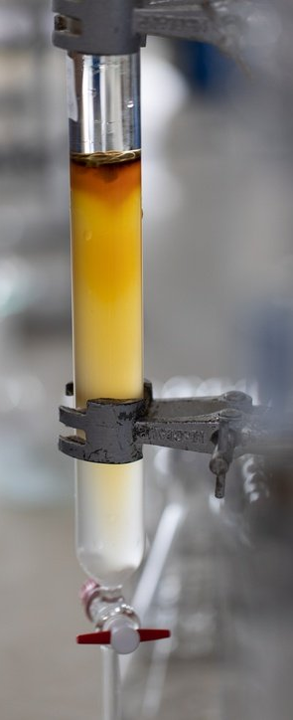
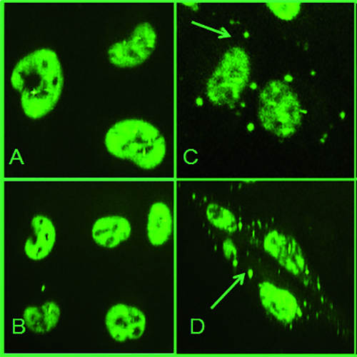
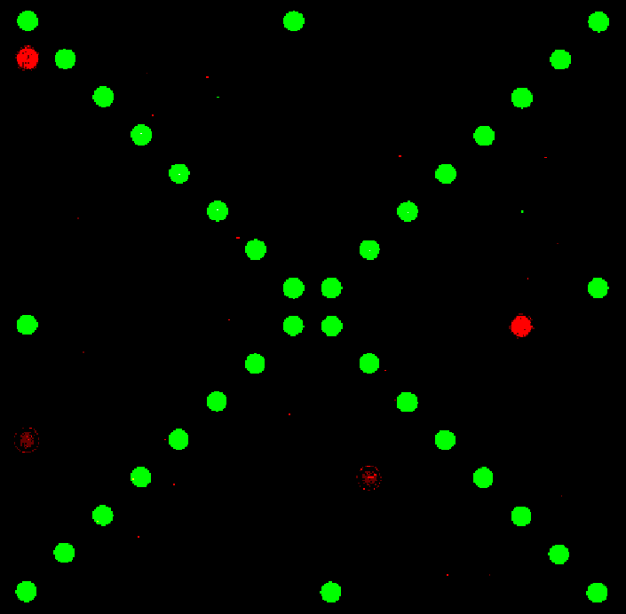
Mod1: drug discovery
Research goal: Identify & characterize small molecule binders to a protein drug target
Laboratory skills
Recombinant protein expression and purification
Cell culture and cell staining
Assays to study binding interactions in vitro and in cells
Tag-Reactive Dye
Control
Protein
Protein+SM
SNAP-Tag
TDP-43

Slide 8
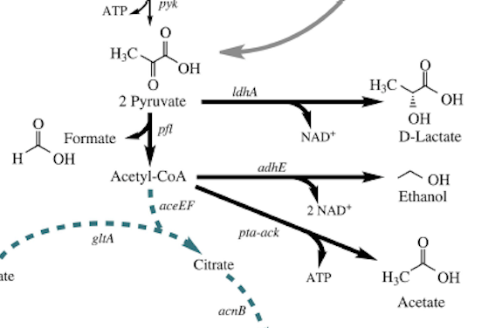
Mod2: metabolic engineering
Experimental goals:
Alter bacterial genetic circuitry using CRISPRi system to increase yield of specific fermentation products
Complete colorimetric assay to measure effects of targeted CRISPRi system
Laboratory skills:
Bacterial culturing
Molecular biology techniques
Data analysis

Slide 9
Mod3: Research design

Slide 10
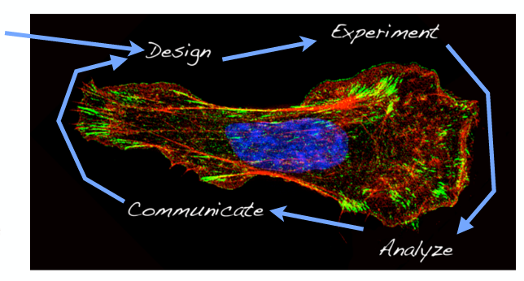
Workflow in 20.109
We start here…

Slide 11
Workflow in 20.109
Research!
We start here…
But you can’t design an experiment without reviewing the literature!

Slide 12
We do real science
We aim to prevent ‘just follow the protocol’ benchwork
Will discuss not only how experiments are completed, but what each step actually does

Slide 13
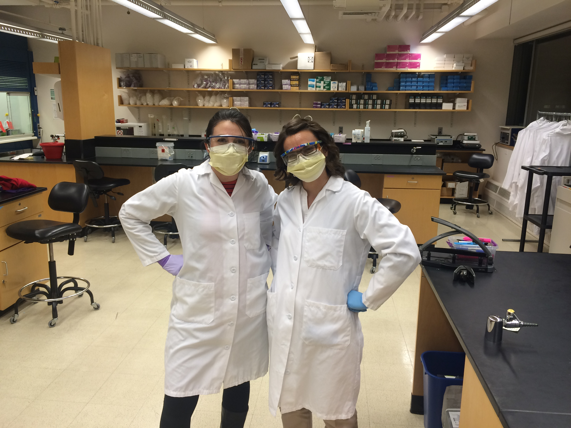
We follow best practices
We do relevant and cutting-edge research
Will discuss best practices for data collection and personal / environmental safety

Slide 14
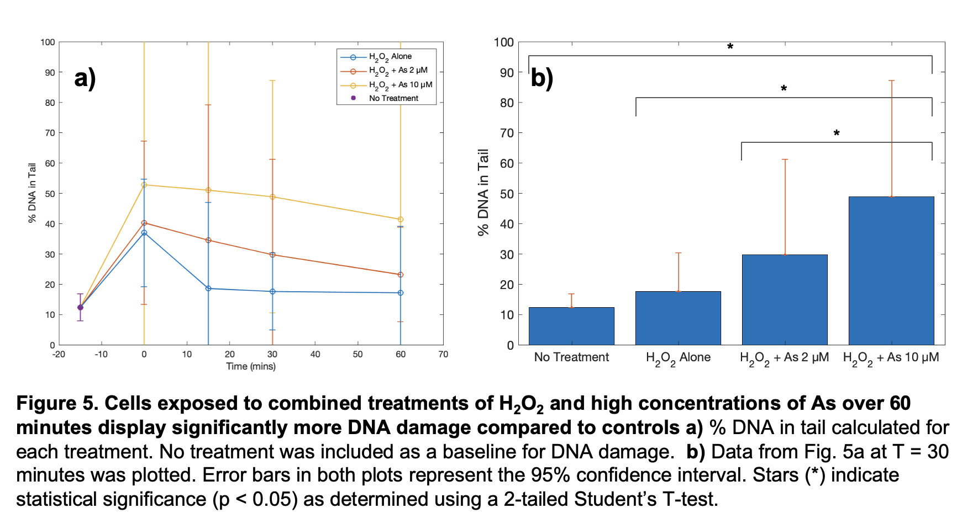
We analyze and report data

Slide 15
We develop written and verbal communication skills
Written communication assignments = 35%
Verbal communication assignments = 40%
Daily work and participation = 25%

Slide 16
We are here to help!
20.109 Teaching Team
Faculty
Instructors
Teaching assistants
BE Communication Lab Lab
Instructors
Writing fellows

Slide 17
Our goals for you this semester
Organize a constructive laboratory notebook
Implement laboratory protocols and troubleshoot
Interpret and analyze data
Recognize the utility of models and assays
Critically examine scientific literature
Communicate your science
Work as a team
Provide constructive and helpful feedback

Slide 18
Expectations in 20.109…
Your expectations of us:
We will come to class and laboratory prepared
We will be clear and reasonable in all assignments
We will treat every 109er with respect
We will give everyone equal chance at success
Our expectations of you:
You will come to class
You will be prepared for lecture and laboratory
You will not interfere with each other’s learning
You will invest the very best of yourself
You will be honest with your peers and the teaching faculty

Slide 19
Schedule and final notes
Lectures meet Tuesday and Thursday 11-12p
Class divided into two laboratory sections: T/R & W/F 1-5p
You will work in pairs throughout the semester
Collaboration with integrity is key!
Attendance is expected, in both lecture and laboratory
Participation is required
Laboratory exercises are completed with your partner
Some homework and assignments are completed with your partner

