Slide 1

Wrapping Up Module 1
April 22, 2021
Data Summary Assignment
March 1, 2022
Notes:
NEW IMAGE

Slide 2
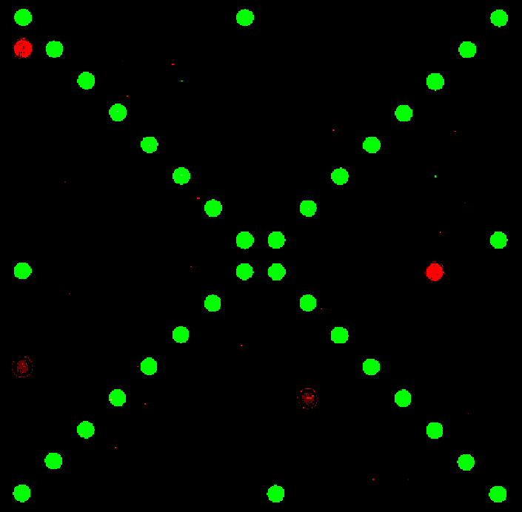
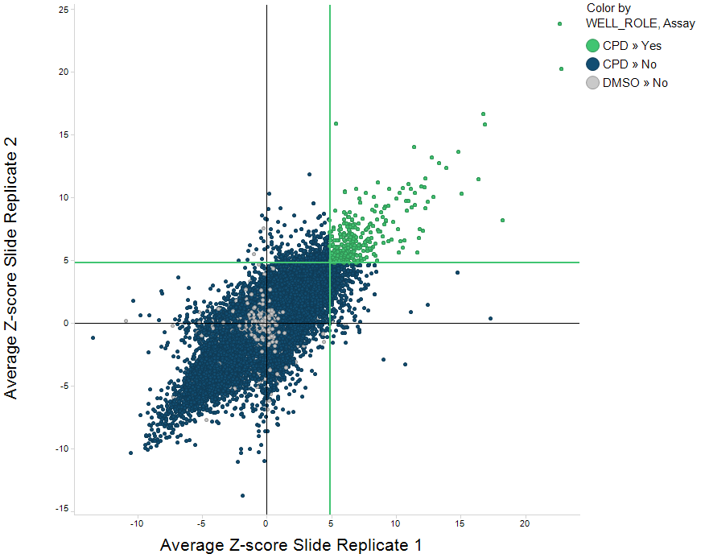
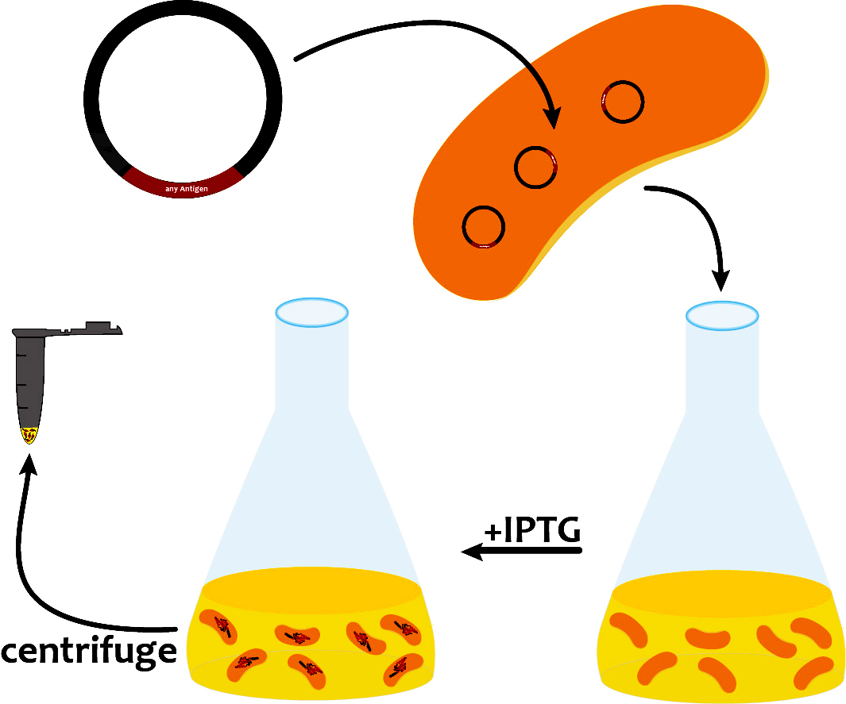
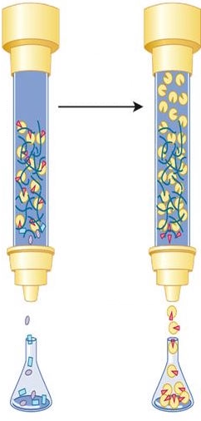
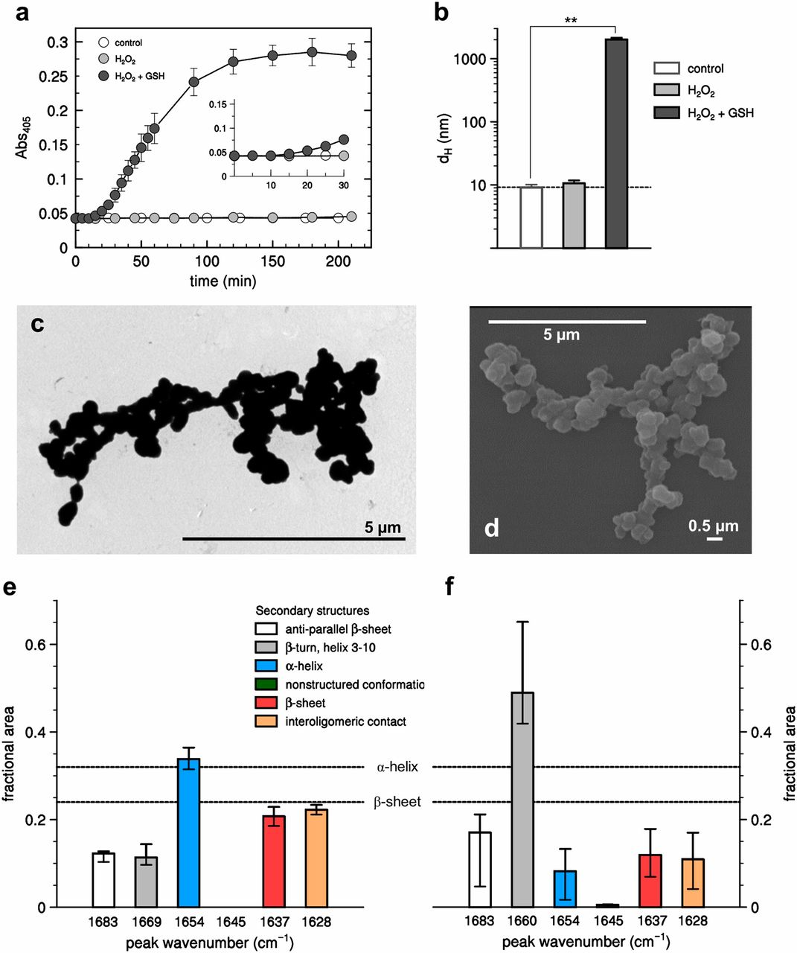
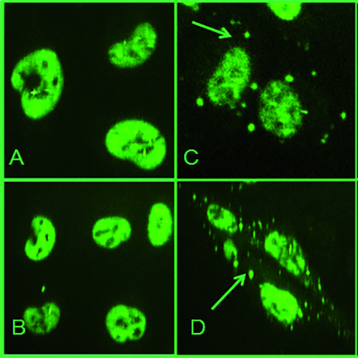
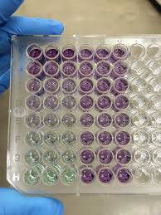
Studying putative probes of TDP-43
examine legacy SMM screens for TDP-43
express and purify TDP-43 protein
Control
Protein
Protein+SM
assess purity and concentration
aggregation assays
cellular localization staining
Notes:
Visual journey build slide

Slide 3
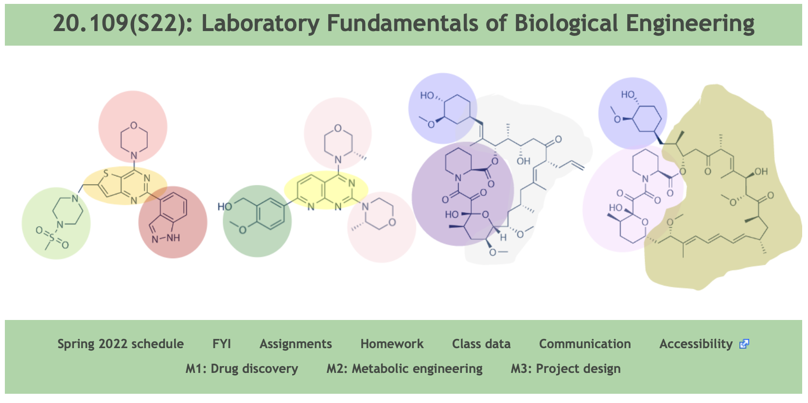
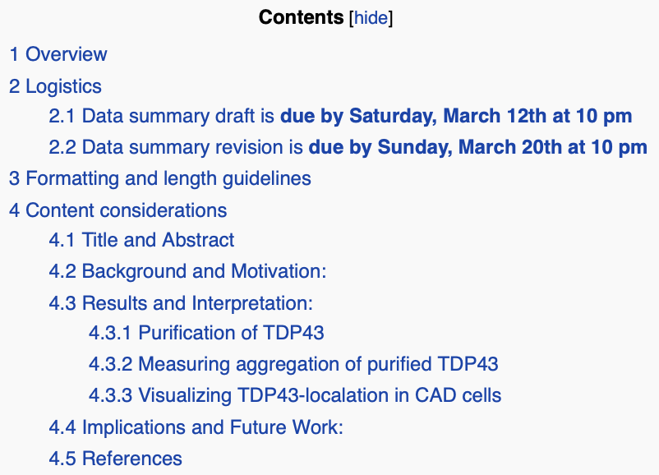
Mod1 Assignment – Data Summary
The course Wiki sums up the assignment details –
scope, formatting, length, etc.

Slide 4
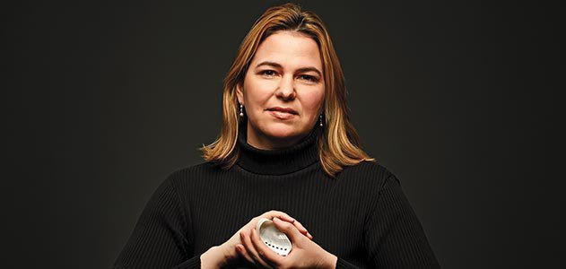
Module 1 Data Summary
thorough summary of your data and figures with supporting text –
include context so that a scientifically literate reader can understand
the work and its broader implications
The figure format is similar to a scientific journal article, but the traditional Results and Discussion sections are to be condensed into succinct bullet form accompanying each figure
you will complete the assignment with your lab partner

Slide 5
Data Summary Due Dates
Draft data summary – due Saturday, March 12th by 10 PM
Submissions read by Koehler, Lyell, Bhargava with feedback and a preliminary grade, which can be improved in a revised report
Comments provided by March 16th
Data summary revision – due Sunday March 20th by 10 PM
Instructions on how to incorporate changes are posted on the Wiki

Slide 6
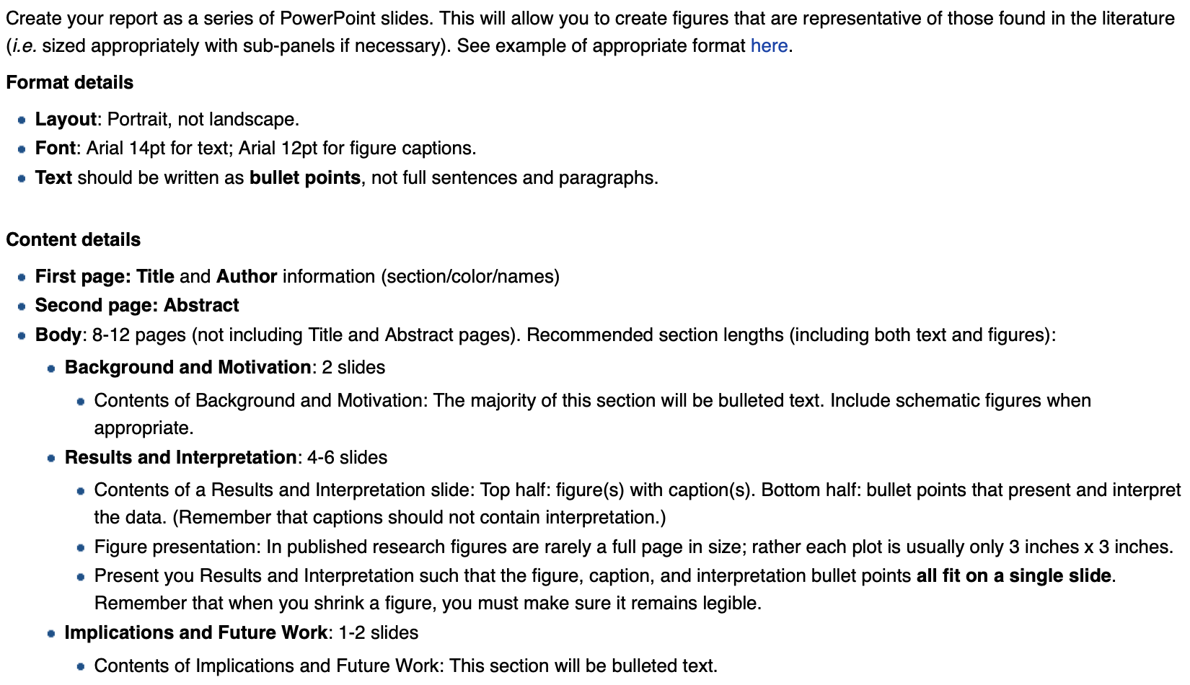
Data Summary for Module 1
format and content guidelines – see Wiki

Slide 7
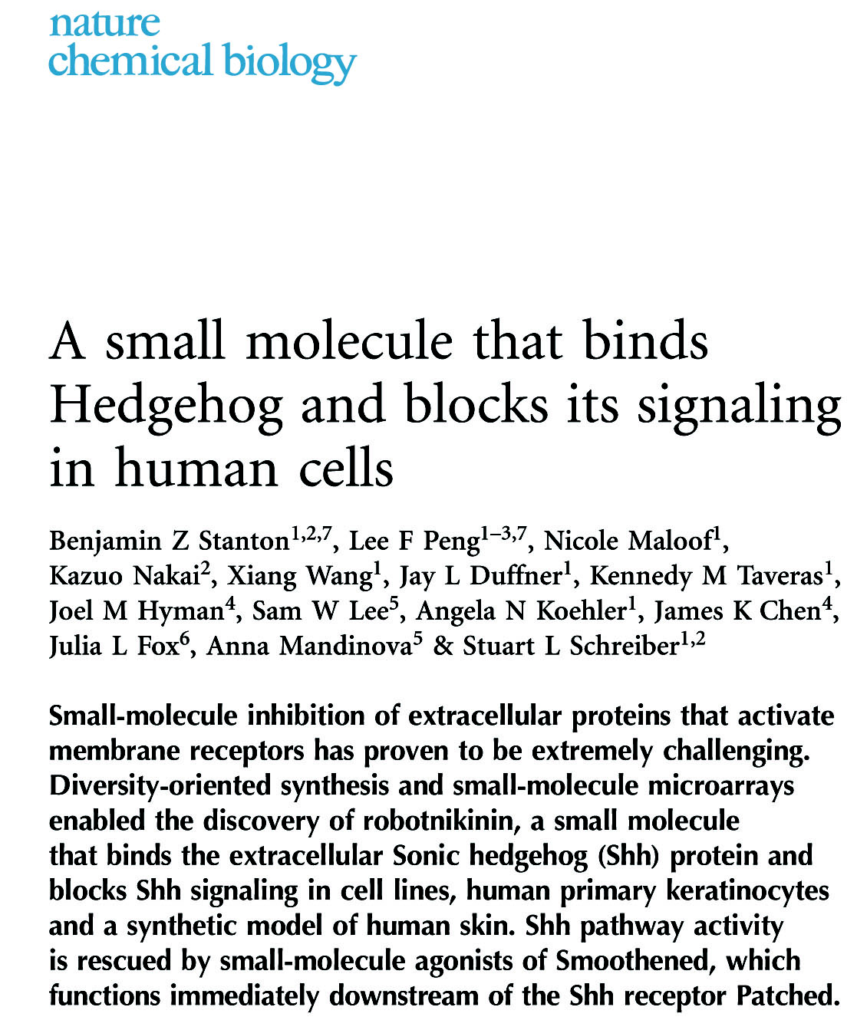
Data Summary for Module 1
scientific abstract
Please review Title and Abstract slides from
BE Comm Lab workshop
Notes:
Individuality

Slide 8
Background and Motivation
suggested topics or figures
Topic: Introduce and discuss the importance of chemical probes in biology, research, and/or medicine
Topic: Introduce and discuss the utility of small-molecule microarrays (SMMs) to find putative ligands
Topic: Introduce and discuss the roles of TDP-43 in biology and/or disease
Topic: Discuss your experimental goal
Schematic: Experimental approach

Slide 9
Results and Interpretation
suggested topics or figures
Purification of TDP-43
Schematic: Experimental approach**
Topic: Evaluation of purity and concentration
Figure: Image of polyacrylamide gel
Optional Figure: BCA data graph (concentration mat be provided in the summary text).
** homework assignment
Notes:
FOR SCHEMES - Do not include minor technical details that are not necessary to understand the goal of the experiment. Avoid clutter.

Slide 10
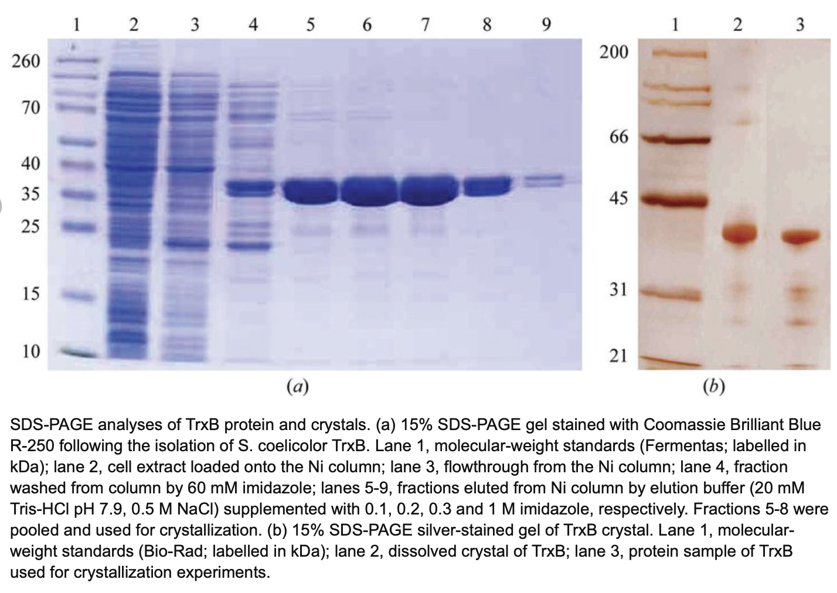

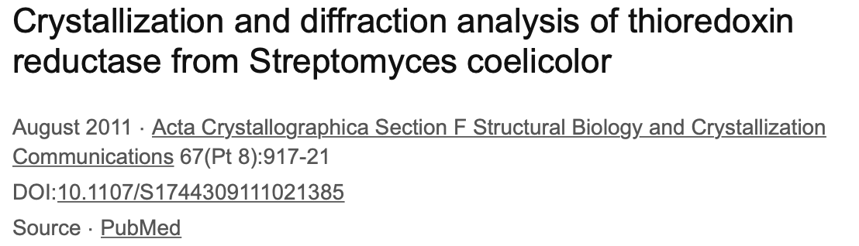
Nice example of a figure: Please include captions

Slide 11
Results and Interpretation
suggested topics or figures
Measuring aggregation of purified TDP-43
Schematic: Experimental approach
Topic: Aggregation +/- small molecule
Figure: Images of TDP43 aggregation assay +/- small molecule
Figure: Graph or table quantifying aggregation of TDP-43 +/- small molecule (duplicates tested) with statistics as discussed in lab;
report your data and data from one other team
Visualizing TDP-43 localization in CAD cells
Schematic: Experimental approach
Topic: Cellular localization of TDP-43 +/- small molecule
Figure: Images of TDP-43 localization experiment +/- small molecule
Figure: Graph or table comparing TDP-43 localization +/- small molecule, again with statistics discussed in lab
Notes:
Can have more data from other teams but please explain why
Small Molecule Name = at least use ChemID, feel free give your molecule a fancy name, so long as the ChemID is also included in the text or a figure. Also, feel free to include a chemical structure in your figures

Slide 12
Implications and Future Work
Why is your work impactful and what would you do next?
Topic: What are the main conclusions from key experiments?
Topic: How did the main conclusions answer the research question?
Topic: Did your results match expectations? If not, can you provide a putative explanation? If yes, can you further test if your hypothesis is correct?
Topic: Based on your results, whether they matched your expectation or not, what additional experiments might you suggest as next steps?
Topic: What are the limitations of the experimental approach?
Topic: How might this method be improved?

Slide 13
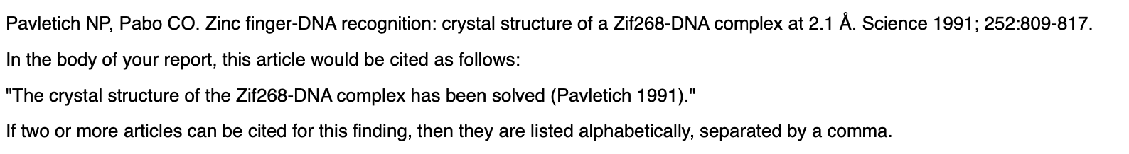
A Note on References
Please make References a separate section at the end of the article
suggested format on the wiki:
Notes:
The data is what the data is

Slide 14
Office Hours
Simple Questions: koehler@mit.edu
Office Hour Dates/Times
Thursday March 3, noon-1pm
Monday March 7, 3-4pm
Wednesday March 9, 8:30-9:30am
Friday March 11, 3-4pm
Notes:
The data is what the data is

Slide 15


