Slide 1
Welcome to Module 3
Studying Protein-Ligand Interactions
L1 Intro to chemical biology: small molecules, probes, and screens
November 7, 2019
Notes:
Welcome students. Storytelling related to science and communications.. Intro myself.
Start with Science. What is a ligand? My fave part of biological engineering involves using agents of various flavors to elicit cell responses, especially agents called small molecules. A little bit of chemistry.
Overview of today’s lecture – we will talk about how chemistry can be harnessed and applied to study or modulate biology, and I will introduce the field of chemical biology, small molecules, and ligand screens.

Slide 2
Angela Koehler
koehler@mit.edu
Instructor
76-361c
Lectures
Nick Struntz
nstruntz@mit.edu
Postdoctoral Fellow
Koehler Lab
Guest Lecturer

Slide 3
The central dogma
i
Notes:
It’s always good to start a class with the Central Dogma of Biology! You all probably learned about the central dogma in high school and again when you arrived here at MIT but let’s review it again.
For folks like me, there is a missing piece. About 10 yrs ago, Stuart Schreiber, our colleague across the street at the Broad Institute, penned a commentary about how small molecules are so important in biology that they should be included in our teaching of the central dogma: SMALL MOLECULE SYNTHESIS IS ENCODED BY DNA AND CARRIED OUT BY PROTEIN-BASED CATALYSIS MACHINES

Slide 4
The central dogma
imaging agents
carcinogens
antibiotics
drugs
i
cell signaling, cognition, metabolism, life’s origins
chemical probes and drugs
Notes:
These are often key mediators of function in signaling pathways – they especially play a key role in cognition and metabolism and served as the building blocks of the primordial soup.
Small molecules have been synthesized that bind and modulate DNA (ethidium bromide)
Small molecule riboswitches regulate RNA function while certain small molecule antibiotics bind and inhibit RNA macromolecules
And of course, both natural and non-natural molecules have served as probes of biology and drugs in medicine.

Slide 5
Defining chemical biology
Chemical biology is a discipline that spans multiple fields and involves the application of chemical techniques, tools, and analyses to the study and manipulation of biological systems

Slide 6
Defining chemical biology
Chemical biology is a discipline that spans multiple fields and involves the application of chemical techniques, tools, and analyses to the study and manipulation of biological systems
Chemical biologists attempt to use chemical approaches to modulate systems to either investigate underlying biology, typically using quantitative measures, and to engineer new functions

Slide 7
Defining chemical biology
Chemical biology is a discipline that spans multiple fields and involves the application of chemical techniques, tools, and analyses to the study and manipulation of biological systems
Chemical biologists attempt to use chemical approaches to modulate systems to either investigate underlying biology, typically using quantitative measures, and to engineer new functions
Research done by chemical biologists is often more closely related to cell or systems biology than biochemistry. Biochemists study the chemistry carried out by biomolecules and how metabolites function in pathways while chemical biologists apply novel chemical tools to biology, including basic, disease, and synthetic applications.

Slide 8
Systems of interest to chemical biologists
Investigates the set of expressed proteins in a cell at a given time under defined conditions – quantitative, comparative
quantitative proteomics
Dedon, Fraenkel, Hynes, Koehler, White, Yaffe
BE Dept/Course 20
Bio Dept/Course 7
Chem Dept/Course 5
Notes:
Many examples, here are just a few…
Proteomics - Proteomics investigates the proteome, the set of expressed proteins at a given time under defined conditions. As a discipline, proteomics has moved past rapid protein identification and has developed into a biological assay for quantitative analysis of complex protein samples by comparing protein changes in differently perturbed systems; protein sequences, PTMs, PPIs. Chemistry => Mass spec, enrichment tags, affinity tags, building special probes to capture (affinity profiling, suicide probes)

Slide 9
Systems of interest to chemical biologists
quantitative proteomics
Dedon, Fraenkel, Hynes, Koehler, White Yaffe
glycobiology
Imperiali, Kiessling, Ribbeck, Sasisekharan, Vander Heiden
BE Dept/Course 20
Investigates how sugars regulate biology, including cell-virus interactions and protein stability, among functions – quantitative, comparative
Bio Dept/Course 7
Chem Dept/Course 5
Notes:
Glycobiology - there exists a separate system of trafficked molecules in the cell that are not encoded directly at any direct level: sugars. Assemblies of complex carbohydates on proteins, particularly on cell surfaces, regulates diverse biology and can often govern processes such as the folding of proteins and maintenance of protein stability or mediating the interactions between cells and viruses. As such, GLYCOBIOLOGY IS ALSO A KEY AREA OF INTEREST TO DIVERSE AREAS, INCLUDING MICROBIOLOGY, IMMUNOLOGY, AND CANCER DEVELOPMENT. Quantitative methods to profile the full complement of sugars and complex carbohydrates in a cell under defined conditions and is often called glycomics in analogy to proteomics. People have developed many chemical approaches to study the glycome, including preparing specific molecules that can label sugars and track their location within a cell or within a whole animal.

Slide 10
Systems of interest to chemical biologists
quantitative proteomics
Dedon, Fraenkel, Hynes, Koehler, White Yaffe
glycobiology
Imperiali, Kiessling, Ribbeck, Sasisekharan, Vander Heiden
BE Dept/Course 20
Bio Dept/Course 7
Often involves using chemicals to perturb signaling systems that govern cell state
Chem Dept/Course 5
stem cell biology and programming cell fate
Boyer, Collins, Griffith, Guarente, Jaenisch, Kiessling, Koehler, Langer, Lauffenburger, Lu, Lodish, Weinberg, Weiss, Yilmaz, Young
Notes:
An improved understanding of stem-cell and regenerative biology, as well as a better control of stem-cell fate, is likely to produce treatments for many devastating diseases and injuries. Chemical approaches are starting to have an increasingly important role in this young field. Attention has focused on chemical approaches that allow the PRECISE MANIPULATION OF CELLS IN VITRO TO OBTAIN HOMOGENEOUS CELL TYPES FOR CELL-BASED THERAPIES. Another promising approach is the development of conventional chemical and biological therapeutics to stimulate endogenous cells to regenerate. Such therapeutics can act on target cells or their niches in vivo to promote cell survival, proliferation, differentiation, reprogramming and homing.
LIVING MACHINES

Slide 11
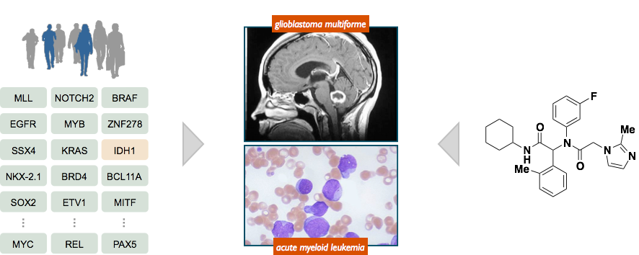
Chemical probes of disease biology
patient samples reveal
list of disease genes
physiologic settings to test
the impact of disease genes
discover small molecules
that reverse the
impact of disease genes
Approach: use small molecules to test emerging concepts in
human disease in physiologically relevant settings
Output: validated small-molecule probe to facilitate human
clinical development or diagnostic applications
Notes:
Why does someone like me care so much about small molecules? Probes of biology!
Unlike other types of probes dose control, temporal control, spatial control, MANY PROTEINS HAVE MORE THAN ONE FUNCTION, Modulate individual functions
Finally, small molecules can serve as leads for drug development or lower the activation barrier for the development of other drugs against a target.

Slide 12
Chemical tools & methods
are a vital aspect of
MIT BE Research Programs
Measure
Model
Manipulate
Make
Imaging, Biomaterials, Bio-factories
Notes:
¾ OF THE MAJOR RESEARCH AREAS COVERED BY THE FACULTY IN OUR DEPARTMENT INCORPORATE CHEMICAL TOOLS OR METHODS INTO THEIR RESEARCH PROGRAMS to learn more biology or to develop synthetic tools or functions:
imaging agents
Biomaterials
bio-factories

Slide 13
Chemical biology courses at MIT
suitable for advanced undergraduates
20.554 Frontiers in Chemical Biology (F)
Laura Kiessling, Matthew Shoulders
7.73 Principles of Chemical Biology (S)
Barbara Imperiali, Jing-Ke Weng
Introduction to current research at the interface of chemistry, biology, and bioengineering. Topics include imaging of biological processes, metabolic pathway engineering, protein engineering, mechanisms of DNA damage, RNA structure and function, macromolecular machines, protein misfolding and disease, metabolomics, and methods for analyzing signaling network dynamics.
Spanning the fields of biology, chemistry and engineering, addresses the principles of chemical biology and its application of chemical and physical methods and reagents to the study and manipulation of biological systems. Topics include activity-based protein profiling, small molecule inhibitors and chemical genetics, fluorescent probes for biological studies, chemical biology approaches for studying dynamic post-translational modification reactions, natural product biosynthesis, and high-throughput drug screening.
Notes:
Both courses are suitable for advanced undergraduates
20.554 focuses on engineering biomolecule, expressing novel variants of proteins – engineered systems
7.73 covers more in the way of engineering to build exogenous tools and technologies for modulating natural systems and monitoring the consequences to the system
This module will give you a flavor for some of the underlying methods that are discussed in both courses.

Slide 14
Chemical biology courses at MIT
suitable for advanced undergraduates
20.554 Frontiers in Chemical Biology (F)
Laura Kiessling, Matthew Shoulders
7.73 Principles of Chemical Biology (S)
Barbara Imperiali, Jing-Ke Weng
Introduction to current research at the interface of chemistry, biology, and bioengineering. Topics include imaging of biological processes, metabolic pathway engineering, protein engineering, mechanisms of DNA damage, RNA structure and function, macromolecular machines, protein misfolding and disease, metabolomics, and methods for analyzing signaling network dynamics.
Spanning the fields of biology, chemistry and engineering, addresses the principles of chemical biology and its application of chemical and physical methods and reagents to the study and manipulation of biological systems. Topics include activity-based protein profiling, small molecule inhibitors and chemical genetics, fluorescent probes for biological studies, chemical biology approaches for studying dynamic post-translational modification reactions, natural product biosynthesis, and high-throughput drug screening.
engineering new biomolecules
and synthetic systems
modulating natural systems and
measuring outputs
Notes:
Both courses are suitable for advanced undergraduates
20.554 focuses on engineering biomolecule, expressing novel variants of proteins – engineered systems
7.73 covers more in the way of engineering to build exogenous tools and technologies for modulating natural systems and monitoring the consequences to the system
This module will give you a flavor for some of the underlying methods that are discussed in both courses.

Slide 15
What is a small molecule?
Notes:
Some perspective relative to other molecules that bioengineers study

Slide 16
What is a small molecule?
Notes:
The makeup of small molecules

Slide 17
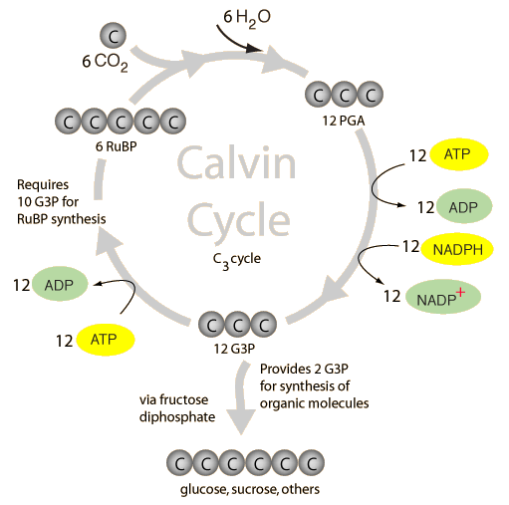
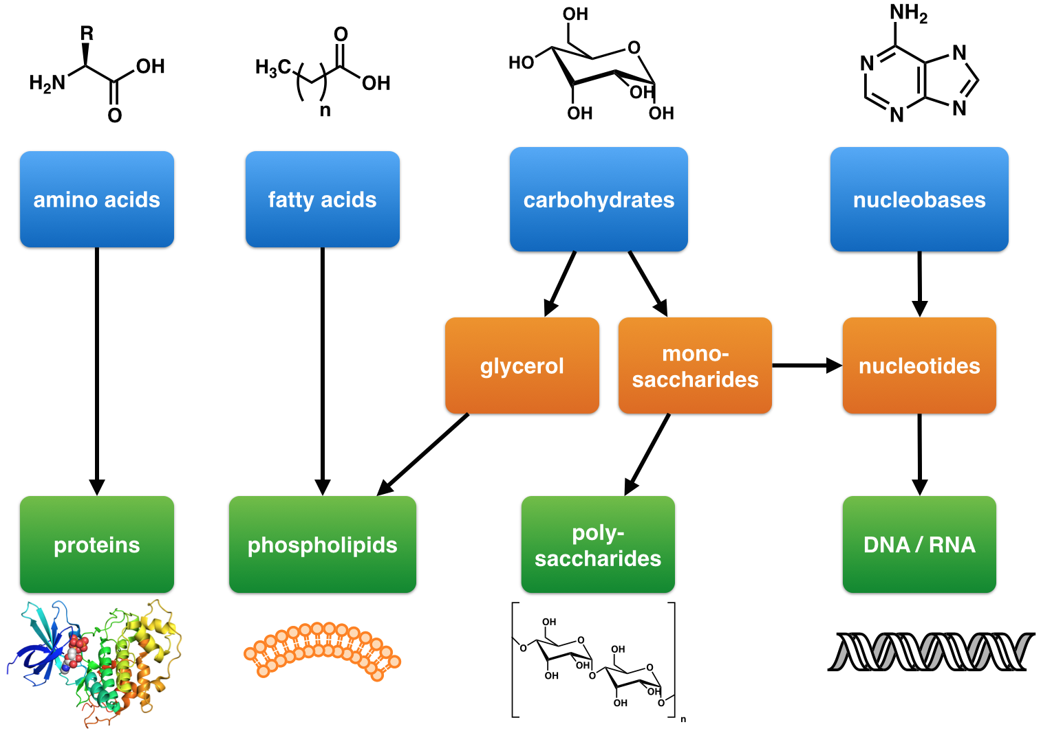
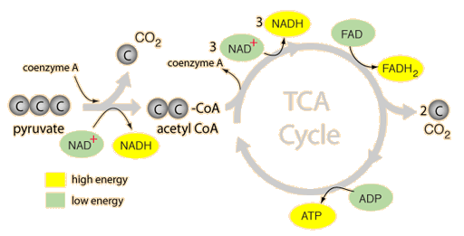
Small molecules of life
primary metabolites - intrinsic function is essential to survival of organism
first messengers – signaling molecules that control metabolism and cell differentiation (e.g. hormones, biogenic amines)
7.05
Notes:
We usually do not think of primary metabolites as drugs themselves. Rather, we think about developing therapeutic strategies to modulate the levels of these essential small molecules. First messenger molecules, such as hormones, have been an exception.
Can anyone think of first messengers that are used as drugs? Birth control? Estrogen/Progesterone. Testosterone. Serotonin. Melatonin.

Slide 18

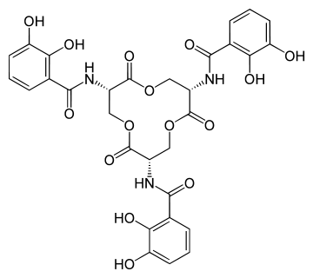
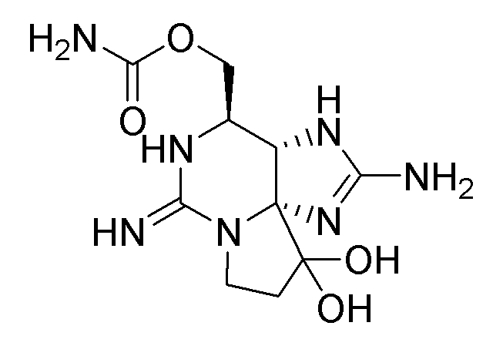
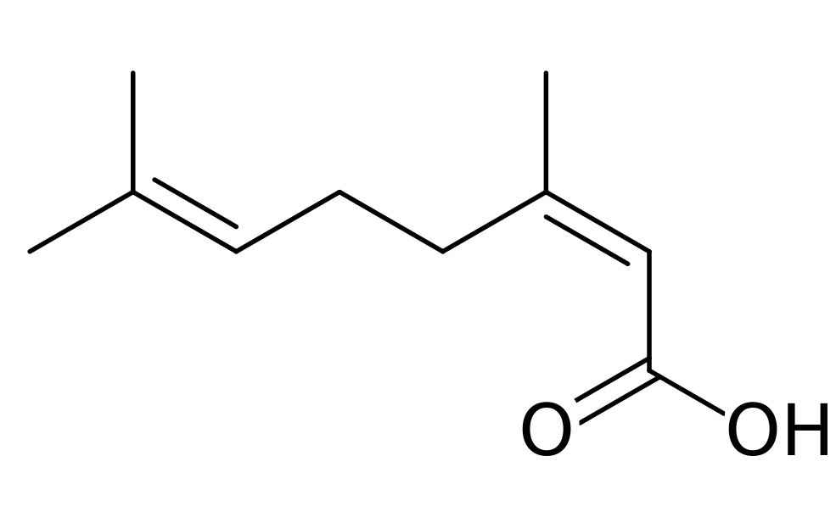
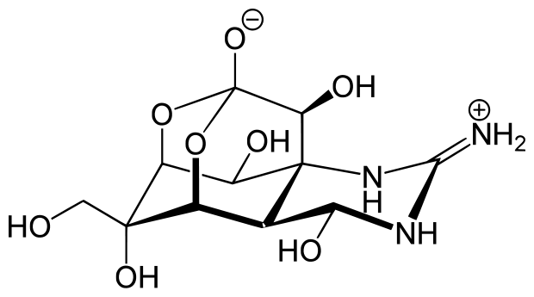
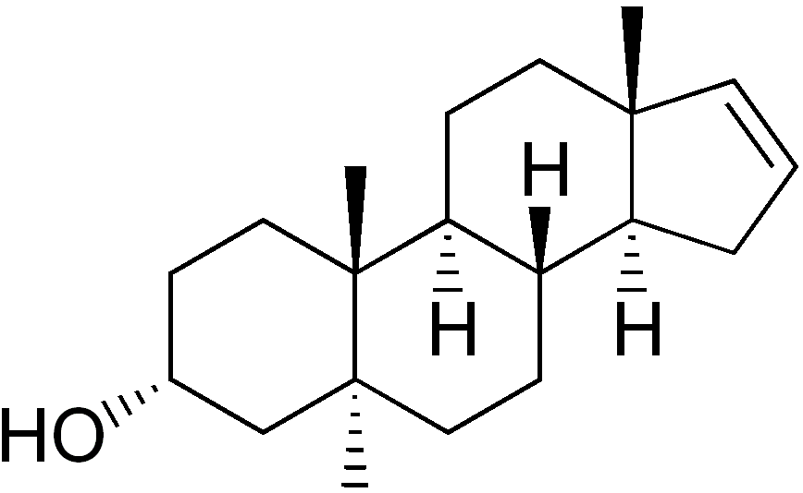
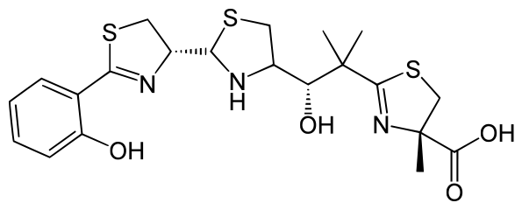
Small molecules of life
secondary metabolites – non-essential to organism, extrinsic function that affects other organisms; broad range of functions, narrow species distribution
increase competiveness of an organism
pheromones – social interactions
transporters and chelators
toxins – competitive weapons
enterobactin
geraniol
saxitoxin (TZ)
nerolic acid
androstenol
yersiniabactin
tetrodotoxin (TTX)
Significant interest in exploring bioactivity of these ‘natural products’ for biological probe and therapeutic applications
Notes:
Many pheromones, or molecules of communication, belong to the terpenoid structural class
A good example of transporters and chelators are the siderophores, produced by pathogens as a mechanism to sequester iron and other ions from host species. Useful in therapies for iron or aluminum overload, starting points for antibiotics and delivery agents, i.e. Trojan horse with conjugates of the siderophore to antibiotics.
Saxitoxin, also known within the US military as TZ, is more 1000x more potent than sarin and is listed in schedule 1 of the Chemical Weapons Convention. Known to be issued to spies, astronauts and U-2 pilots for suicide in case of capture by enemy forces.
Tetrodotoxin (TTX) comes from pufferfish (fugu in Japan), neurotoxin that blocks action potentials by blocking sodium channels, first recorded poisoning comes from logs of Captain James Cook whose crew ate pufferfish and fed the fish to their pigs on board. The pigs all died while the crew experienced numbness and shortness of breath. TTX poisoning is most common in Japan due to the types of fish consumed with a fairly low fatality rate. In fact TTX is being pursued clinically for treatment of cancer-associated pain with early clinical trails demonstrating significant relief for some patients.

Slide 19
Small molecules and their partners
the compound that changed my life
colchicine
Secondary metabolite from meadow saffron
Notes:
As professors, we often don’t do these beautiful and important molecules justice as critical regulators of function. Part of my goal is for you to appreciate the value of these compounds in biology and how they can be used as tools to probe the functions of their targets, often proteins, and how they are used as starting points for therapeutics.
Example 1 – Colchicine. This is a natural product and secondary metabolite produced in plants and originally extracted from Meadow Saffron. During my Junior year in college I was taking advanced cell biology and synthetic organic chemistry courses alongside a quantitative physiology course and by sheer coincidence all three courses discussed this molecule in the course of a week - its biosynthesis in plants and lab synthesis, its use as a therapy, and its use as a tool in cell biology experiments. How many of you are familiar with colchicine? Have you used it in lab?

Slide 20
Colchicine is a mitotic spindle poison
colchicine
binds to tubulin protein
blocks microtubule polymerization
time
course
karyotype spread
colchicine prevents chromosome
segregation and enables study
chromosome count and physical
characteristics
Notes:
The compound binds to tubulin protein, which you will remember as a key component of microtubules. This binding event prevents microtubule polymerization. MTs are essential to the process of mitosis so the compound effectively serves as a mitotic spindle poison. The mitosis-inhibiting function of the colchicine also makes it a highly useful tool in cell biology when one wants to block mitosis or in cellular genetics to capture chromosomes in metaphase for karyoptyping.

Slide 21

Colchicine informs therapeutic strategies
inflammatory diseases – neutrophil motility
mitotic poisons for cancer therapy
Egyptians -1500 BC
Ben Franklin
Taxol
stabilizes MTs
gout
lung, ovarian, breast, sarcomas
pericarditis
Vinblastine
blocks MT polymerization
leukemia, lymphoma, breast, testicular
Behçet's disease
Notes:
Colchicine has been used primarily to treat diseases or post-operative conditions associated with inflammation with documented medical uses going back to Egyptian medical papyrus in 1500 BC. The plants that make the compound were brought to North America by Ben Franklin to treat his own gout. The compound impacts neutrophil motility and activity, given the impact on MTs. This ultimately leads to a decrease in inflammation. It’s typically not the first course of action and is used when NSAIDs are not tolerated well by the patient, mainly due to the overall toxicity associated with the drug.
The compound may have been more impactful as a chemical probe to define mechanism of interest for killing cancerous cells using more potent mitotic poisons of the same class and of new classes.

Slide 22
Chemical genomic toolkit
How many specific probes do we need to study the entire ‘expressed genome?’
Notes:
How large would a complete ‘chemical genomic toolkit to study the genome or expressed proteomc complement be?
How large is the genome? ~20,000 genes
How large is the proteome? Well, it is larger than the genome due to alternative splicing. Estimated to be > 92,000 expressed proteins meaning that around 72,000 are splicing variants.
So, we need 92,000 probes, right?!

Slide 23
Chemical genomic toolkit
How many specific probes do we need to study the entire ‘expressed genome?’
92,000 expressed proteins
1 inhibitor of function
1 activator of function
184,000 unique chemical probes!
Notes:
Well, most chemical biologists would like to have both an inhibitor and an activator of each protein – 184,000 probes
Truly, the number is not really known but it is likely to be larger than this number, which is routinely used but probably incorrectly used in many chemical biology classes.
Why? Because most proteins have more than one function.

Slide 24
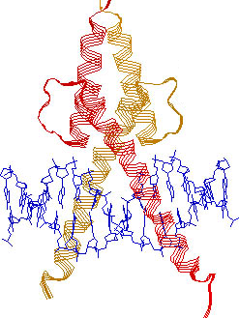
Chemical genomic toolkit
How many specific probes do we need to study the entire ‘expressed genome?’
92,000 expressed proteins
1 inhibitor of function
1 activator of function
184,000 unique chemical probes?
MyoD:
regulates smooth muscle differentiation
‘exercise transcription factor’
Notes:
To see what I mean, let’s take a look at my lab’s favorite protein class – transcription factors. Here is a structure of a transcription factor called MyoD bound to DNA. MyoD is a protein that governs the process of muscle cell differentiation. It is expressed at very low levels in multipotent satellite cells, essentially undetectable, and then its expression shoots up in response to stimuli such as exercise or muscle damage. MyoD expression is considered to be one of the earliest markers of myogenic commitment. Deregulation of this protein contibutes to various muscular atrophies and development disorders.
This protein, like the vast majority of TFs, have two MAJOR functions – The protein forms dimers and the dimer binds to DNA. Here, we might want an probe that stabilizes the dimer (an ‘activator’) or prevents the dimer from forming (‘inhibitor’) as well as probes that block the dimer from binding to DNA or stabilize the DNA-dimer interaction. All of these probes may tease out different aspects of MyoD function.

Slide 25
Approaches to probe discovery
’forward’ chemical genetics
screen for phenotype of interest
identify protein target
assay positive
- small molecule
+ small molecule
example to be discussed
in lecture 5
Notes:
How do you discover probes?

Slide 26
Approaches to probe discovery
’forward’ chemical genetics
screen for phenotype of interest
identify protein target
assay positive
- small molecule
+ small molecule
’reverse’ chemical genetics
example to be discussed
in lecture 2
broad survey of
phenotypic outcomes
directly bind target of interest
assay positive

Slide 27
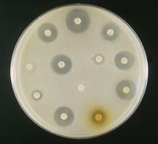
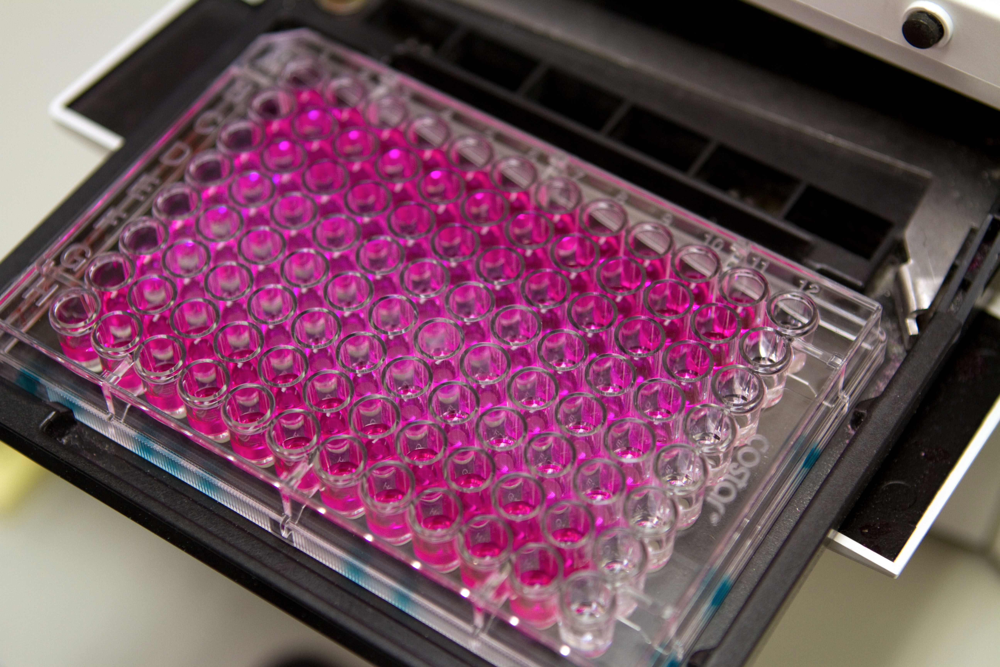
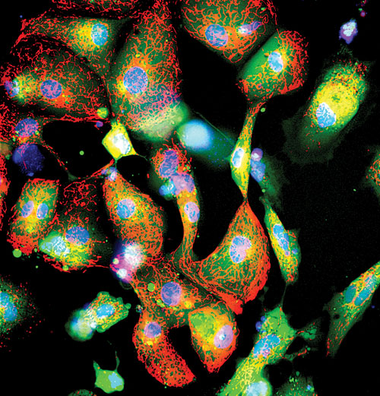
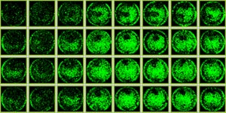
High-throughput assays
viability
biochemistry – reactions and interactions
signal intensity
reproducibility
morphology
localization
expression
27
Notes:
A screen of both types can involve 10s of compounds or millions of compounds. The size of the screen often relates to the question being asked, the #s of compounds available to the researcher, and the design of the experiment. Experiments that are miniaturized or that involved automated processes often lend themselves to ‘higher-throughput’ experiments (sometimes called assays). Examples here – zone of inhibition, colorimetric, and fluorescecne. The bottom assays are image-based and special instruments and computational tools are used to collect and analyze the data. The bottom left image is an example of a ‘high-content’ assay. This is an example of an experiment that involves imaging of multiple things at once, using different color (or readouts).

Slide 28
Protein target: FKBP12
Cellular roles:
plays a role in immune regulation
regulates protein folding
regulates protein trafficking in the cell
Molecular functions:
Enzyme - isomerase
binds several other signaling proteins
target of several immunosuppressants
more details to come in Lecture 5!
Notes:
Peptidyl-prolyl cis-trans isomerase FKBP1A is an enzyme encoded by the FKBP1A gene.
The protein encoded by this gene is a member of the immunophilin protein family, which play a role in immunoregulation and basic cellular processes involving protein folding and trafficking. This encoded protein is a cis-trans prolyl isomerase that binds the immunosuppressants FK506 (tacrolimus) and rapamycin (sirolimus). It interacts with several intracellular signal transduction proteins including type I TGF-beta receptor. It also interacts with multiple intracellular calcium release channels including the tetrameric skeletal muscle ryanodine receptor. In mouse, deletion of this homologous gene causes congenital heart disorder known as noncompaction of left ventricular myocardium. There is evidence of multiple alternatively spliced transcript variants for this gene, but the full length nature of some variants has not been determined.

Slide 29
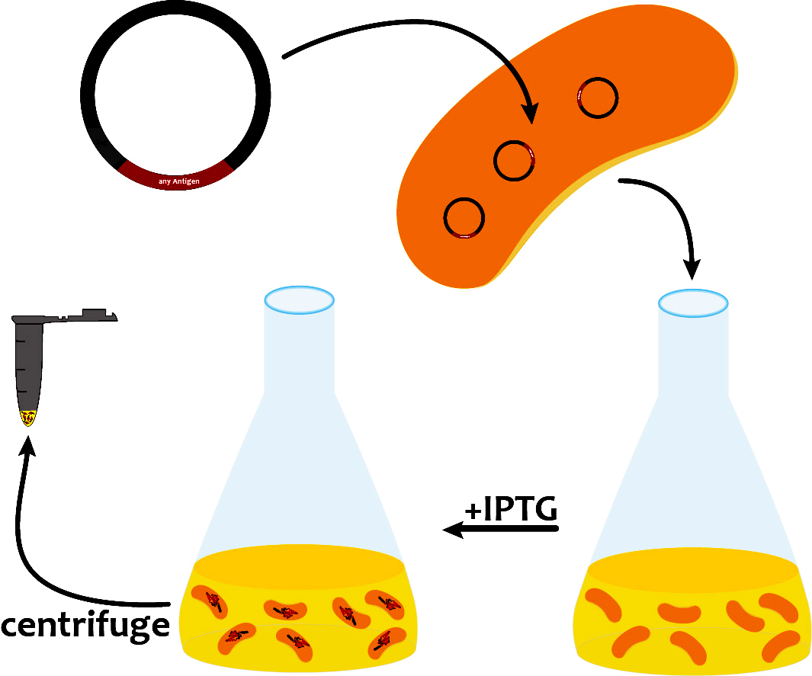
Spring 2017 Mod 1 path to probe discovery
in silico cloning; overexpress FKBP12
lab days 1 & 2
Notes:
Visual journey build slide

Slide 30
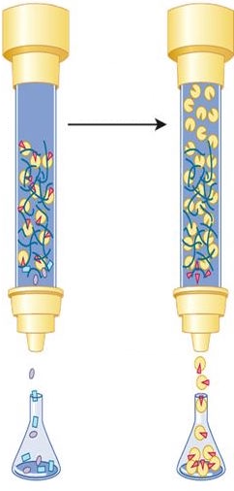
Spring 2017 Mod 1 path to probe discovery
in silico cloning; overexpress FKBP12
lab days 1 & 2
purify and analyze FKBP12 concentration
lab days 3 and 4
Notes:
Visual journey build slide

Slide 31
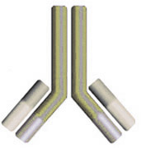

Spring 2017 Mod 1 path to probe discovery
in silico cloning; overexpress FKBP12
lab days 1 & 2
purify and analyze FKBP12 concentration
lab days 3 and 4
Alexa 647-
anti-His antibody
His-Tag
FKBP12
ligand discovery screen
lab day 5
Notes:
Visual journey build slide

Slide 32
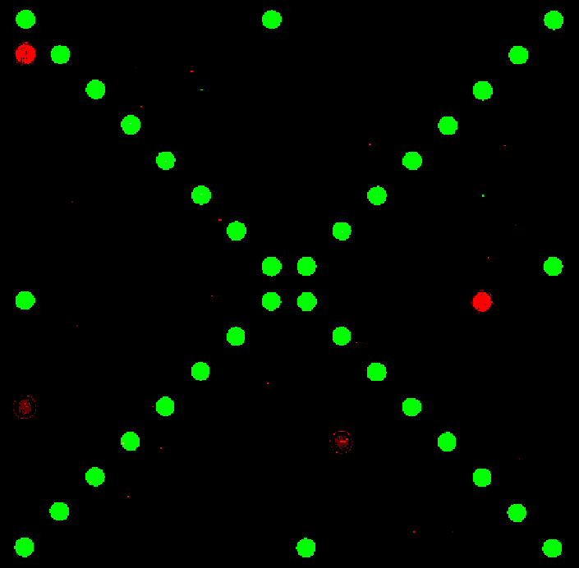
Spring 2017 Mod 1 path to probe discovery
in silico cloning; overexpress FKBP12
lab days 1 & 2
purify and analyze FKBP12 concentration
lab days 3 and 4
ligand discovery screen
lab day 5
scan images and analyze data
lab days 6 and 7
Notes:
Visual journey build slide

Slide 33
Spring 2017 Mod 1 path to probe discovery
in silico cloning; overexpress FKBP12
lab days 1 & 2
purify and analyze FKBP12 concentration
lab days 3 and 4
ligand discovery screen
lab day 5
scan images and analyze data
lab days 6 and 7
compare hit lists for teams
lab day 8
Notes:
Visual journey build slide

Slide 34
Spring 2017
Spring 2019
Notes:
The pass off

Slide 35
Spring 2019 Mod 1 path to probe discovery
in silico cloning; overexpress FKBP12
lab day 1
purify and analyze FKBP12
lab days 2 and 4
Notes:
Visual journey build slide

Slide 36
Spring 2019 Mod 1 path to probe discovery
+
in silico cloning; overexpress FKBP12
lab day 1
purify and analyze FKBP12
lab days 2 and 4
re-analyze screen data
lab day 3
Notes:
Visual journey build slide

Slide 37
Spring 2019 Mod 1 path to probe discovery
+
in silico cloning; overexpress FKBP12
lab day 1
purify and analyze FKBP12
lab days 2 and 4
re-analyze screen data
lab day 3
test FKBP12 and ligands
in enzyme activity assay
lab day 5
Notes:
Visual journey build slide

Slide 38
Spring 2019 Mod 1 path to probe discovery
+
in silico cloning; overexpress FKBP12
lab day 1
purify and analyze FKBP12
lab days 2 and 4
re-analyze screen data
lab day 3
test FKBP12 and ligands
in enzyme activity assay
lab day 5
test ligands in FKBP12
binding assay
lab day 6
Notes:
Visual journey build slide

Slide 39
Spring 2019 Mod 1 path to probe discovery
+
in silico cloning; overexpress FKBP12
lab day 1
purify and analyze FKBP12
lab days 2 and 4
re-analyze screen data
lab day 3
ΔT = Y °C
test FKBP12 and ligands
in enzyme activity assay
lab day 5
test ligands in FKBP12
binding assay
lab day 6
complete data analysis
prioritize best ligands
lab day 7
Notes:
Visual journey build slide

Slide 40
Spring 2019
Fall 2019
Notes:
The pass off

Slide 41
Do the compounds affect the melting temperature
of FKBP12 in cells?
western blot for protein levels
best ligands from S19
FKBP12 binding assay
ΔT = Y °C
Cellular thermal shift assay
FKBP12 ligand
% soluble protein
vehicle
FKBP12
ligand
vehicle (DMSO)
Temperature (°C)
compound treatment
in cells
heating and cooling
lyse cells
separation
(optional)
detection
Notes:
Visual journey build slide

Slide 42
Our path to evaluate ligands - lectures
11/7/19 Lecture 1 Intro to chemical biology: small molecules, probes, and screens
11/12/19 No lecture, Monday schedule
11/14/19 Lecture 2 Low-tech ligand discovery using microarrays
11/19/19 Lecture 3 Guest Lecture – Nick Struntz, Ph.D.
Engineering transcriptional responses with a small molecule
11/21/19 Lecture 4 Quantitative evaluation of protein-ligand interactions
11/26/19 Student Pitches
12/3/19 Lecture 5 The story of FKBP12 – our protein target
Notes:
The plan… assuming no snow days!
We will make the slides available through the Wiki!

