Slide 1
Statistics: Examples and Exercises
20.109 Fall 2010
Module 1 Day 7

Slide 2
Your Data and Statistics
"Figures often beguile me," he wrote, "particularly when I have the arranging of them myself; in which case the remark attributed to Disraeli would often apply with justice and force: 'There are three kinds of lies: lies, damned lies, and statistics.'”
Quote from Mark Twain, Chapters from My Autobiography, 1906

Slide 3
Why are stats important
Sometimes two data sets look different, but aren’t
Other times, two data sets don’t look that different, but are.

Slide 4
Why are stats important
Informed experimental design is very powerful
Save time, money, experimental subjects, patients, lab animals …….

Slide 5
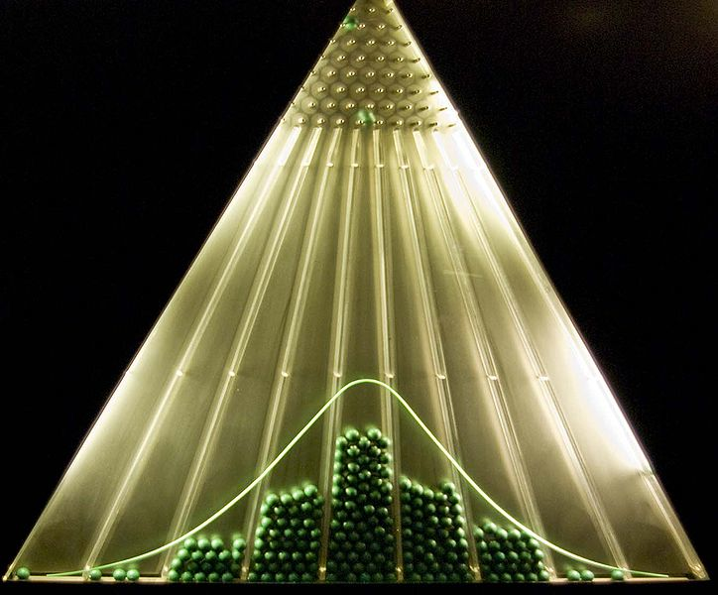
Normal Distribution
The data are centered around the mean
The data are distributed symmetrically around the mean
http://en.wikipedia.org/wiki/File:Planche_de_Galton.jpg
Notes:
For example, the average height for adult men in the United States is about 70 inches (178 cm), with a standard deviation of around 3 in (8 cm). This means that most men (about 68 percent, assuming a normal distribution) have a height within 3 in (8 cm) of the mean (67–73 in (170–185 cm)), whereas almost all men (about 95%) have a height within 6 in (15 cm) of the mean (64–76 in (163–193 cm)). If the standard deviation were zero, then all men would be exactly 70 in (178 cm) high. If the standard deviation were 20 in (51 cm), then men would have much more variable heights, with a typical range of about 50 to 90 in (127 to 229 cm).

Slide 6
Mean μ vs
The entire population mean is μ
Sample population mean is
As your sample population gets larger,
Data Set
2, 3, 4, 4, 5, 5, 6, 6, 7, 7, 8, 9
Mean

Slide 7
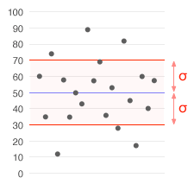
Standard Deviation
Describes how data are expected to vary from the mean
σ is s.d. of population
s is s.d. of sample
μ = 50
σ = 20
http://en.wikipedia.org/wiki/File:Standard_deviation_illustration.gif

Slide 8
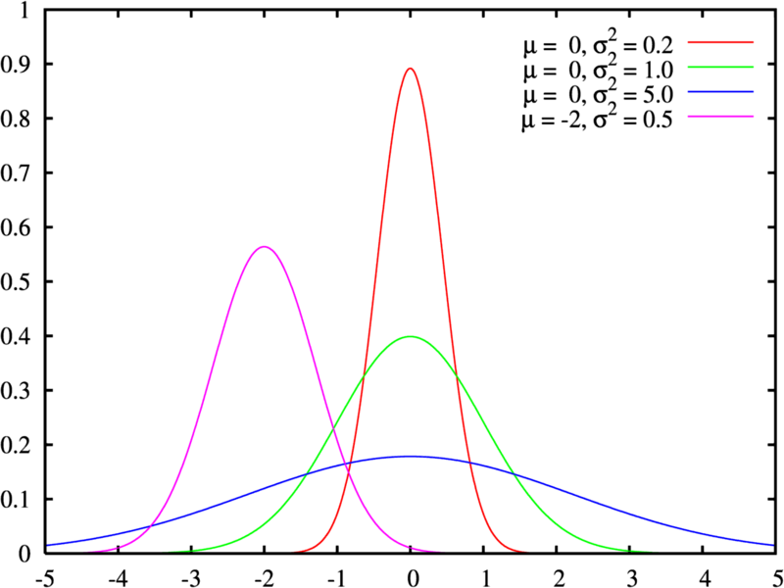
Meaning of Standard Deviation
Red, Green, Blue all same mean
Different standard deviation

Slide 9
Meaning of Standard Deviation
Data with a larger spread (blue and green) have a larger Standard Deviation

Slide 10
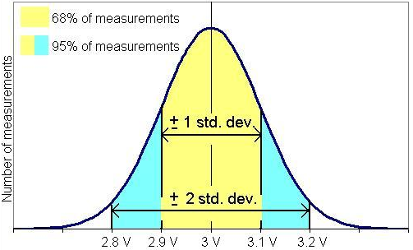
Standard Deviation
68% of values are within 1 standard deviation
95% of values are within 2 standard deviations of the mean

Slide 11
Statistical Significance
How do we know that two data sets are truly different

Slide 12
Recap: Probability density function p(x)
Normalized
p(x)
Probability that
is
a
x
a
b
x is a random number

Slide 13
95% confidence interval of an estimate
A range such that 95% of replicate estimates would be within it
p(x)
95% of area

Slide 14
95% Confidence interval for a normally distributed variable
# data points t_{0.025}
2 12.706
3 4.303
4 3.182
5 2.776
10 2.262
20 2.093
30 2.045
50 2.010
100 1.984
Increasingly accurate estimate of
Note: Uncertainty decreases proportionally to
So take more data!

Slide 15
Example
3 measurements of absorbance at 600 nm: 0.110, 0.115, 0.113
95% confidence limit?
Soln:

Slide 16
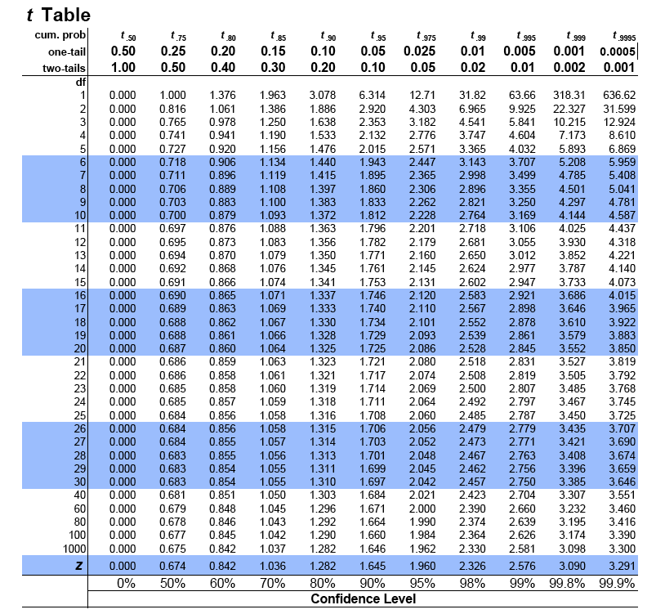

Slide 17
Confidence Intervals
Use t to find interval containing μ if is known
Example:
t₉₅ = 2.6
6.4 < μ <8.6
I am 95% confident that the population mean lies between 6.4 and 8.6
Hawks | Cyclones
9 | 4
8 | 6
7 | 5
6 | 2
7 | 4
8 | 5
X₁ 7.5 | X₂ 4.3
s₁ 1.0 | s₂ 1.4

Slide 18
T-tests
Compare confidence intervals to see if data sets are significantly different
Assumptions
Data are normally distributed
The mean is independent of the standard deviation
μ ≠ f(σ)
Various types
One sample t-test
Are these data different than the entire population?
Two sample t-test
Do these two data sets come from different populations?
Paired t-test
Do individual changes show an overall change?

Slide 19
Use t-test to compare means
We have and
Do they come from different populations?
Are and different?
Null Hypothesis H_{o}:
=
Alternative Hypothesis H_{a}:
>
t statistic tests H_{o}. If t < 0.05, then reject H_{o} and accept H_{a}

Slide 20
T-test Illustration
Two populations that are significantly different, with X₂ larger than X₁

Slide 21
T-test Illustration
Two populations that are not significantly different, but X₂ is still larger than X₁

Slide 22
Exercise: Find 99% Confidence
MIT | Harvard
100 | 46
87 | 54
56 | 76
87 | 92
98 | 87
90 | 60
X₁ 86.3 | X₂ 69.2
s₁ 15.9 | s₂ 18.6
t=?
t_{calc} = 1.79
t₉₉ = ?
t_{calc} ? T₉₉
Go to table in notes to find t₉₉ with 11 degrees of freedom

Slide 23
Today and Thursday’s Experiments
Transfections today
Measure fluorescence via Bioanalyzer on Thursday

Slide 24
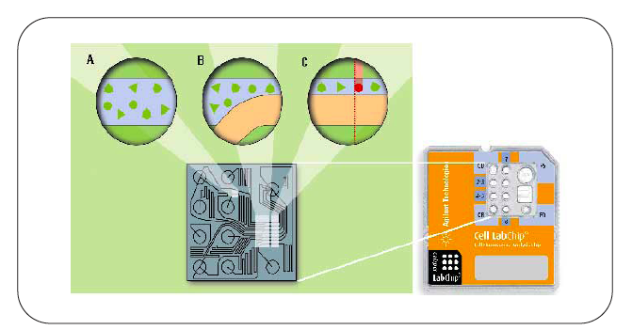
Thursday’s Experiments: Bioanalyzer

Slide 25
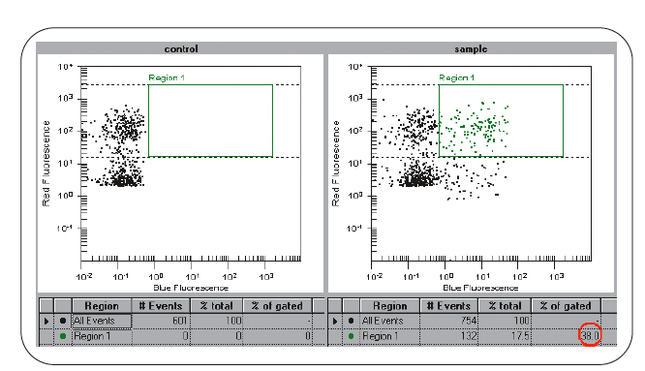
Bioanalyzer Output

Slide 26
FACS Data
Targeted cells showed green fluorescence via flow cytometry at expected frequency.
Jonnalagadda, et al. 2005 DNA Repair. (4) 594-605.

Slide 27
FACS vs. Bioanalyzer
Ultimate readout will be fluorescence intensity in red and green channels for each cell
FACS measures thousands of events, while the Bioanalyzer measures hundreds
What can this mean for your statistics???

Slide 28
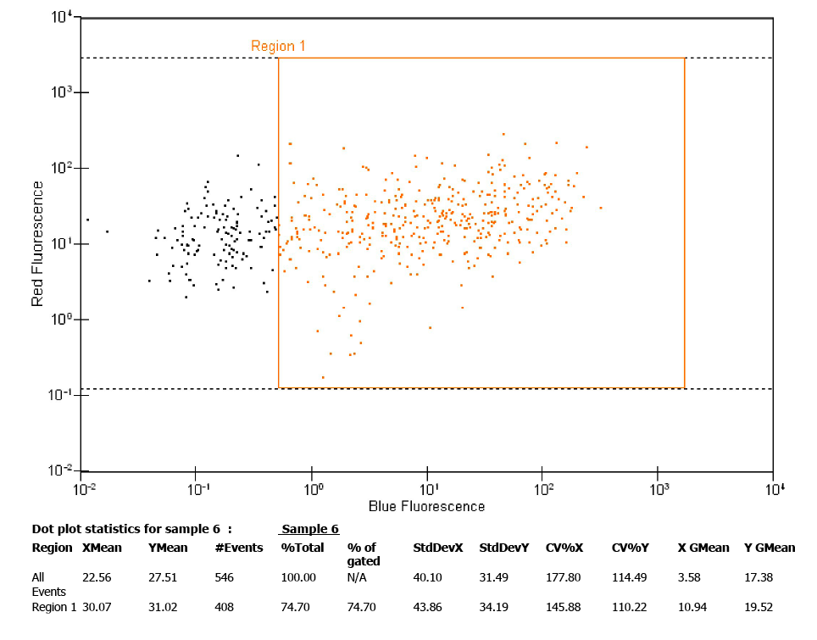
Example Bioanalyzer Data
Live cells will be labeled red, HR cells will also be green
Positive Control

Slide 29
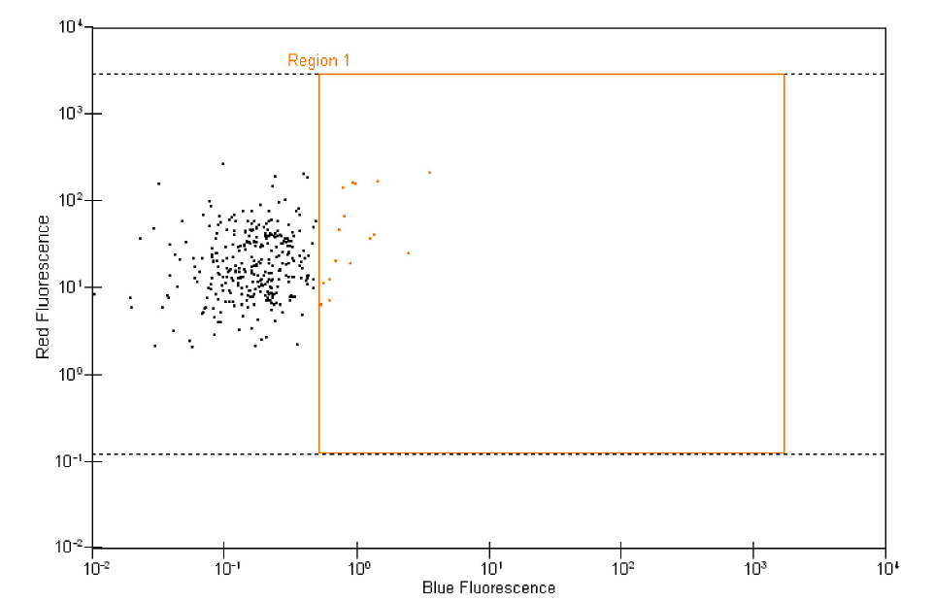
Example Bioanalyzer Data
Live cells will be labeled red, HR cells will also be green
Possible Experimental Sample Output

Slide 30
Excel Example: Day 8 Results
 | Fluorescence Intensity
Cell | Δ3 | Δ3 + Δ5
1 | 25 | 22
2 | 22 | 25
3 | 27 | 87
4 | 38 | 105
5 | 32 | 200
6 | 21 | 22
7 | 48 | 23
8 | 15 | 48
9 | 26 | 320
10 | 22 | 29
: EGFP
.
.
.
.
.
.
.
.
.
Notes:
Remainder of Demo Performed in Excel

Slide 31
Conclusion
Due to the nature of the data
Look at gating for individual cell data
Consider a Gaussian distribution for significance when comparing across conditions and groups
Think about how much data you have within each population and use different distributions to think about certainty in your data

Slide 32
Extra Slides

Slide 33
Notes:
RAD51 is being knocked out by adding tet. TET KOs RAD51

Slide 34
Application
Hawks | Cyclones
9 | 4
8 | 6
7 | 5
6 | 2
7 | 4
8 | 5
X₁ 7.5 | X₂ 4.3
s₁ 1.0 | s₂ 1.4
t_{calc} = 4.6
t₉₅ = 2.2
t_{calc} > t₉₅
HAWKS WIN!
Go to table in notes to find t₉₅ with 11 degrees of freedom (12-1)
(The excel sheet does a different comparison)

Slide 35
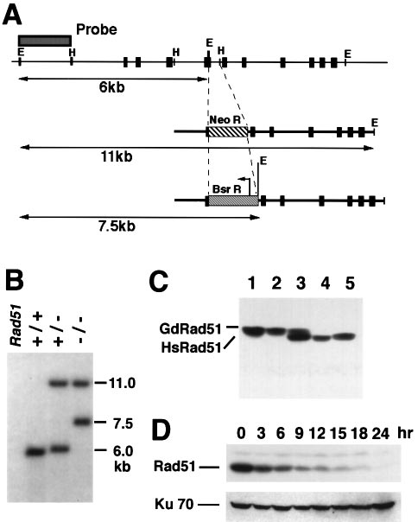
Figure 2

Slide 36
