Slide 1
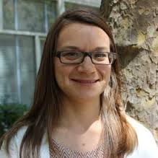
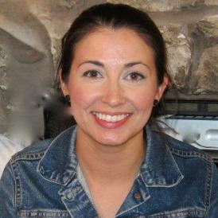
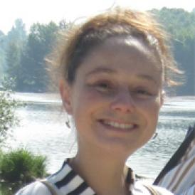
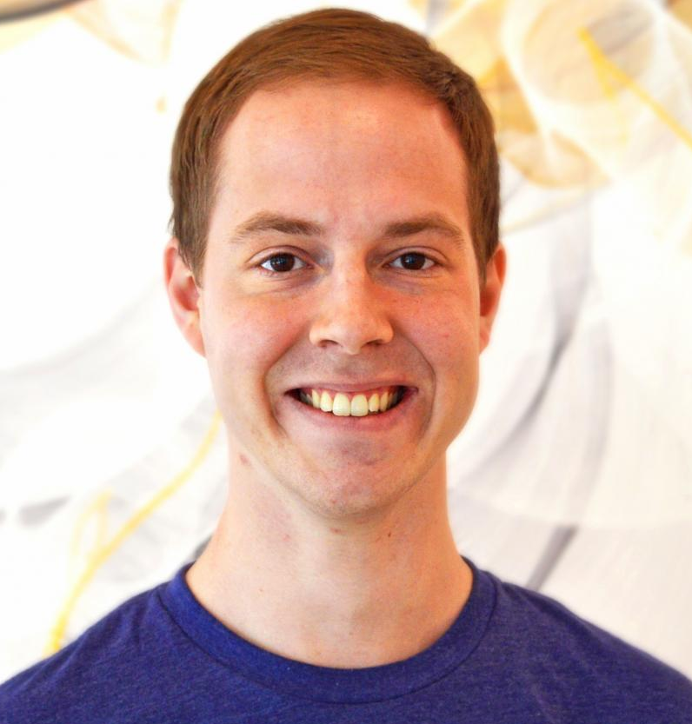
20.109 Spring 2017 Module 2 – Lecture 5
Gene Expression Engineering (April 11th 2017)
Noreen Lyell
Leslie McLain
Maxine Jonas
Rob Wilson
Leona Samson (Lectures)

Slide 2
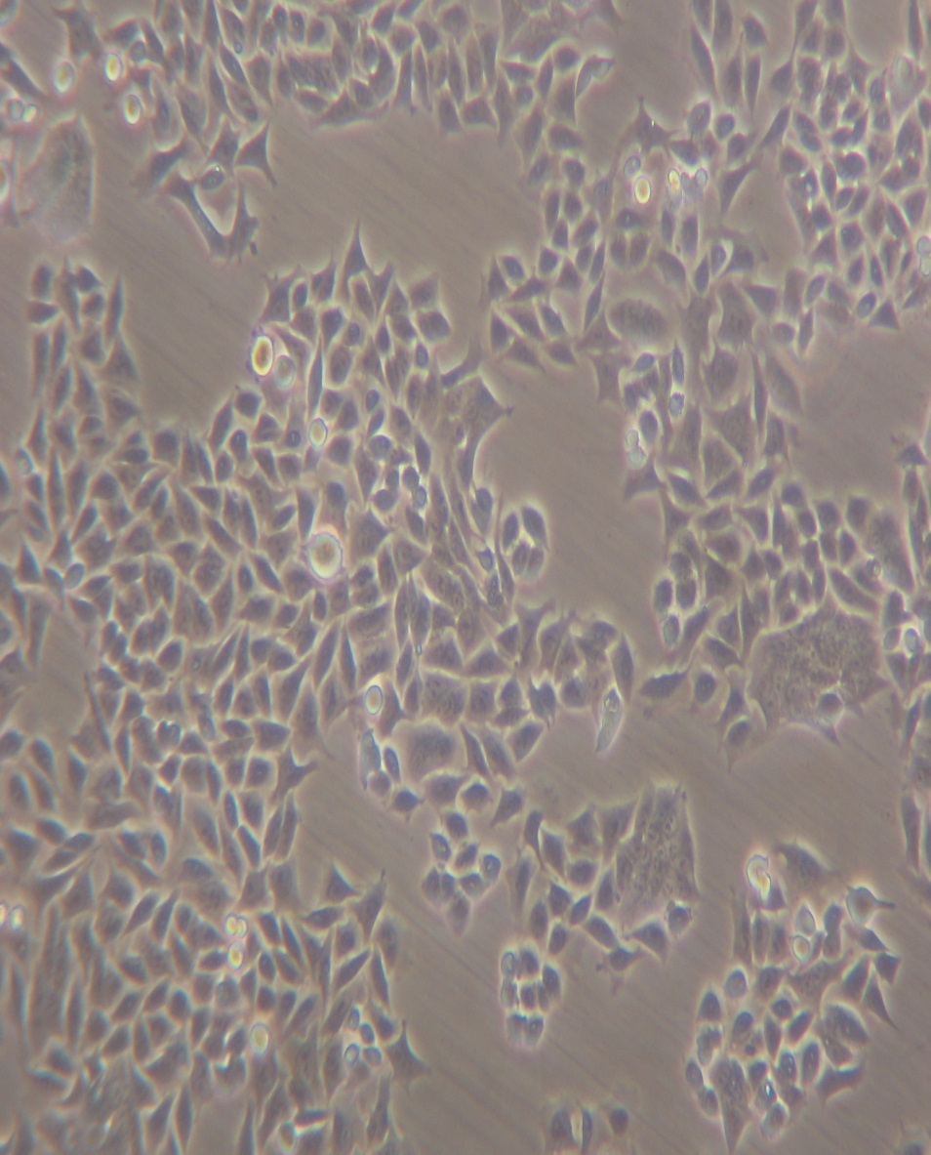

Here’s how you treated your cells
Figure from Lizzie Ngo
Graduate Student
Engelward Lab
& Samson Lab
DLD-1 cells
BRCA2 -/- cells
Etoposide to inhibit TopoII leading to DNA DSBs
Compound 401 to inhibit Non Homologous End Joining (NHEJ)
Etoposide + Compound 401
Olaparib to inhibit PARP1 to stabilize DNA SSBs leading to DNA DSBs at collapsed replication forks

Slide 3
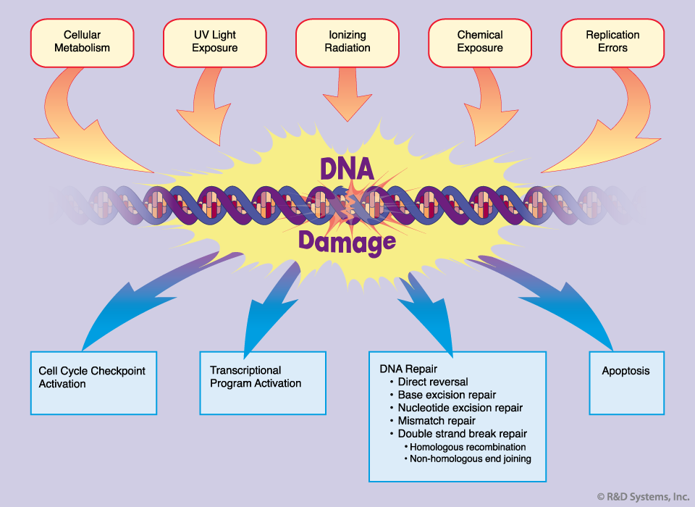
Necrosis Cell death
https://www.rndsystems.com/resources/articles/dna-damage-response

Slide 4
Lecture Outline
Some History on taking a genomics approach in the Samson Lab
Let’s think about the RNAseq data (p53, p73, heatmap etc.)
Let’s look at your cell killing data (alternative interpretations). BRCA2 null?? C401 result?? NHEJ Status? What kind of damage is induced via Etoposide vs Olaparip? Which pathway would/should predominate?

Slide 5
Cell Death Mutation
DNA damage
DISEASE
Cell cycle arrest
DNA repair

Slide 6
How can we identify ALL pathways that influence cell death and mutation?
Cell Death Mutation
DNA damage
DISEASE
Cell cycle arrest
DNA repair

Slide 7
Screening for Genes that Provide Alkylation Resistance to E. coli
Functional Complementation

Slide 8
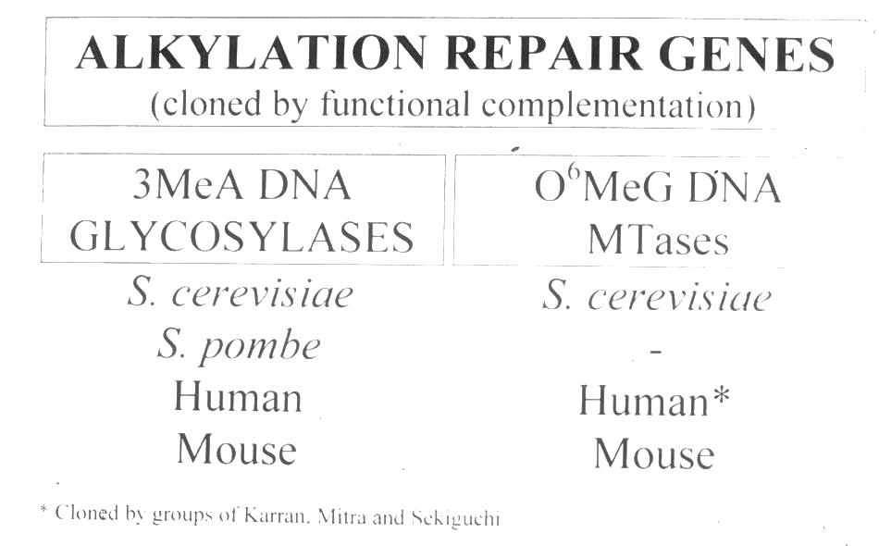

Slide 9
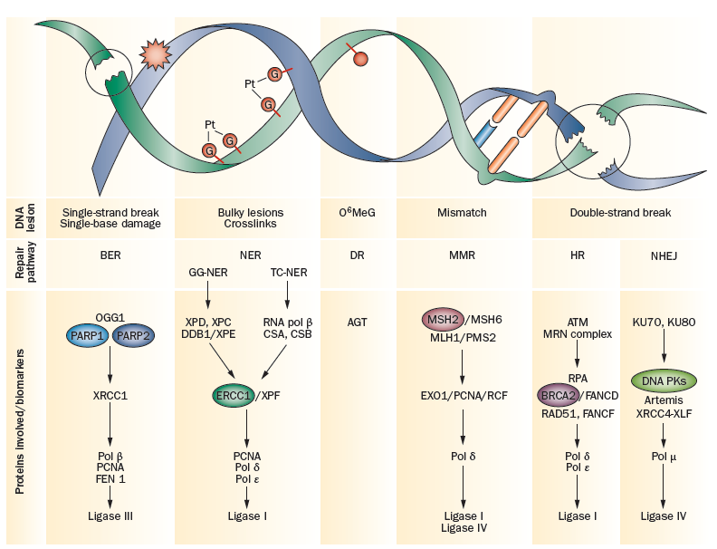
Six Major DNA Repair Pathways
BER NER DR MMR HR NHEJ
aka MGMT

Slide 10
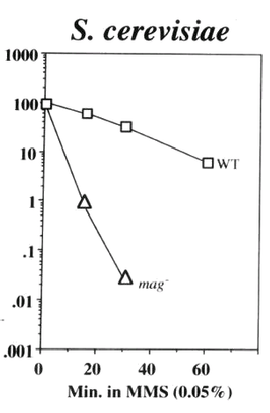
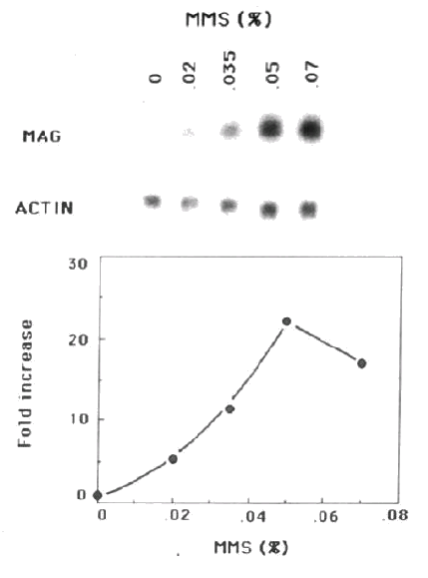
The S. cerevisiae 3-MethylAdenine DNA Glycosylase encoded by the MAG gene
Northern Blot – mRNA level
Killing curve – MMS sensitivity

Slide 11
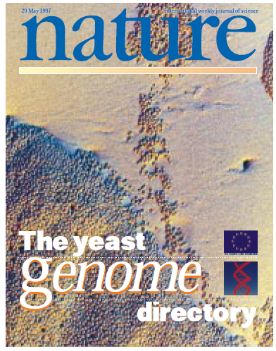
1997 saw the sequencing of the first eukaryotic genome….
S. cerevisiae
The field is changed for ever...

Slide 12
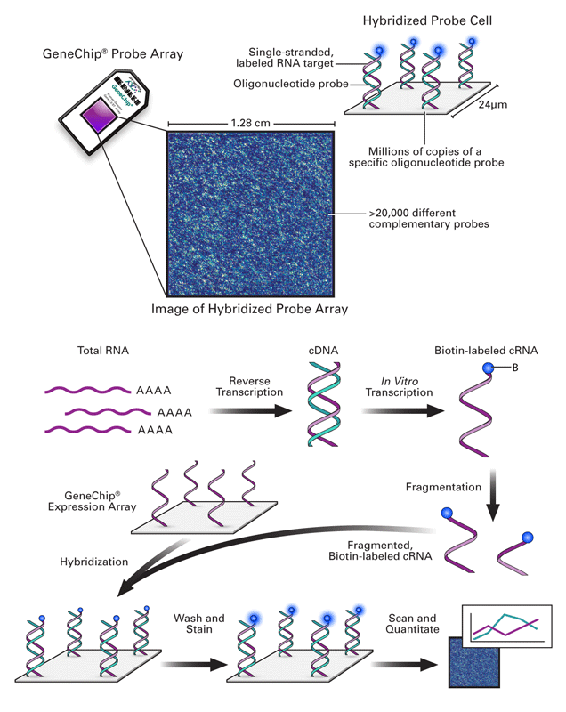
Affymetrix Array
This is now the Old Fashioned Way

Slide 13
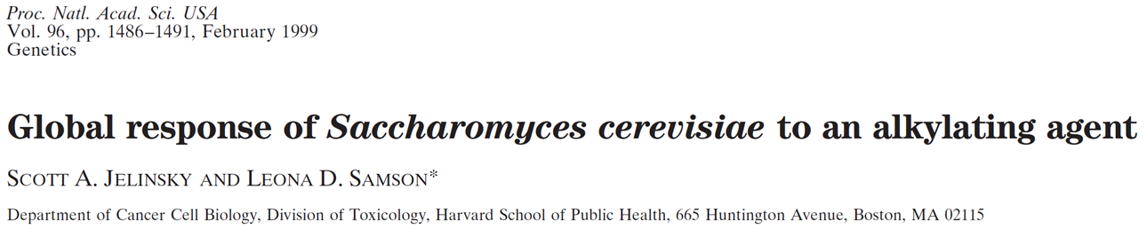
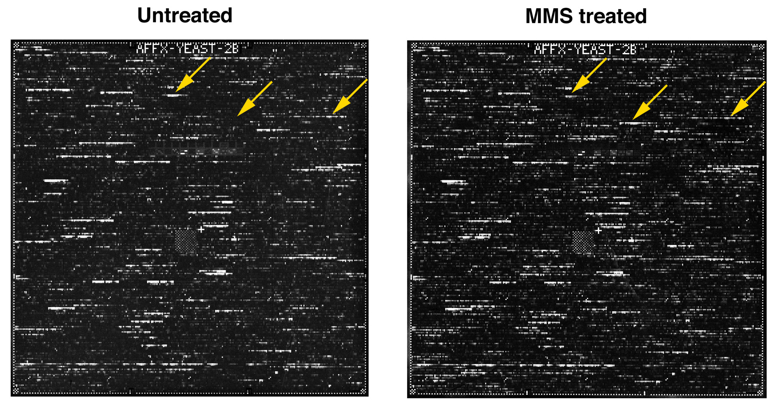

Slide 14
Previous Screening for Damage Inducible Genes
Year
Organism
Method
Genes
1980
E. coli
Gene/operon fusions
~ 20
1984
S. cerevisiae
Differential Hybridization
~ 10
1985
S. cerevisiae
Gene fusion
~ 50
1988
CHO cells
Differential Hybridization
~ 20

Slide 15
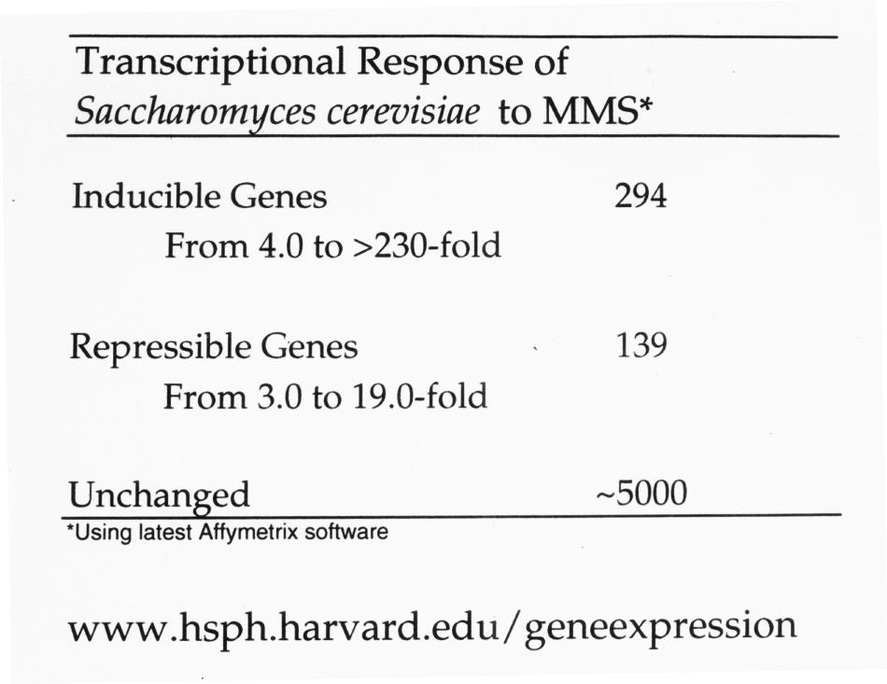

Slide 16
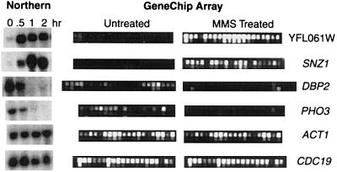

Slide 17
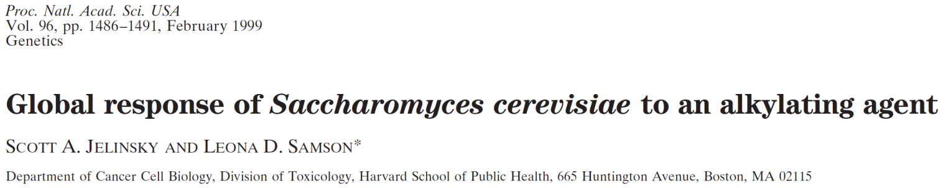
GENES REPRESENTED
DNA Repair
Cell Cycle
DNA Replication
Transcription
Signaling
Transport
Protein Degradation
Protein Synthesis
Amino Acid Metabolism
RNA Metabolism
Cell Membrane Biosynthesis
Chromatin structure
433 genes up or down regulated!

Slide 18
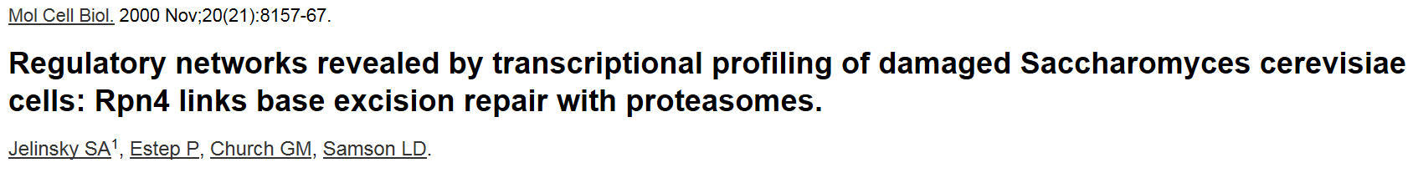
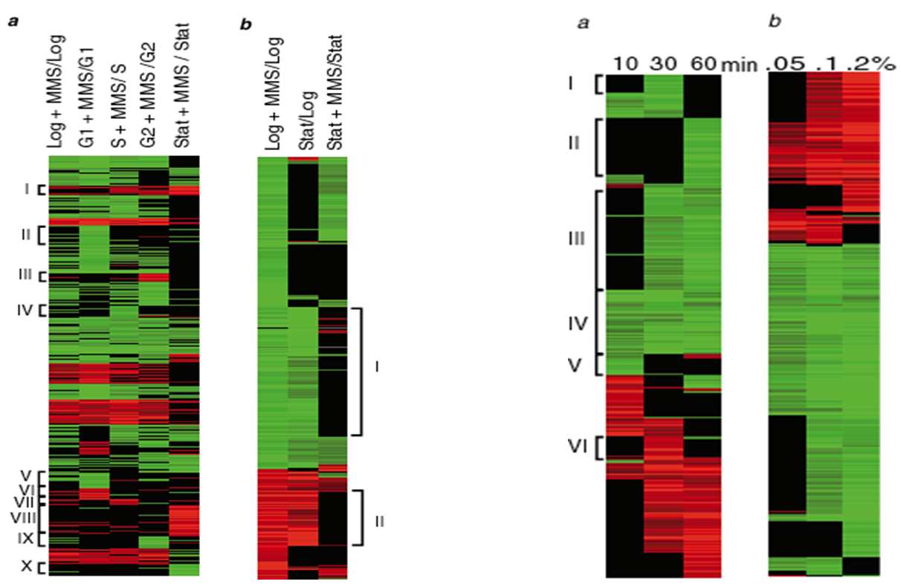
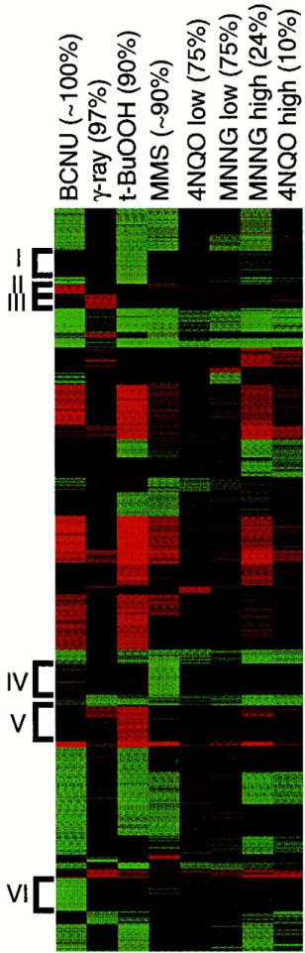
0.1% MMS
MMS
> 2000 genes are responsive to MMS

Slide 19
GENES REPRESENTED
DNA Repair
Cell Cycle
DNA Replication
Transcription
Signaling
Transport
Protein Degradation
Protein Synthesis
Amino Acid Metabolism
RNA Metabolism
Cell Membrane Biosynthesis
Chromatin structure
> 2,000 genes up or down regulated!

Slide 20
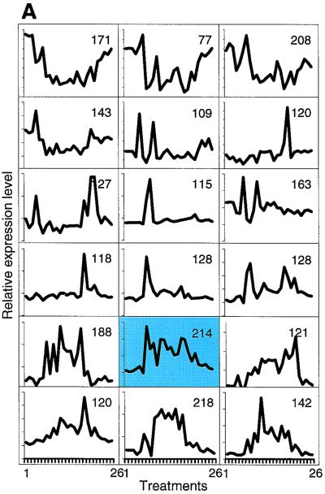
GENES REPRESENTED
DNA Repair
Cell Cycle
DNA Replication
Transcription
Signaling
Transport
Protein Degradation
Protein Synthesis
Amino Acid Metabolism
RNA Metabolism
Cell Membrane Biosynthesis
Chromatin structure
> 2,500 genes

Slide 21
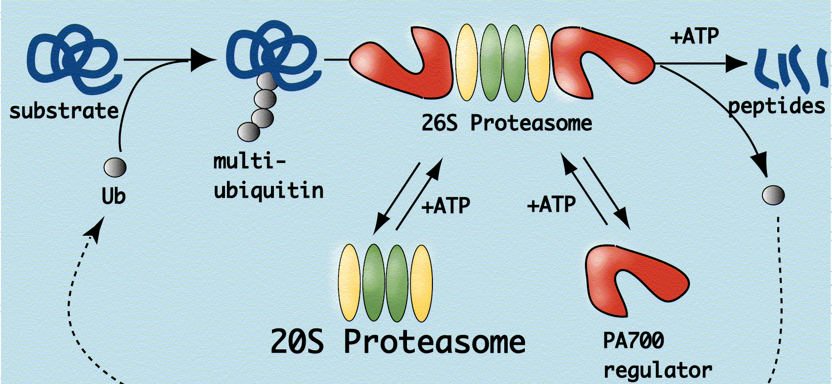
http://www.protein.osaka-u.ac.jp/crystallography/e-fig1.gif
MMS exposure massively induces almost all the ~35 genes encoding the subunits of the 26S PROTEASOME particle!!

Slide 22
http://www.protein.osaka-u.ac.jp/crystallography/e-fig1.gif
RPN4
The proteasome subunit Rpn4p acts as transcriptional activator of proteasome genes --- and some DNA Repair genes!! Rpn4 mutants are MMS sensitive

Slide 23
1997 saw the sequencing of the first eukaryotic genome….
S. cerevisiae
What else could be done with this knowledge?

Slide 24
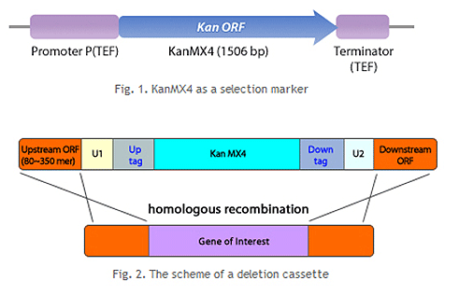
Yeast Gene Deletion Library
Yeast has a total of 6,275 genes
4,733 deletion strains generated

Slide 25
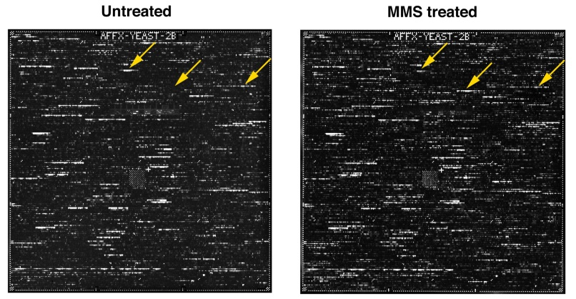
Transition from the ‘old’ to the ‘new’ paradigm using S. cereviciae
One Gene
Tx -Responsive to MMS
One sensitive Knock-Out Strain
lot
All Genes
Tx -Responsive to MMS
All Sensitive Knock-Out Strains
Transcriptional Profiling
Genomic phenotyping

Slide 26
Tom Begley and Ari Rosenbach
MMS t-buOOH UV 4NQO
hv
4 agents, 5 doses, 4,733 strains, tested in triplicate

Slide 27
Genomic Phenotyping Using MMS
WT
mag1Δ
rev1Δ
rad14Δ

Slide 28
[MMS]
[tBuOOH]
[4NQO]
[UV]

Slide 29
Of 4,733 strains tested
Sensitive Resistant
MMS: 1441 0
t-BuOOH: 447 78
4NQO: 819 2
UV: 288 1

Slide 30
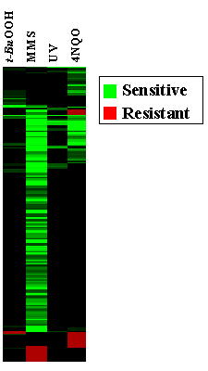
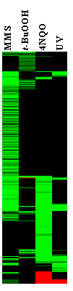
Genomic Phenotyping Signatures are
DISTINCT
for each agent

Slide 31
Global Transcriptional Response to MMS
GENES REPRESENTED
DNA Repair
Cell Cycle
DNA Replication
Transcription
Signaling
Transport
Protein Degradation
Protein Synthesis
Amino Acid Metabolism
RNA Metabolism
Cell Membrane Biosynthesis
Chromatin structure
One Gene
Tx -Responsive to MMS
Identify All Genes
Tx -Responsive to MMS

Slide 32
Genomic Phenotyping for MMS sensitivity
One sensitive Knock-Out Strain
GENES REPRESENTED
DNA Repair
Cell Cycle
DNA Replication
Transcription
Signaling
Transport
Protein Degradation
Protein Synthesis
Amino Acid Metabolism
RNA Metabolism
Cell Membrane Biosynthesis
Chromatin structure
All Sensitive Knock-Out Strains
Genomic phenotyping

Slide 33
Transition from the ‘old’ to the ‘new’ paradigm using S. cereviciae
One Gene
Tx -Responsive to MMS
One sensitive Knock-Out Strain
lot
All Genes
Tx -Responsive to MMS
All Sensitive Knock-Out Strains
Transcriptional Profiling
Genomic phenotyping

Slide 34
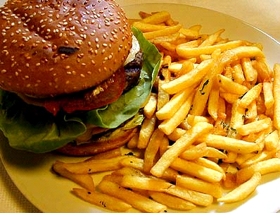
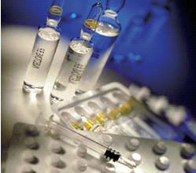
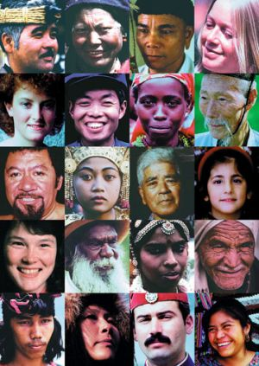



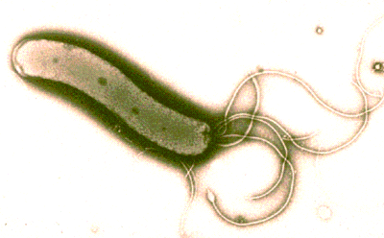
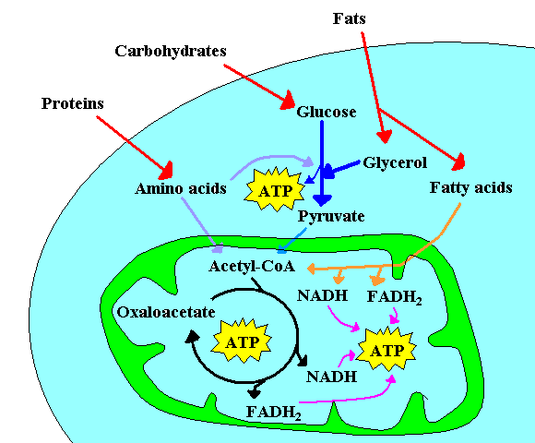
Environmental exposures to potentially harmful agents – DNA damaging agents
Harmful agents
People have different exposures
Eat
Eat
Medicine
Eat
Medicine
Eat
Medicine
Medicine
Absorbed
Drink
Absorbed
Drink
Absorbed
Absorbed
Ambient
Drink
Absorbed
Drink
Ambient
Absorbed
Breathe
Infection
Breathe
Infection
Breathe
Metabolism
Breathe
Infection
People have different responses

Slide 35
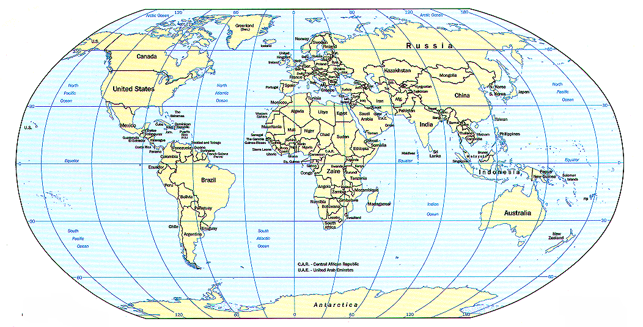
Coriell Lymphoblastoid Cell line collection derived from ethnically diverse HEALTHY humans
Native (30)
European (120)
Asian (120)
Mexican (60)
African (120)
450 healthy unrelated US residents with ancestry from
around the globe
Nested subsets: 90, 44, 24, 8
Ethical reasons: no medical, phenotypic, or ethnic information is provided

Slide 36

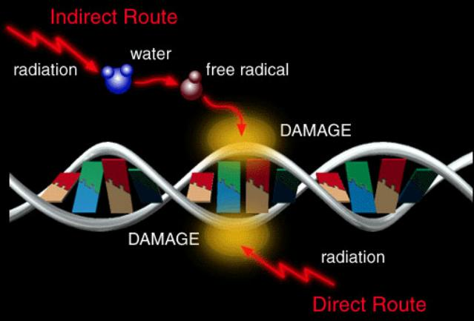
Model DNA damaging agent - MNNG
  MNNG
  (N-methyl N-Nitro
  N-Nitrosoguanidine)
Typical of environmental agents (e.g. in tobacco smoke) and of cancer chemotherapy agents
Methylation of O⁶ position of guanine strongly associated with mutagenicity and cytotoxicity of MNNG

Slide 37
Extensive Range of Sensitivity in Cells Exposed to Alkylation Damage – Control Cell Lines
% Control Growth
Sensitive
Resistant

Slide 38
Extensive Range of Sensitivity in Cells Exposed to Alkylation Damage – Coriell Cell Lines
% Control Growth
Sensitive
Resistant

Slide 39
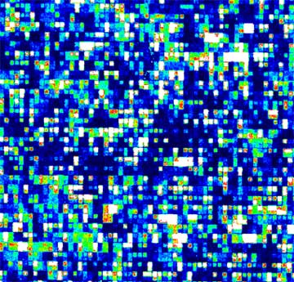
Training population comprised the most sensitive and most resistant human cell lines
% Control Growth
Sensitive
Resistant
Gene Expression Profiling
Affymetrix Full Human Genome – 20,000 human genes

Slide 40
48 Basally Expressed Genes
Training population
Test Population
sensitive
resistant
sensitive
resistant
8 human cell lines
remaining 16 human cell lines

Slide 41
48 Basally Expressed Genes
Training population
Test Population
sensitive
resistant
sensitive
resistant
8 human cell lines
remaining 16 human cell lines

Slide 42
Most significant positive association was expression of MGMT DNA repair protein
Resistant
p< 0.01
R²=0.91 (extremes)
Expression intensity
Sensitive
% Control Growth
Notes:
For extremes relation ship is strongly linear 1/3 samples relationship is known There isa questionable relatioship

Slide 43
Second most significant positive association: C21orf56 - orf of unknown function
p< 0.01
R²=0.75 (extremes)
Resistant
Expression intensity
Sensitive
% Control Growth

Slide 44
48 Basally Expressed Genes
Training population
Test Population
sensitive
resistant
sensitive
resistant
8 human cell lines
remaining 16 human cell lines

Slide 45
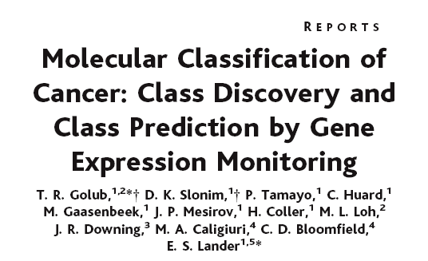
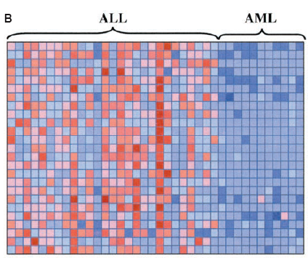
Classic Example of Applying Class Prediction – to Distinguish tumor types
Identify expression patterns that distinguish between classes to create Class predictor gene set
2) Gene set predictor then used to successfully classify leukemia subtypes (85% success)

Slide 46
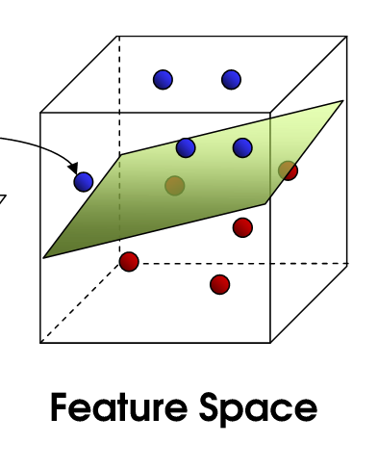
Two-class prediction algorithm:
Support Vector Machine
Sensitive
Mathematical hyperplane
Training population of
two groups with
known responses
to MNNG
used to build
gene set predictor
?
Predictor used to
classify test samples
with unknown exposures
Resistant

Slide 47
48 genes tested for prediction of alkylation sensitivity for the remaining test population
Sensitive
Resistant
48

Slide 48
48 genes predict response to alkylation
with 94% accuracy
Sensitive
Resistant
48
15/16
94%

Slide 49
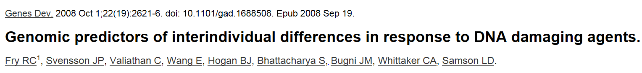
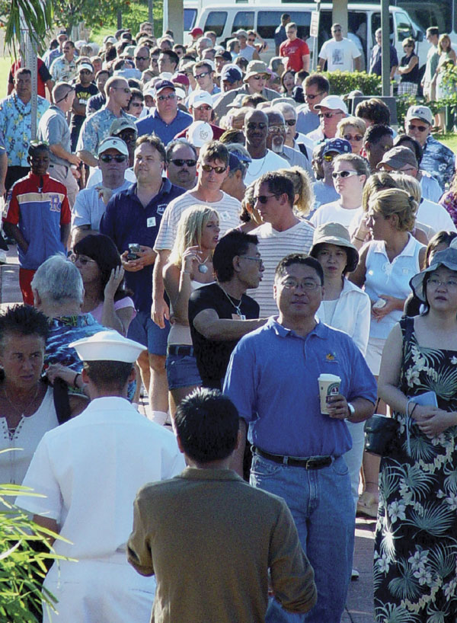
Basal gene expression can predict with high accuracy response to alkylation damage
predicts
Basal Expression
Alkylation Sensitivity

Slide 50
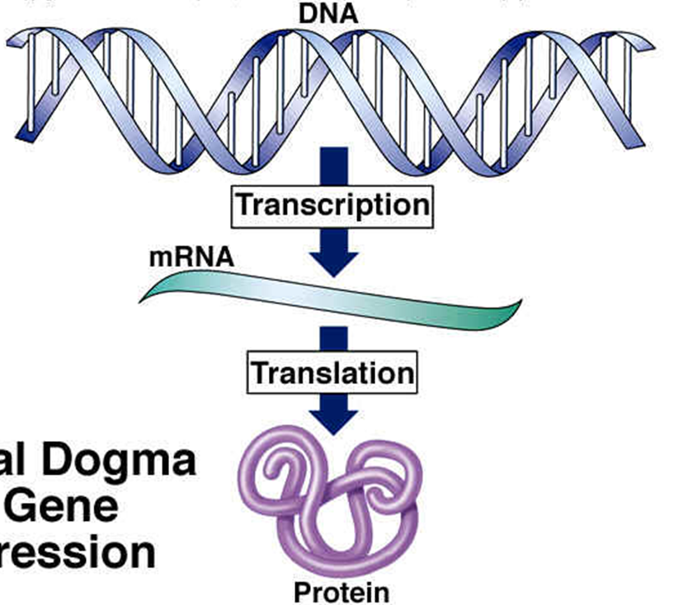
Genome Sequencing
mRNA Profiling
Exome Sequencing
Proteomic Analyses
In vitro / In vivo
Functional Assays
FUNCTION

Slide 51

Developing Novel Methods to Measure DNA Repair Capacity in Human Populations
Leona D. Samson
MIT
Biological Engineering Department
Biology Department
Center for Environmental Health Sciences
Koch Institute for Integrative Cancer Research
Computational and Systems Biology Initiative
Broad Institute (Harvard and MIT)

Slide 52
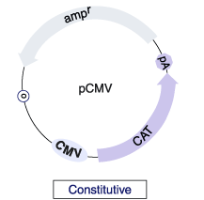

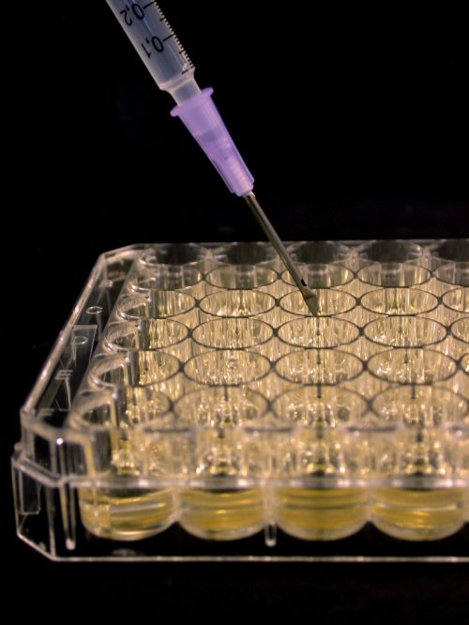
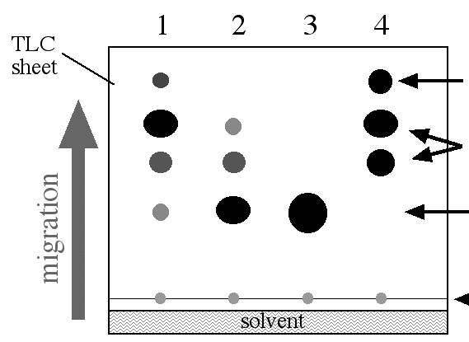
Reactivation of UV damaged DNA by Host cell Reactivation (HCR)
Athas & GROSSMAN Cancer Res. 1991
+ UV light
Transient transfection peripheral blood lymphocytes
CAT Assay
Time to repair

Slide 53
Six Major DNA Repair Pathways
BER NER DR MMR HR NHEJ

Slide 54
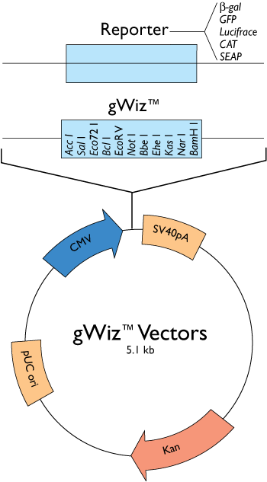
Reactivation of damaged DNA – multiplexed
Each Fluorescent Protein gene will harbor a different type of DNA damage
DsRed2FP
EGFP
EYFP
ECFP
EBFP
http://www.genlantis.com/corp/images/gWiz_vectmap.gif

Slide 55
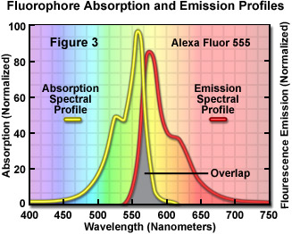
Reactivation of damaged DNA – multiplexed
+ different DNA lesions
Transient transfection of mixture
Fluorescence quantitation
Time to repair

Slide 56
Six Major DNA Repair Pathways
BER NER DR MMR HR NHEJ

Slide 57

DNA Repair Capacity in 5 pathways for the 24 Coriell cell lines
Relative Repair Activity

Slide 58
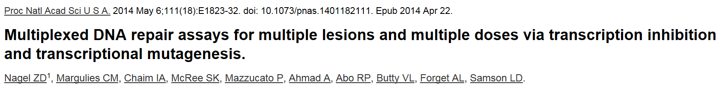
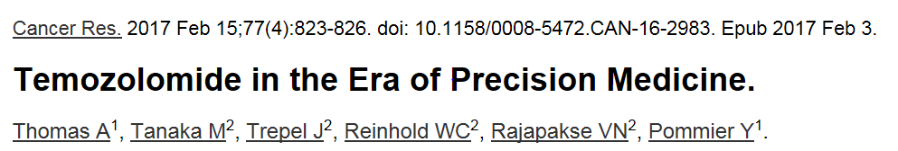
“In the January 1, 2017, issue of Cancer Research, Nagel and colleagues demonstrate the value of assays that determine the DNA repair capacity of cancers in predicting response to temozolomide. Although technical limitations preclude immediate clinical translation, the study reported by Nagel and colleagues (1) to identify functional assays to measure DNA repair capacity is an important step toward personalized medicine”
(slightly paraphrased)

Slide 59
Enough about me….
Let’s talk about you!!

Slide 60
Here’s how you treated your cells
Figure from Lizzie Ngo
Graduate Student
Engelward Lab
& Samson Lab
DLD-1 cells
BRCA2 -/- cells
Etoposide to inhibit TopoII leading to DNA DSBs
Compound 401 to inhibit Non Homologous End Joining (NHEJ)
Etoposide + Compound 401
Olaparib to inhibit PARP1 to stabilize DNA SSBs leading to DNA DSBs at collapsed replication forks

Slide 61
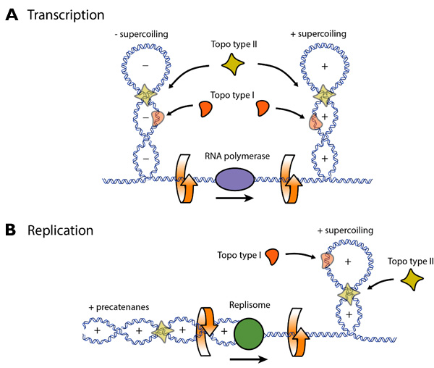
RNA Transcription and DNA Replication cause DNA SUPERCOILING
https://www.google.com/search?q=transcription+and+supercoiling&rlz=1T4GGHP_enUS635US636&source=lnms&tbm=isch&sa=X&ved=0ahUKEwiht7nTmcrSAhUC8IMKHR31CPoQ_AUICSgC&biw=1451&bih=689#imgrc=pBDGWOKz0axQVM:

Slide 62
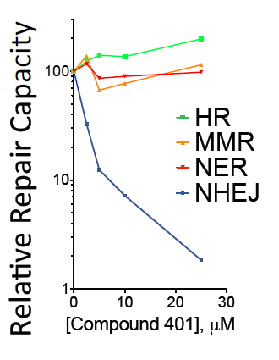
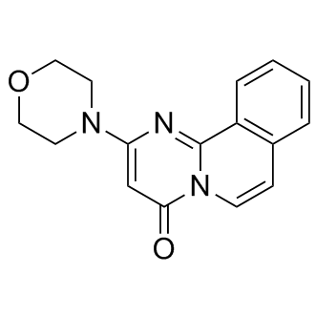
COMPOUND 401 – “Selective” Inhibitor of DNA-PK and NHEJ
Proc Natl Acad Sci U S A. 2014 111(18):E1823-32.
COMPOUND 401
Biological Activity of COMPOUND 104
Reversible and selective inhibitor of DNA-dependent protein kinase (DNA-PK) and mammalian target of rapamycin (mTOR) (IC₅₀ values are 0.28 and 5.3 μM respectively). Displays little affinity for other commonly studied kinases including PI 3-K, ATM and ATR (IC₅₀ values are all > 100 μM).

Slide 63

Olaparib
http://mcr.aacrjournals.org/content/12/8/1128

Slide 64


Slide 65

BOTH BRCA2 alleles have part of exon 11 replaced with a selectable marker gene (for G418 resistance)
It is essential to confirm the identity of the cells you are working with

Slide 66

RNAseq
https://www.google.com/search?q=illumina+rna+seq+video&rlz=1T4GGHP_enUS635US636&tbm=isch&source=lnms&sa=X&ved=0ahUKEwjbnJPrg4nTAhUB_IMKHciMAAoQ_AUIBygC&biw=1016&bih=544#tbm=isch&q=rna+seq&*&imgrc=1VtRXq_0PDgWyM:&spf=828

Slide 67

Spring 2017 20.109 RNAseq Results
DLD-1
Sequence counts
BRCA2-/- Sequence counts
Amanda Kedaigle (Fraenkel Lab)

Slide 68

Spring 2017 20.109 RNAseq Results
~ 1400 genes differentially expressed between DLD1 and BRCA2 -/- cell line (!!)
I asked Amanda Kedaigle (Fraenkel Lab) to show me what happened with those 1400 genes upon the induction of DSB’s by etoposide
Amanda Kedaigle (Fraenkel Lab)

Slide 69

Activated p53 Target Genes
http://www.nature.com/nrc/journal/v14/n5/fig_tab/nrc3711_F3.html

Slide 70



http://journals.plos.org/plosgenetics/article?id=10.1371/journal.pgen.1000680
http://p53famtag.ba.itb.cnr.it/

Slide 71

Spring 2017 20.109 RNAseq Results
p53 Target genes
CDKN1A = p21 gene
Compare the RNAseq results to qPCR for p21 mRNA expression
Amanda Kedaigle (Fraenkel Lab)

Slide 72

Spring 2017 20.109 Class Results
(n = 7)

Slide 73
Olaparib
http://mcr.aacrjournals.org/content/12/8/1128

Slide 74



Same but using a proliferation assay similar to cell titer glo
https://www.thermofisher.com/content/dam/LifeTech/global/life-sciences/synthetic-biology/pdfs/Engineered-Cell-Models-AppNote-BRCA2-mutations-CANCER-Global-FHR.pdf

Slide 75
Spring 2017 20.109 Class Results
(n = 7)

Slide 76




Supposedly the very same DLD1 and BRCA2 -/- cell lines

Slide 77



Slide 78



Slide 79
Spring 2017 20.109 Class Results
(n = 7)

Slide 80



HR -deficient
NHEJ -deficient
RAD54 interacts with RAD51 and is required for the homology search during HR mediated repair of DSBs
VP-16 = Etoposide

Slide 81
Spring 2017 20.109 Class Results
(n = 7)

Slide 82

Chromosomes from a Normal cell
Chromosomes from a Tumor cell
Spectral Karyotyping (SKY)
“SKY Painted Chromosomes”

Slide 83
Six Major DNA Repair Pathways
Nagel, Z. D., C. M. Margulies, I. A. Chaim, S. K. McRee, P. Mazzucato, A. Ahmad, R. P. Abo, V. L. Butty, A. L. Forget and L. D. Samson ; 2014; PNAS

Slide 84
20.109 Spring 2017 Module 2 – Lecture 5
Gene Expression Engineering (April 11th 2017)
Noreen Lyell
Leslie McLain
Maxine Jonas
Rob Wilson
Leona Samson (Lecturer/Professor Emerita)

