Slide 1
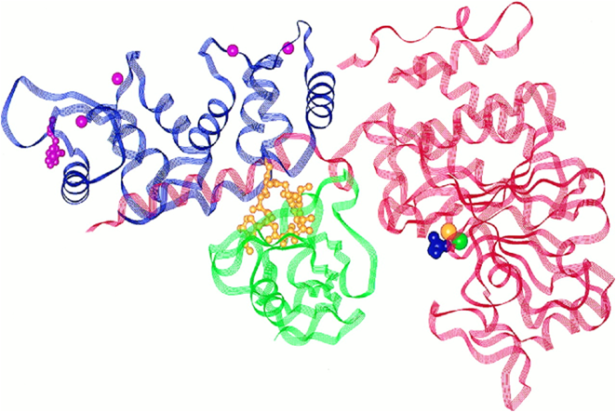
For the love of proteins:
FKBP12 and immunophilins
February 13, 2018
Notes:
Today I will focus on the target for our chemical probe screens during this module – the protein FKBP12 shown here in green and sandwiched nicely in between two subunits of a partner protein protein known as calcineurin. We will talk about multiple functions of FKBP proteins, the compounds that they are known to bind, and how FKBPs have been useful tools in biological engineering applications. Of course, in lab you are already learning how to clone, express, and purify this protein for your downstream studies to evaluate potential ligands for this protein.
This lecture honors Valentine’s day given that the complex is somewhat famous for the two subunits of calcineurin resembling a heart enveloping our target FKBP12. More importantly, one of the key functions of FKBP12 is to bind to other proteins and to several immunosuppressive molecules… hence the name immunophilins, coming for the greek word for friend.

Slide 2
Our target protein: FKBP12
108 amino acids
FK-506 Binding Protein that is 12 kilodaltons
Notes:
FKBP12 contains the hallmark secondary structures – a alpha-helix, some beta-strands, and less structured loop regions.
Let’s take a deeper dive into the name starting with the 12 kDa. Do you think FKBP12 is a small or large protein?

Slide 3
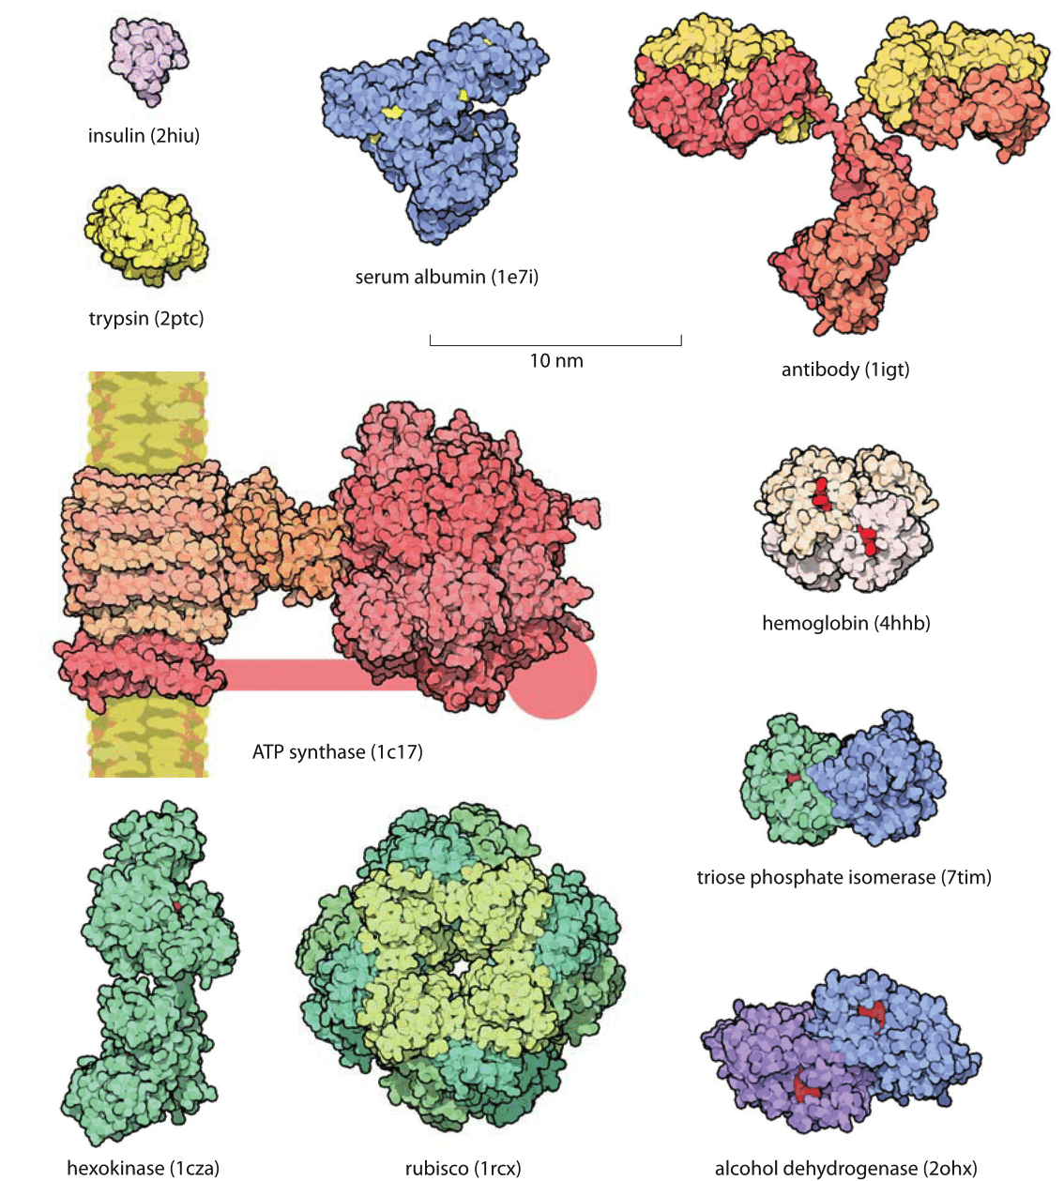
How big is the typical protein?
fkbp12
12 kDa
hexokinase
102 kDa
immunoglobulin G
150 kDa
ATP synthase complex
>500 kDa
hemoglobin
64.5 kDa
insulin
5.8 kDa
trypsin
23.3 kDa
Notes:
Let’s look at some data from a 2001 paper from Trends in Genetics that provides distributions of proteins based on predicted genomic length (not necessarily the full proteome based on splice variants as we spoke about in the last lecture). First, you will notice that the median predicted protein length, based on genomic length, varies across these three organisms. It turns out that FKBP12 at 108 amino acids is a pretty small protein.
Most smaller proteins tend to be easier to produce for a variety of reasons related to ease of manipulation in the cloning process as well as behavior in downstream steps of protein purification. Honestly, this is part of the reason we chose to use fkbp12 for this learning exercise.

Slide 4
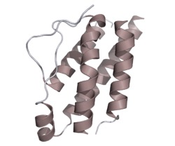

FK-506 is an immunosuppressant drug
blocks T-cell proliferation
inhibits secretion of interleukin-2
FK-506 (Tacrolimus)
inhibits the development of
T-cells for immune responses
eczema and other
skin conditions
transplant rejection
Streptomyces tsukubaensis
inflammatory bowel disorders
Notes:
Okay, let’s take a look at the other part of the name – FK506 otherwise known as tacrolimus. The compound is a 23-membered macrolide lactone that was first discovered from a fermentation broth of a Japanese soil sample that contained the bacterium Streptomyces tsukubaensis. Researchers quickly found that the compound had anti-immune effects as it blocked the development and proliferation of T-cells.
This is an immunosuppressant drug used mainly in organ transplant protocols to lower the risk of organ rejection. The drug is also used for ulcerative colitis, inflammatory bowel disease, eczemas, and vitiligo. It was approved by the FDA for use in liver transplantation protocols in 1994 and was subsequently added to a number of transplant protocols, including corneal graft protocols.
There was much excitement about this compound, and a related natural product called Rapamycin that was isolated on Easter island that had similar effects on T-cells and immune response. So, in the 1990s a couple of labs decided that they wanted to develop a more precise picture of the mechanism of action for this compound. How does it work in cells? What might one of the first questions you would want to answer to understand how it works?

Slide 5
Fishing for the target of FK506
BE student
bait
cellular pond
Notes:
Fishing analog

Slide 6
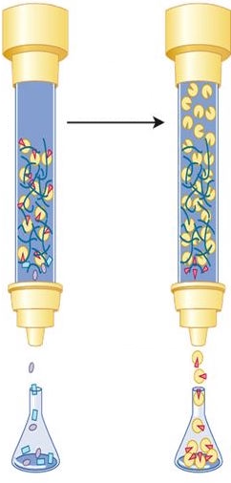

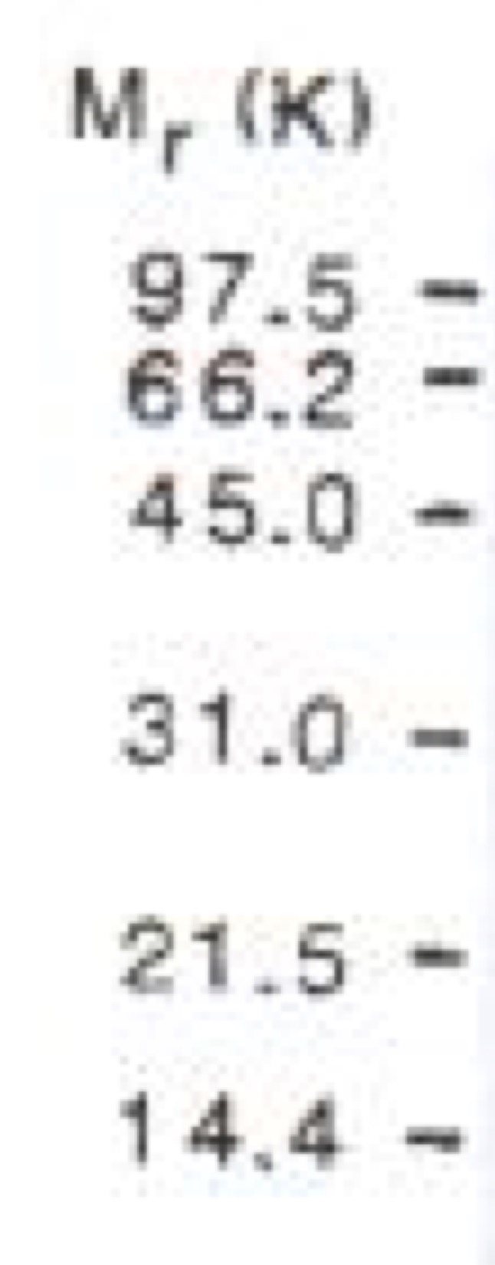
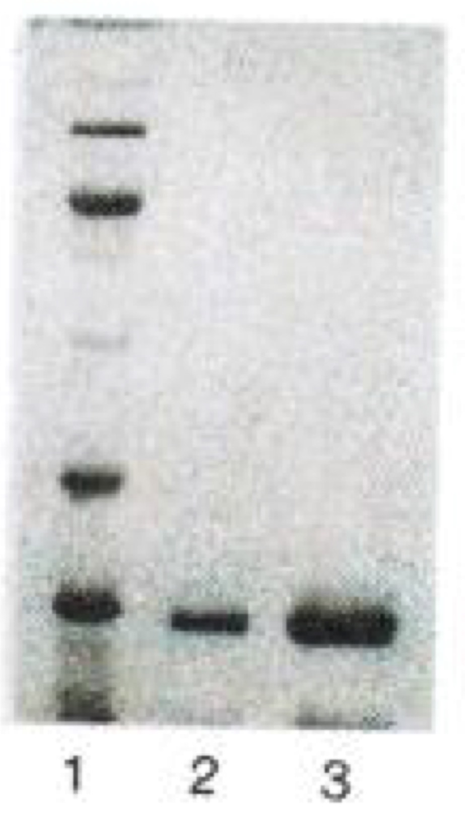
Fishing for the target of FK506
affinity chromatography
add tissue homogenate
couple ‘bait’ to matrix
elute
SDS-PAGE
sepharose
bead
fishing
pole
bait
Harding et al. Nature 341, 758-760 (1989)
Siekierka et al. Nature 341, 755-757 (1989)
Notes:
This elution fraction was evaluated using a method called SDS-PAGE where we resolve the proteins in a sample based on their molecular weights. They found that the sample was quite clean and contained one major band at around 14 kDa. This process is similar in scope to the affinity chromatography method you are using to purify FKBP12 in lab except that you have put a tag on your protein that binds well to Nickel in the matrix.
What do you think the researchers did next?

Slide 7
Fishing for the target of FK506
determining the protein sequence
purified protein
from calf thymus
Edman degradation:
proteolytic fragments
N-terminal sequencing methods
VALENTYN
IHARTMIT
MITRCKS
Notes:
FKBP was was purified to homogeneity from calf thymus using methods on the previous slide. The Schreiber Lab at Harvard used a chemical method called Edman degradation to break apart the intact protein molecule into overlapping fragments coupled to N-terminal sequencing. A general scheme for this process is shown above.

Slide 8
Fishing for the target of FK506
determining the protein sequence
purified protein
from calf thymus
Edman degradation:
proteolytic fragments
108 amino acid peptide chain
(11.8 kilodaltons)
MGVQVETISPGDGRTFPKRGQTCVVHYTGMLEDGKKFDSSRDRNKPFKFVLGKQEVIRGWEEGVAQMSVGQRAKLTISPDYAYGATGHPGIIPPNATLIFDVELLKLE
electrospray mass spectrometry to measure the full mass of purified protein
11.8 kDa
Standaert et al. Nature 346, 671-674 (1990)
Lane et al. Journal of Protein Science 10, 151-160 (1991)
Notes:
Computational analysis of the overlapping fragments produced a 108-amino acid sequence with a predicted molecular weight of just about 11.8 kilodaltons. The team used high resolution electrospray mass spectrometry to determine that the total molecular weight of the protein agreed with the predicted molecular weight based on fragments.
If the predicted MW and observed MW match up, what else does this tell you about the protein? The bovine protein does not appear to have any post-translational modifications such as glycosylation or phosphorylation. Later the team also determined a sequence for the human protein and found that the bovine and human sequences only vary by three amino acids. The team also cloned the human version to make a recombinant version to be used a a broad spectrum of biochemical analyses.

Slide 9
FKBPs are everywhere!
FKBPs encoded in the human genome – domain architectures
MOST ABUNDANT
FKBPs found in the cytoplasm or at cell surface receptors
FKBPs found in both the cytoplasm and nucleus
FKBPs that are anchored to the Endoplasmic Reticulum
FKBPs that can transit to mitochondria and other organelles
Notes:
It turns out that FKBP12 is not the only game in town. There are many FKBP proteins that make up a family. FKBPs have been identified now in most eukaryotes from yeast to humans and in bacteria.
FKBPs are also found throughout the cells. Here I am showing you ‘domain architectures’ for the FKBPs encoded in the human genome. Each protein enjoys a similar naming convention associated with the molecular weight of the protein.
The major cytoplasmic player is FKBP12, the most abundant of all the FKBPs, and it is encoded by 3 distinct transcripts called 12A, 12B, and 12C. They contain identical open reading frames, but vary in abundance and are distinguished by unique 3' untranslated regions. The A and B transcripts increase in abundance when T-cells are activated or stimulated by a signal in vitro. 12A-C are found in a variety of tissues and considered to be ubiquitous, which suggested to early researchers that FKBPs carried out diverse or critical cellular functions.
The other FKBP genes encode proteins with a variety of subcellular localization patterns and additional protein domains that add diversity of function. You will see several proteins here that are considered to be ‘large’ or ‘super’ FKBPs given the multimers of FK506 binding domains in black of the addition of other domains. Some people classify FKBPs based on their cellular locale while others use the Goldilocks rule – separating them into small, medium, and large groupings. A number of FKBPs are anchored at the Endoplasmic Reticulum. Does anyone have an idea for what this might suggest about function? We can come back to this later.
While there are many FKBPs of interest in disease biology, we will focus our module on FKBP12a.

Slide 10
Several drugs bind to FKBP12 with high affinity
anti-immune effects
anti-tumor effects
Notes:
Most of the compounds on this slide fall into a class macrolide antibiotics and were later found to bind to the protein with affinities typically around 1-10 nM. Several of these structurally complex compounds also were shown to have anti-tumorigenic properties which continued to spur on more interest in how this protein works. What is the biochemical role of the protein? What is the cellular role of the protein?
Before we turn to those topics, I want to say a little about the structures on this slide and our project for 20.109. While nature has produced a number of chemical structures that bind to FKBP12, these compounds are large and do not necessarily possess the qualities of compounds that eventually go on to make the most effective drugs. There has been considerable interest in the design or discovery of smaller compounds that act in a similar manner to these compounds, by modulating FKBP12 and other associated targets. We will talk a little more about these efforts later in the course and your project will search for new binders of the protein that might serve as starting points for improved modulators for cell biology or therapeutic purposes.
The existence of these compounds is also very valuable for the execution of our project. Why??
The can serve as positive controls in our screen? We hope that you will be able to ‘re-discover’ these known ligands to the protein!!
So, what are the functions of FKBP12?

Slide 11
FKBP12 is a peptidyl-prolyl isomerase
Proline is
highly constrained
-
Side chain is bonded
to its secondary amine
Nitrogen
FKBP12 (PPIase)
80%
20%
E_{a} ~ 20 kcal/mol
(v. 0.1 kcal/mol for typical peptide)
Enzyme catalyzes rate acceleration
of 10⁶ fold over non-enzymatic
cis-trans isomerization
Notes:
As shown on the free energy diagram here, there is a relatively small free energy difference between the two configurations. However, the activation energy required to catalyze the isomerization between cis and trans is relatively high, approximately 20 kcal/mol. The Ea for a typical peptide bond is only a 0.1 kcal/mol.
Unlike regular peptide bonds, the X-prolyl peptide bond will not adopt the intended conformation spontaneously, thus, the process of cis-trans isomerization can be the rate-limiting step in the protein folding process. A survey of similar PPIase proteins has shown rate accelerations of up to 10^6 fold as compared to nonenzymatic isomerization.

Slide 12
FKBP12 is a molecular chaperone:
enabler of proper protein folding
Notes:
You may recall that molecular chaperones are proteins that folding or unfolding and the assembly or disassembly of other macromolecular structures. Chaperones can be present when the macromolecules perform their normal biological functions and have correctly completed the processes of folding and/or assembly.

Slide 13
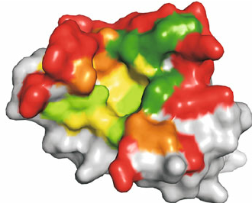
FKBPs are ‘downstream’ chaperones
Bacteria
Eukaryotes
folded
protein
FKBP
folded
protein
folded
protein
FKBP
folded
protein
FKBP
FKBP
folded
protein
folded
protein
folded
protein
FKBP
FKBP
FKBP
Notes:
In bacteria (left) and eukaryotes (right), chaperones that function in stabilizing nascent polypeptides on ribosomes and in initiating folding cooperate with machinery that acts downstream in completing folding. You may have already studied the major systems that mediate this process in other classes, including the heat shock protein system or the GroEL-GroES molecular machines. If not, don’t worry. You’ll likely to get to hear about these systems from a thermodynamic standpoint later on in advanced BE classes. For this class, I simply want to point out that FKBP12 is called a downstream chaperone. This means that the protein often acts at the very end of a folding pathway working in concert with the major folding machinery or staying nearby folded proteins that are ready to execute a function.
Okay given this knowledge about the role of FKBP in protein folding, which disease or diseases do you think are impacted by FKBP?

Slide 14
FKBPs in diseases of protein folding
misfolded
protein
protein plaques
protein
protein
aggregates
higher FKBP52
=
lower Tau aggregation
Notes:
A number of common neurodegenerative diseases involve this mechanism although the proteins that form plaques can vary from disease to disease. Plaques, or amyloids, can also be found in diseases affecting the heart and liver too. An emerging hypothesis is that FKBPs that are defective may play a role in misfolding, namely in Alzheimer’s and Parkinson’s given recent associations between FKBPs and the Tau protein. Researchers have also found that if FKBP levels are higher, mostly FKBP52, the accumulation of aggregated Tau levels is decreased and neurite outgrowth was altered.

Slide 15
FKBP12 ‘gains a function’ to inhibit T-cell activity
GOF
GOF
nutrient/energy/redox sensor
protein synthesis
IL-2 synthesis
Notes:
As I mentioned previously, FKBP12 is notable in humans for binding to immunosuppressant molecules such as FK506 or Rapamycin. FKBP12 is normally a monomer but upon binding to one of these small molecules the protein forms complex that is able to make a new complex with other proteins. On the left, we see that the FK506-FKBP12 complex will inhibit a phosphatase called Calcineurin (CaN), thus blocking signal transduction in the T-lymphocyte transduction pathway. Inhibiting calcineurin impacts the ability of a transcription factor called NFAT to regulate expression of IL-2, a critical molecule in regulating the immune system. Therefore, the immunosuppressive activities of FK506 are not thought to be related to the prolyl isomerase activity. This is called a drug-induced gain of function. FKBP12 does not normally interact with calcineurin. The compound induces a gain of function for FKBP12 that impacts downstream cellular processes and ultimately cell fate with therapeutic consequences.
A similar situation occurs when Rapamycin binds to FKBP12. The complex binds to a protein called mTOR (mechanistic Target of Rapamycin). This diagram greatly simplifies the extraordinarily rich molecular and cellular biology surrounding both calcineurin and mTOR. Our own David Sabatini, Professor Biology at the Whitehead Institute, is one of the researcher who really elucidated the biology around mTOR both during his time as a trainee at Johns Hopkins and here at MIT. mTOR is a kinase that comes together with other proteins to form two major complexes – mTORC1 and mTORC2, which regulate distinct cellular processes. The two complexes actually localize to different paths of the cell, thus affecting their activity and function. In general, it is a Ser/Thr kinase that acts on other proteins. In both complexes, mTOR regulates cell growth and proliferation, cell motility, and protein synthesis, among other functions. As shown on this diagram, the Rapamycin/FKBP12 complex modulates mTORC1, which is involved in a broad spectrum of cellular function, most notably as a metabolic sensor. mTORC1 regulates IL-2 synthesis like Calcineurin so this is how both FK506 and Rapamycin modulate T-cell activity for their immunosuppressive effects but the complex biology around mTOR means that Rapamycin treatment is used for other purposes and there are additional metabolic side effects associated with its use, including the development of diabetes.
Gains of function are useful tools in the biological engineer’s toolbox. We’ll say more about that in a second and later in the module.

Slide 16
FKBP12 ‘ternary’ complexes
Rapamycin and mTOR
FKBP12
FKBP12
K_{D} ~ 0.5 nM
FRB of mTOR
FRB of mTOR
rapamycin
K_{D} ~ 26 µM
K_{D} ~ 12 nM
Choi et al. Science, 273, 239-42 (1996)
Banaszynski, Liu, and Wandless, J. Am. Chem Soc., 127, 4815-21 (2005)
PDB entry:
1NSG
Notes:
The complexes of FKBP12 with small molecule ligand and partner proteins are called ternary complexes. I showed you an example of this on our heart intro slide for FKBP12-fk506-Calcineurin. Here we are looking at the ternary complex involving rapamycin and a domain of mTOR. The domain of mTOR that binds to rapamycin is often referred to as the FRB domain – F meaning FKBP12, R meaning rapamycin, B meaning Binding. You will see that the compound is enveloped nicely in between the two proteins. Rapamycin first binds to FKBP12 with tight dissociation constant (0.5 nM). Remember that the lower the constant the better. This can be confusing. I usually say with high affinity but the lower the dissociation constant, the higher the affinity. Just be mindful of this when people talk about the strength of molecular interactions. Rapamycin can actually bind to FRB alone, but it is a very weak interaction at 26 µM. The FKBP12-Rapamycin complex binds to FRB with high affinity again – 12 nM. The interaction of FRB and FKBP12 without compound is negligible, with an affinity >50 µM.

Slide 17
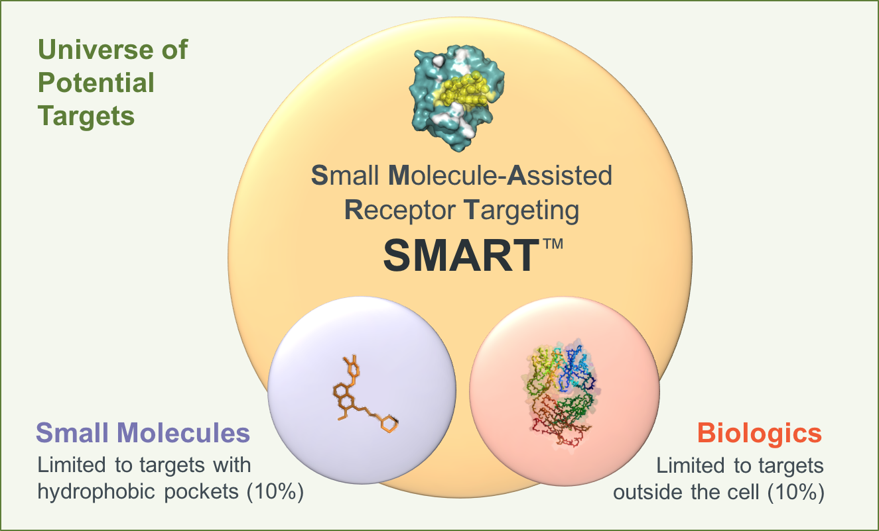
Drugging the ‘undruggable’ through GOF
Greg Verdine, Harvard
George Church, Harvard
Jim Wells, UCSF
Notes:
Druggability - shape complementarity is the rule of the game. Some will argue that ~80% of all proteins are ‘undruggable’ for a variety of reasons. Undruggable does not necessarily mean that the proteins will make bad targets but that we have not yet found pinches of magic dust that bind and modulate their function. We will come back to this in the next lecture. Some proteins are too floppy or too rigid for the traditional approaches to drug discovery involving small molecules. Biologic drugs, usually meaning protein tools or antibodies, are fabulous when it comes to making high affinity and selective interactions with other proteins. They have been very very successful for targeting extracellular proteins. These large biologic molecule experience great difficulty when it comes to entering a cell and modulating an intracellular target. They are often typically not capable of transiting through the cell membrane via active (receptor-mediated trafficking) or passive mechanisms (e.g. diffusion). These molecules require special tricks to deliver them to the inside of a cell. This is a very, very, very hot area of research in many labs at MIT, especially in the Biological and Chemical Engineering Departments.
Verdine, Wells, and Church decided that they wanted to take on the challenge of ‘undruggability’ making use of this gain of functions, initially using FKBP12. The called the technology SMART.

Slide 18
SMARTTM – small molecule-assisted receptor targeting
Novel molecules that you find during this class may serve as new starting points for this concept, providing new molecular interfaces with FKBP12 that can be used to engage a new proteins through design or screening
Notes:
Rapamycin is the natural prototypical SMART drug. It enters cells and forms a complex with FKBP that can then bind a flat undruggable surface on mTOR with high affinity and selectivity. This leads to inhibition of mTOR activity.
The initial focus of Warp Drive Bio’s SMART discovery efforts is a series of drugs that antagonize RAS in various states and mutant forms. Although RAS has been studied for decades it is a target that has been undruggable to date. The long-term goal of the Warp Drive Bio RAS program is to obtain durable treatment responses in the ~30 percent of cancer patients with RAS-driven disease.

Slide 19
FKBP12 as a tool for biological engineering
controlling transcription

Slide 20
FKBP12 as a tool for biological engineering
inducing protein degradation

Slide 21
FKBP12 as a tool for biological engineering
induced genome editing

Slide 22
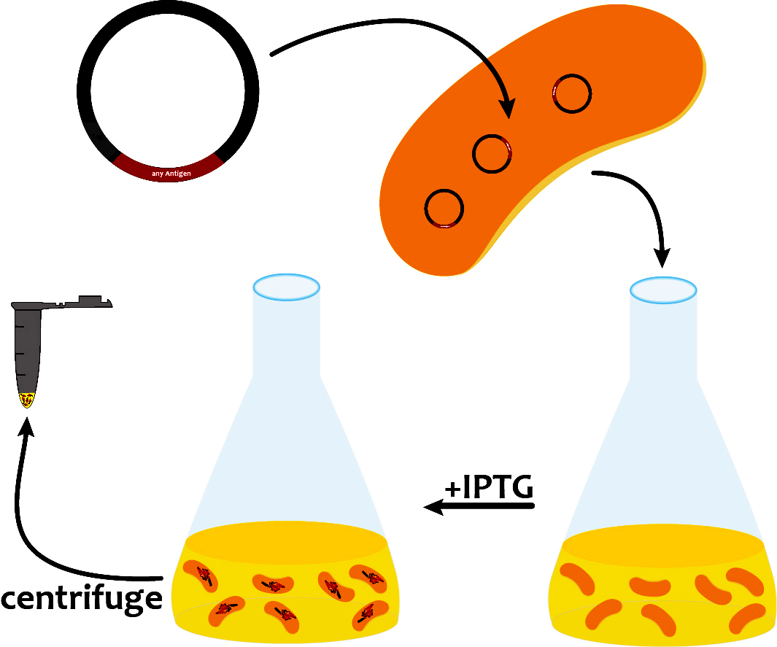
Our path to evaluate FKBP12 ligands
+
in silico cloning; overexpress FKBP12
lab days 1 & 2
purify and analyze FKBP12
lab days 3 and 4
re-analyze screen data
lab day 2
IC₅₀ = X µM
ΔT = Y °C
test FKBP12 and ligands
in enzyme activity assay
lab day 5
test ligands in FKBP12
binding assay
lab day 6
complete data analysis
prioritize best ligands
lab day 7
Notes:
Visual journey build slide

Slide 23
Our path to evaluate ligands - lectures
2/8/17 Lecture 1 Intro to chemical biology: small molecules, probes, and screens
2/13/17 Lecture 2 For the love of proteins: FKBP12 and immunophilins
2/15/17 Lecture 3 Small-molecule microarrays
2/21/17 No Lecture
2/22/17 Lecture 4 Quantitative evaluation of protein-ligand interactions
2/27/17 Lecture 5 A ligand discovery vignette: sonic hedgehog
3/1/17 Lecture 6 Engineering transcriptional responses with a small molecule
3/7/17 Lecture 7 Wrap up discussion: suggestions for how to report your findings

