Slide 1
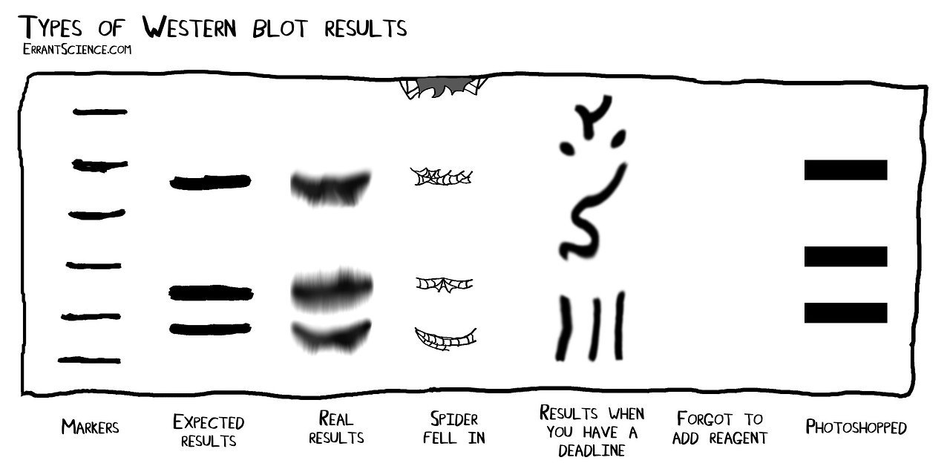
M1D4: Confirm purified protein using Western blot
Comm Lab workshop
Prelab discussion
Electrophorese and transfer purified protein
Participate in paper discussion
02/23/23

Slide 2
Overview of Mod 1 experiments:

Slide 3
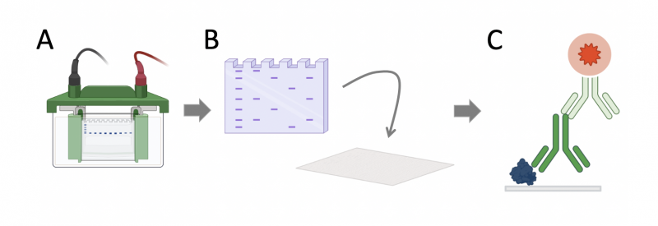
Western blots probe for specific proteins
1
2
3
separate proteins using electrophoresis
transfer proteins onto nitrocellulose membrane
probe membrane using antibodies
Pro and con of the Western blot vs Coomassie staining?

Slide 4
Step 1: separate proteins using electrophoresis
SDS-PAGE used to separate proteins
How does adding Laemmli buffer and boiling change protein structure?
What determines how far a protein migrates in a polyacrylamide gel?
Notes:
SDS and B-mercaptoethanol
Boiled
Negatively charged linear fragments—separated by size in polyacrylamide gel
SDS: surfactant / detergent denatures proteins, coats them with negative charge
β-mercaptoethanol reduces disulfide bonds
bromophenol blue
Glycerol
https://www.nationaldiagnostics.com/electrophoresis/article/multiphasic-buffer-systems
Stacking gel is on top of the separating gel
Cl- ions are green circles
Due to pH of stacking gel, glycine ions become zwitterionic and not that mobile in that layer
The chloride ions don't move far before they leave behind an area of unbalanced positive counter ions. A steep voltage gradient develops, the Kohlrausch discontinuity, which pulls the glycine along so that the chloride and glycine ions become successive fronts moving at the same speed. The ion fronts sweep through the sample molecules. Being intermediate in their mobility between chloride and glycine, the sample molecules are carried along becoming "stacked" into very thin, distinct layers in order of electrophoretic mobility.

Slide 5
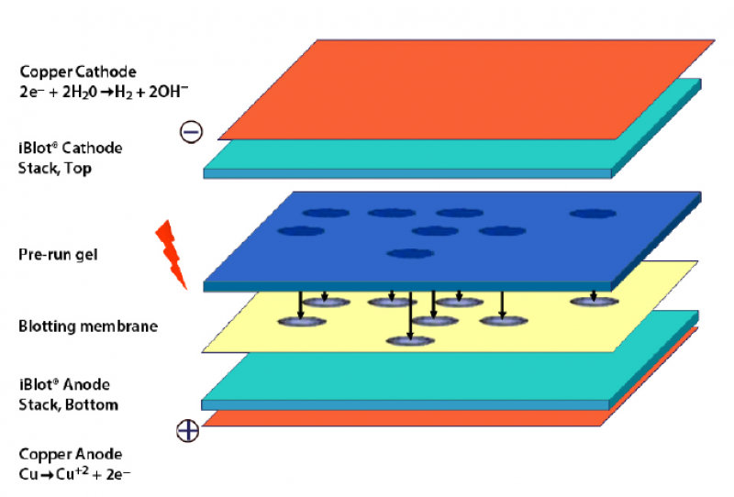
Step 2: transfer proteins onto nitrocellulose membrane
Protein bands from polyacrylamide gel transferred to a nitrocellulose membrane via applying a current
Why is it necessary to transfer proteins onto a membrane?

Slide 6
Step 3: probe membrane using antibodies
Primary – Mouse IgG anti-MAX
Secondary – Goat anti-Mouse IgG
Primary antibody raised against protein of interest to identify band that corresponds to specific protein on the blot
Secondary antibody raised against the species of the primary antibody to visualize band that corresponds to specific protein of interest
Why use a secondary antibody (rather than a labeled primary antibody)?

Slide 7
For today…
Class divided into two groups
Pink Yellow Blue will start on Western blot
Green, Red, Orange, Purple will start with paper discussion
For M1D5…
Revise due M1D3 homework using feedback and workshop materials
Draft outline of script for Research talk

Slide 8
Mini-presentation due Saturday, March 4
Prepare a video of you verbally discussing your research
Use any device or Zoom
No visuals / slides
Do not edit / splice the video
Submit to Gmail account!
bioeng20.109@gmail.com
Remember to follow file name guidelines

Slide 9
Presentation should be 3 min (+/- 15 sec)
Introduce yourself
Provide important background information
Describe key results
Briefly describe critical methods used to generate important data
Use quantitative descriptions when discussing results
Highlight the take-home message

Slide 10
What data / results should be included?
Protein purification
Protein purity and concentration
Western blot results (Include as a placeholder in your next homework)

Slide 11
Review assignment description on wiki

