Slide 1
Biomaterials Engineering
M3D1
11.16.10

Slide 3
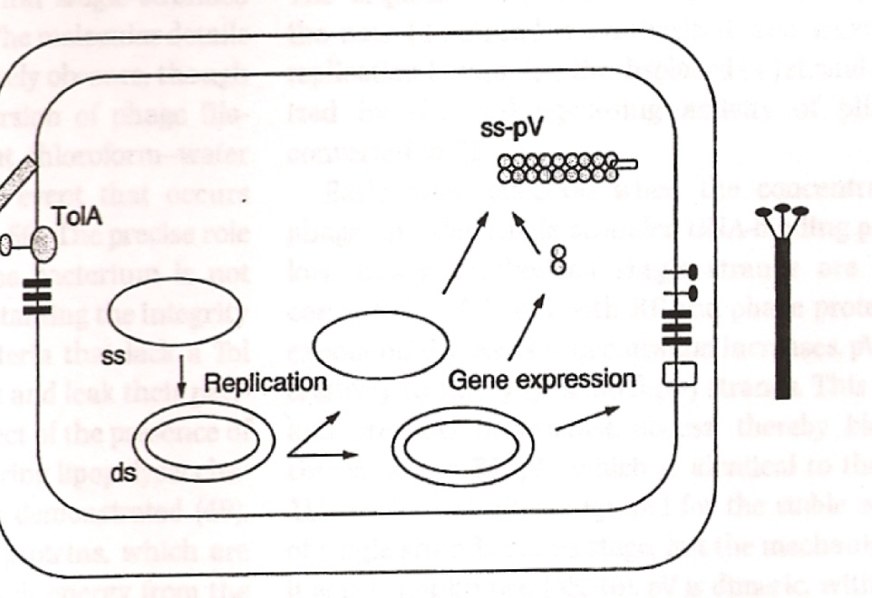
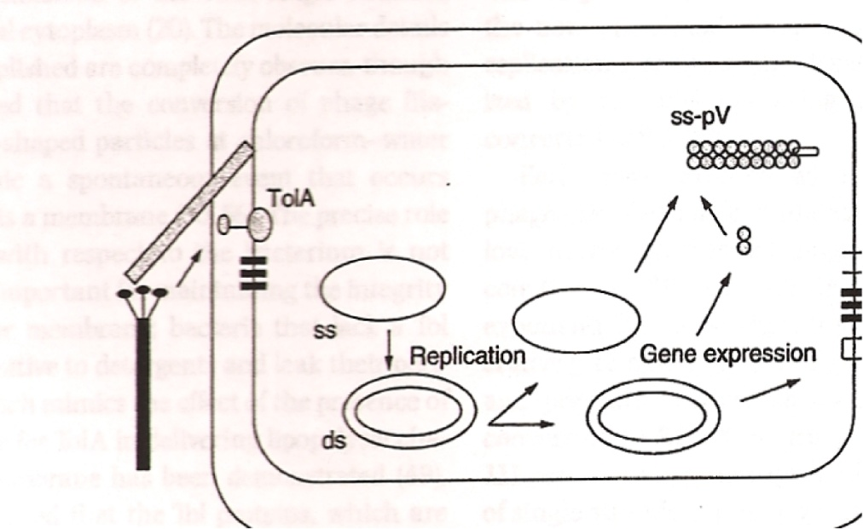
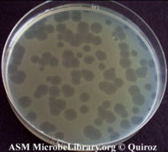
BioMaterials: Starting with “Bio”
PFU =

Slide 5
BioMaterials: now for “materials”
Why bother with nanowires? Why not just gold or silver as anode?
Upper Assembly
Plastic
O-Ring
Lithium (s)
Electrolyte
2 x Polymer Separators
Electrolyte
Electrode
Copper Foil – Current Collector
Steel Spacer
Lower Assembly
Active material = gold nanowires +/- silver
Slide from John Burpo

Slide 6
Part 1: making solutions for phage+gold
All groups make CTAB
Solution to make | Team
Gold | Red, Blue
Silver | Orange, Pink
Ascorbic Acid | Yellow, Grape
Salt (NaCl) | Green, Silver
Do these calculations and make these solutions after you start part 2

