Slide 1
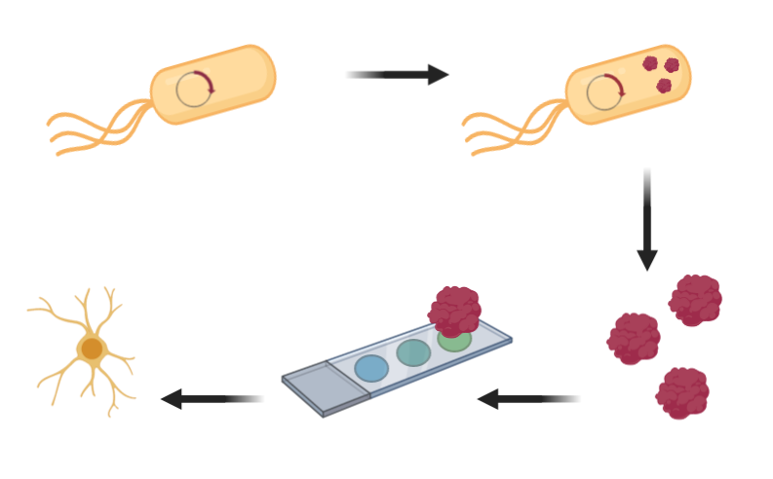
induce protein expression
BL21(A1) pET_MBP_SNAP_TDP43-RRM12
purify and
evaluate protein
test small molecules
screen small molecules

