Slide 1

Wrapping Up Module 1
April 22, 2021
Data Summary Assignment
March 5, 2024
Notes:
NEW IMAGE

Slide 2
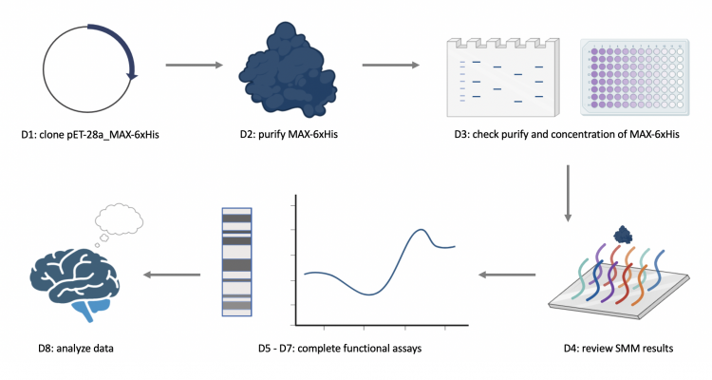
Module 1 experimental path from Wiki
Notes:
Visual journey build slide

Slide 3
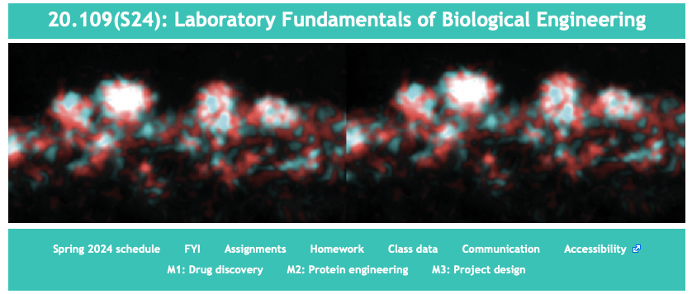
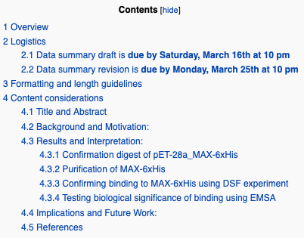
Mod1 Assignment – Data Summary
The course Wiki sums up the assignment details –
scope, formatting, length, etc.
Notes:
THE MOST IMPORTANT MESSAGE FOR TODAY – EVERYTHING YOU NEED IS ON THE WIKI TO GET STARTED

Slide 4
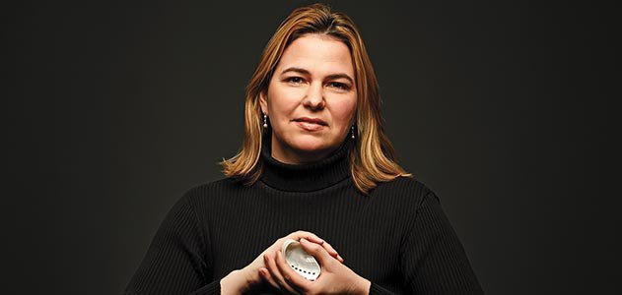
Module 1 Data Summary
thorough summary of your data and figures with supporting text –
include context so that a scientifically literate reader can understand
the work and its broader implications
The figure format is similar to a scientific journal article, but the traditional Results and Discussion sections are to be condensed into succinct bullet form accompanying each figure
you will complete the assignment with your lab partner

Slide 5
Data Summary Due Dates
Draft data summary – due Saturday, March 16th by 10 PM
Submissions read by instructional staff with feedback and a
preliminary grade, which can be improved in a revised report
Comments provided by March 20th
Data summary revision – due Monday March 25th by 10 PM
Instructions on how to incorporate changes are posted on the Wiki
Notes:
Prof. Koehler and Dr. Noreen Lyell will comment on your submission and assign it a grade. The BE Communication Instructor, Dr. Prerna Bhargava, will provide feedback concerning the Title and Abstract and also assign the grade for this portion of the assignment. You will receive all comments on Wednesday, March 22nd.
You will then have the opportunity to revise your report for up to a one and one-third letter grade improvement. In other words, a C can be revised up to a B+, a C+ to an A-, a B- to an A, etc.
For your final report, all changes need to be in a different colored font so the improvements you made are clear. You should also include a cover letter with your final draft that explains how you addressed the concerns raised (e.g. "paragraph x was completely rewritten to better explain….” or “Results for the agarose gel analysis were clarified by ….").

Slide 6
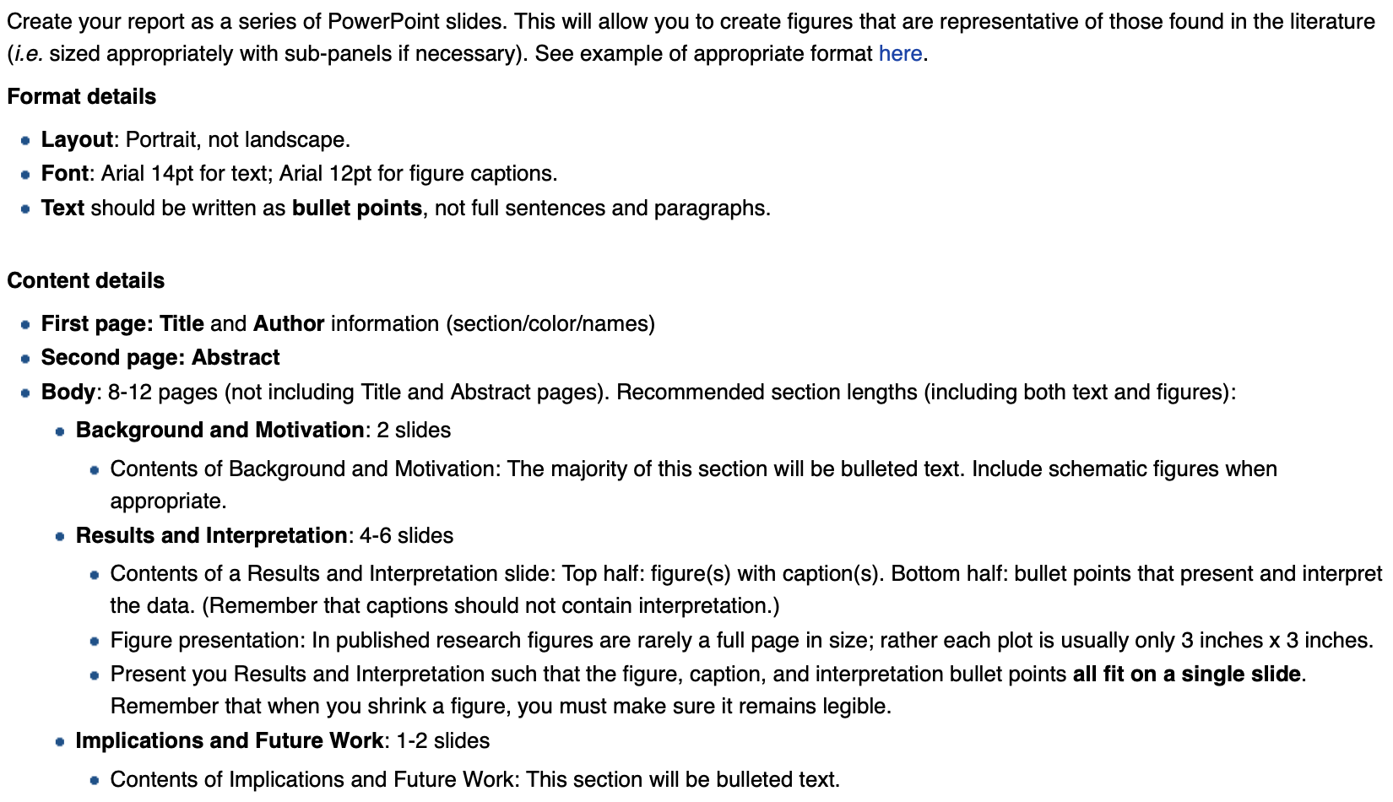
Data Summary for Module 1
format and content guidelines – see Wiki

Slide 7
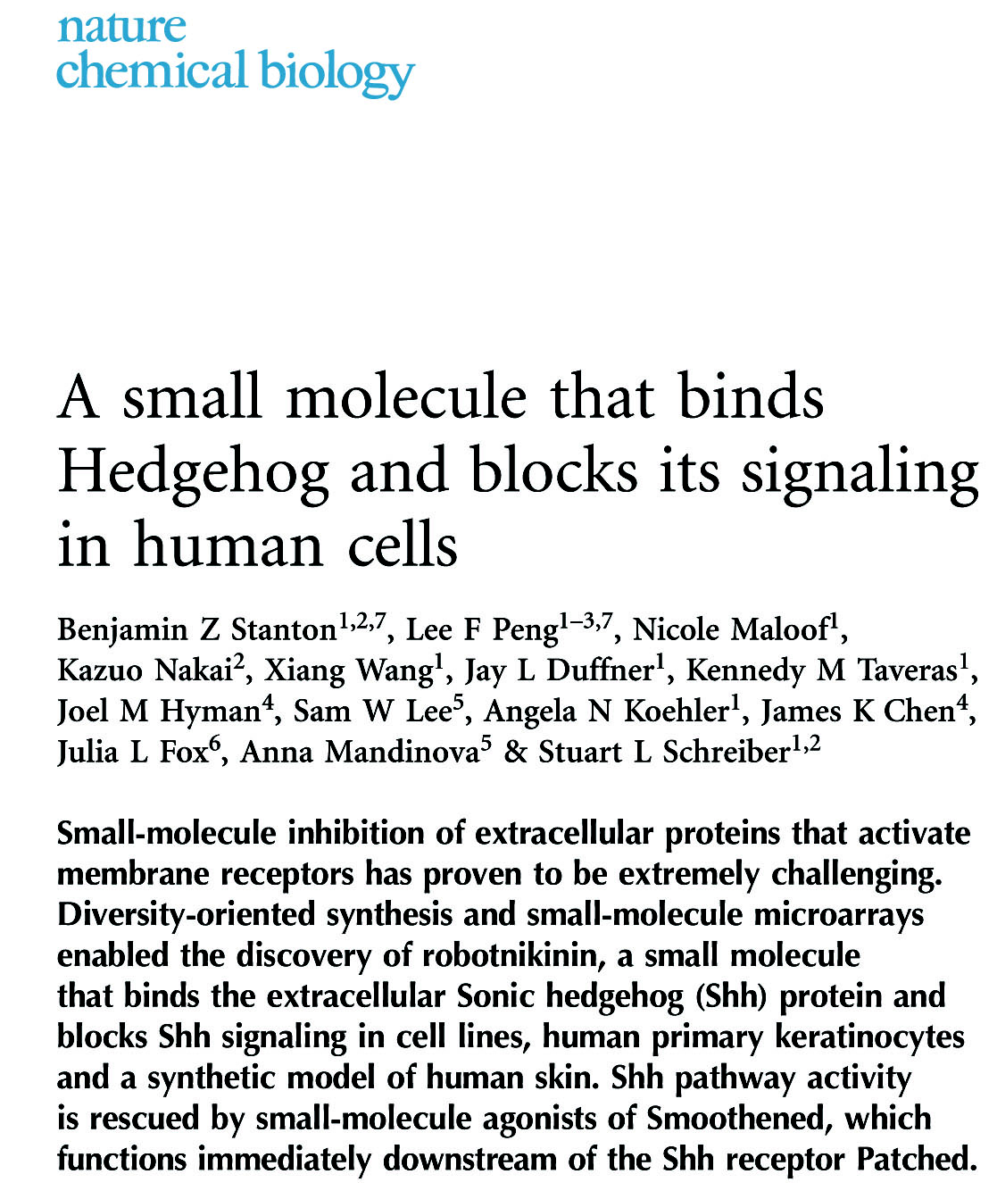
Data Summary for Module 1
scientific abstract
Please review Title and Abstract slides from
BE Comm Lab workshop
Notes:
Individuality

Slide 8
Background and Motivation
suggested topics or figures
Topic: Introduce and discuss the importance of chemical probes in biology, research, and/or medicine
Topic: Introduce and discuss the roles of MAX in biology and/or disease
What are MAX’s roles?
Why is it an interesting protein from a therapeutic perspective?
Which functions of MAX would you like to perturb?
How are SMMs useful as a screening tool for MAX?
What did the students from Spring 2023 do to set up your path?
Schematic: Experimental approach - clear and simple summary of your strategy involving DSF and EMSA methods (something similar in scope to Wiki figure)
Topic: Discuss your experimental goal

Slide 9
Results and Interpretation
suggested topics or figures
Confirmation digest of pET-28a_MAX-6XHis
Topic: Evaluation of construct
Figure: Image of agarose gel results
Protein purification for MAX-6xHis
Schematic: Experimental design
Do not include minor technical details that are not necessary to understand the goal of the experiment
Topic: Evaluation of purity and concentration
Figure: Image of polyacrylamide gel results
Figure: Graph displaying BCA assay results
Notes:
FOR SCHEMES - Do not include minor technical details that are not necessary to understand the goal of the experiment. Avoid clutter.

Slide 10
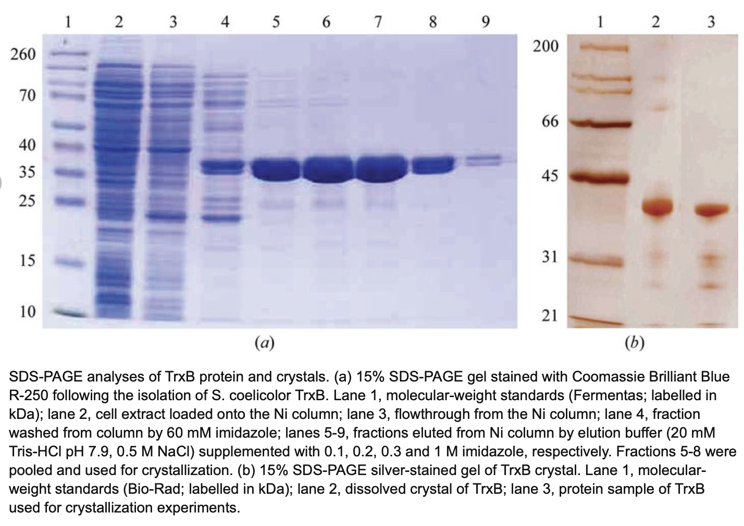

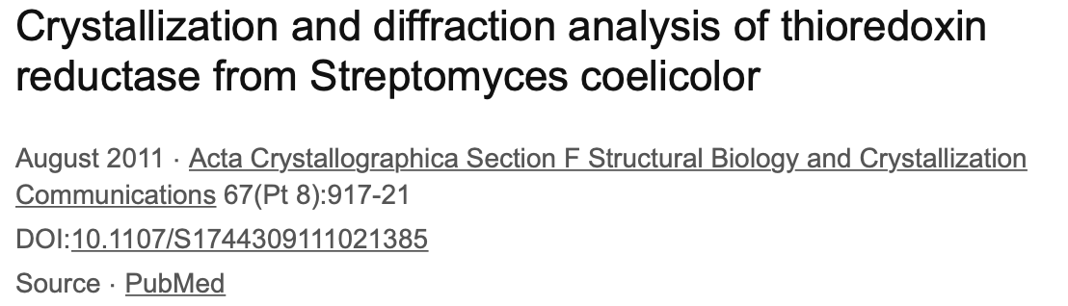
Nice example of a figure: Please include captions, labels

Slide 11
Results and Interpretation
suggested topics or figures
Confirmation of binding to MAX-6xHis using DSF
Schematic: Experimental approach
Topic: Confirmation of binding results using shifts in melting temperature of MAX.
Figure: Graphs of melting curves
Testing biological significance of binding using EMSA
Schematic: Experimental approach
Topic: Effect of small molecules on MYC-MAX interaction
Figure: Images of gel shift data
Notes:
FOR SCHEMES - Do not include minor technical details that are not necessary to understand the goal of the experiment. Avoid clutter.

Slide 12
Implications and Future Work
Why is your work impactful and what would you do next?
Topic: What are the main conclusions from your experiments?
Topic: How do the main conclusions answer the research question?
Topic: Did your results match anticipated results?
If NO, please provide an explanation of why this might be the case.
If YES, can you further evaluate your hypothesis using other experimental strategies that we talked about in class?
Topic: Based on your results, whether they matched expectations or not, what experiments would you suggest as next steps?
Follow-up experiments could distinguish between competing explanations of a given outcome or broaden the sample set for a question you already asked, to give just two examples.

Slide 13
Implications and Future Work
Why is your work impactful and what would you do next?
Topic: What are the limitations of your experimental approach?
Topic: How might your experimental approach be improved?

Slide 14
A Note on References
Please make References a separate section at the end of the article
References are generally used in the Introduction and Discussion sections to support any claims that are not common knowledge.
For this class, you should list the references alphabetically by the first author's last name. Include all the authors, the title, the name of the journal in which it was published, the year of publication, the volume number, and page numbers. Please use the example below as a guide:
Pavletich NP, Pabo CO. Zinc finger-DNA recognition: crystal structure of a Zif268-DNA complex at 2.1 Å. Science 1991; 252:809-817.
In the body of your report, this article would be cited as follows:
"The crystal structure of the Zif268-DNA complex has been solved (Pavletich 1991).”
If two or more articles can be cited for this finding, then they are listed alphabetically, separated by a comma.
Notes:
The data is what the data is

Slide 15
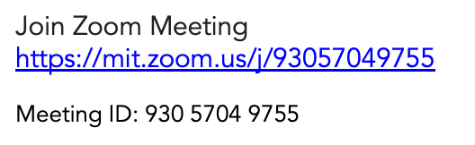
Office Hours
Simple Questions: koehler@mit.edu
Office Hour Dates/Times (via zoom)
Monday, March 11th, 3-4pm
Friday March 15th, 12-1pm
Friday, March 22nd, 12-1pm
Notes:
The data is what the data is

Slide 16

HAVE FUN WITH THIS ASSIGNMENT
USE YOUR CREATIVITY

