Slide 1
Welcome to 20.109!
Fundamentals of Biological Engineering
2/2/16

Slide 2
An introduction to 20.109
Meet the team
Core mission
Building a better bioengineer
Modular structure
Module 1: Protein Engineering
Module 2: System Engineering
Module 3: Biomaterial Engineering
Logistics

Slide 3
Meet the 20.109 teaching team
Lecture / laboratory
Dr. Noreen Lyell (M1)
Prof. Leona Samson (M2)
Prof. Angela Belcher (M3)
Dr. Leslie McClain (T/R)
Dr. Maxine Jonas (W/F)
Communications
Dr. Diana Chien
Dr. Vivian Siegel
Teaching assistant
Jing Zhang
Research assistants
Dr. Jifa Qi
George Sun

Slide 4
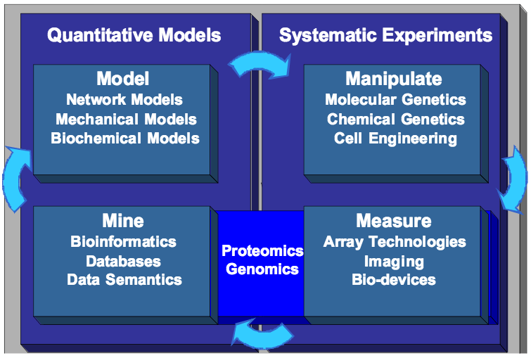
Core mission of BE department
Definition of BE from Prof. Doug Lauffenburger

Slide 5
Core mission of 20.109
To prepare students to be the future of Biological Engineering
To teach cutting edge research skill and technology through an authentic research experience
To inspire rigorous data analysis and its thoughtful communication

Slide 6
Modular structure of 20.109
Module 1: Protein Engineering (Dr. Noreen Lyell)
Module 2: System Engineering (Prof. Leona Samson)
Module 3: Biomaterials Engineering (Prof. Angela Belcher)

Slide 7
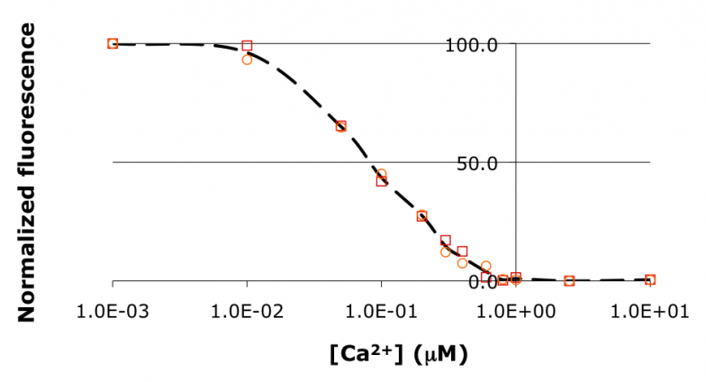
Module 1: Protein Engineering
Experiments
Generate point mutations in calcium binding protein
Measure response to calcium
Lab skills
Manipulate protein sequences
Protein purification and titration assays

Slide 8
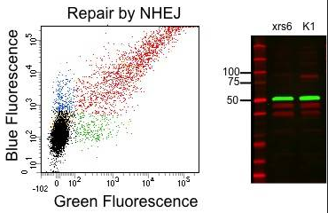
Module 2: System Engineering
Experiments
Measure DNA repair with a genetically engineered sensor
Quantify effects of drugs on DNA repair
Lab skills
Mammalian tissue culture
Experimental design
Transfection of mammalian cells and flow cytometry

Slide 9
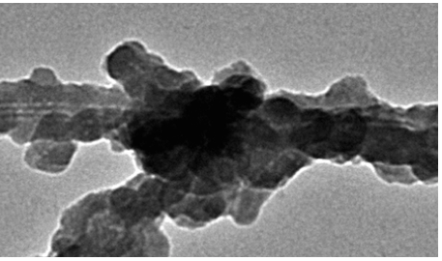
Module 3: Biomaterials Engineering
Experiments
Mineralize phage surface with nanoparticles
Use TEM to visualize structure
Assemble and test batteries
Lab skills
Bacteriophage M13 material production
Fabrication of bio-based devices

Slide 10
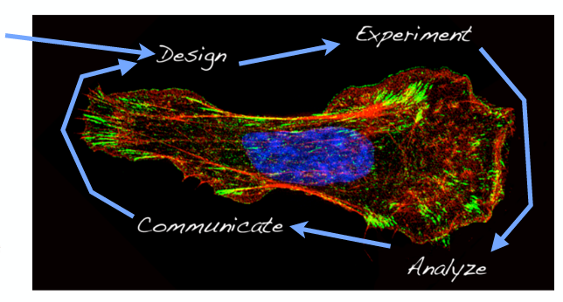
Workflow in 20.109
We start here…
But, you can’t design an experiment without analyzing some data!

Slide 11
Workflow in 20.109
Research
We start here…
But, you can’t design an experiment without analyzing some data!

Slide 12
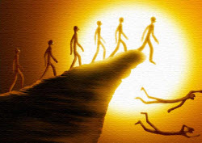
Experiments in 20.109
We aim to prevent ‘just follow the protocol’ syndrome

Slide 13
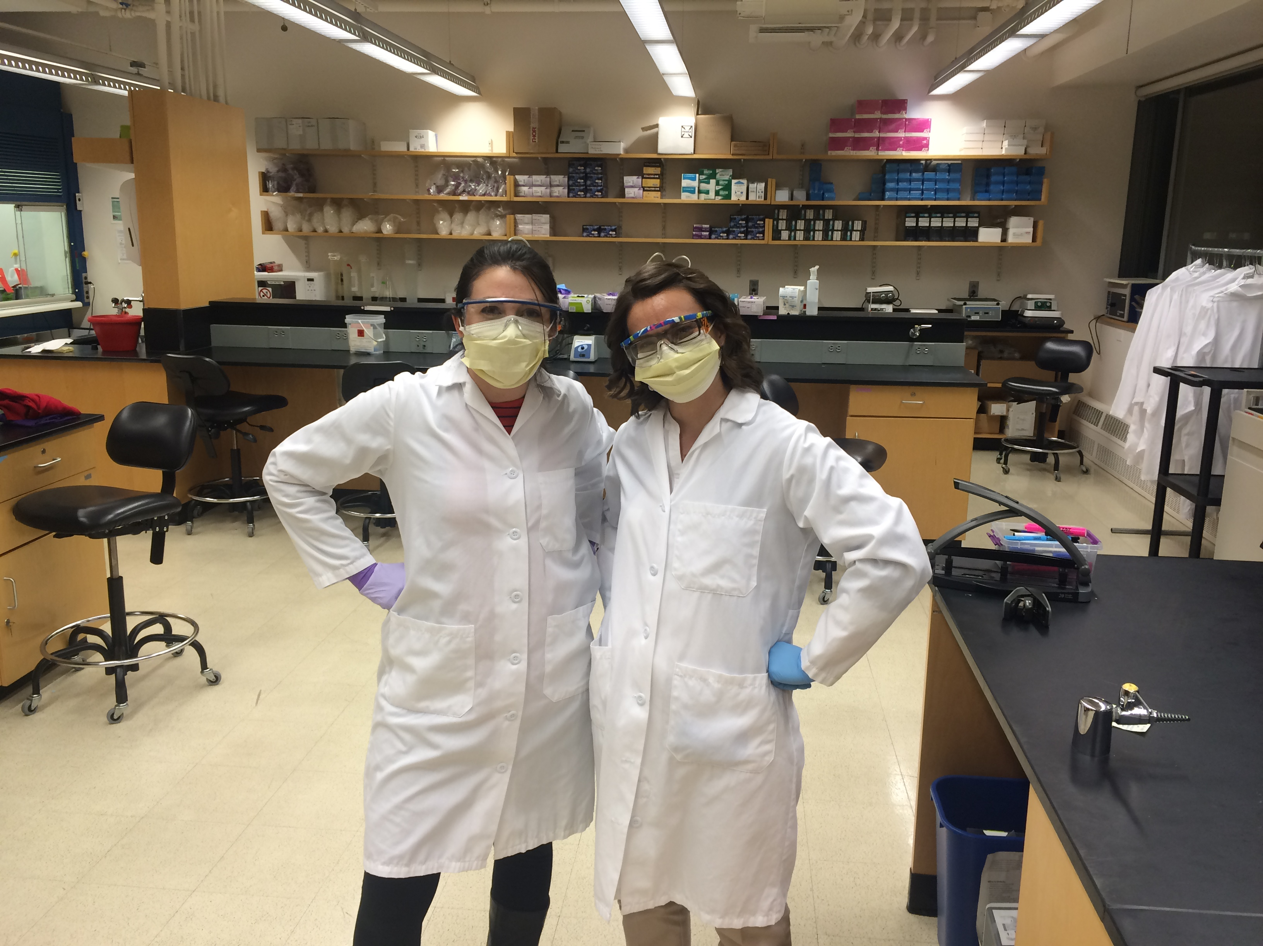
Experiments in 20.109
We do relevant and cutting edge science…
and we do it safely!!

Slide 14
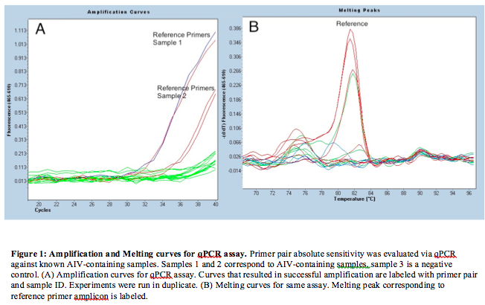
Experiments in 20.109
We analyze real and novel data

Slide 15
Written and oral communication
Written communication assignments = 45%
Oral communication assignments = 35%
Daily work and participation = 20%

Slide 16
Why communicate your science?
http://nrelscience.org/2013/09/26/why-scientists-should-tell-more-stories/

Slide 17
Why scientists should tell more stories
“Story is the number one way we learn from past experiences, to be better people, and share in experiences. Yet as scientists we feel the need to separate ourselves from this proven method of communication…
…encourage the use of narrative in science, but with caution. I would argue that narrative is imperative for science communication. Data already incorporates a narrative; we just need to find ways to bring it to light.”

Slide 18
We are here to help
BE Communications Lab
Instructors
Dr. Diana Chien
Dr. Vivian Siegel
Writing fellows
20.109 Teaching faculty

Slide 19
Course logistics
Lectures
Tuesday and Thursday 11-12p in 16-220
Dr. Lyell➔ Prof. Samson➔ Prof. Belcher
Laboratory sections
Tuesday and Thursday 1-5p in 56-322
Wednesday and Friday 1-5p in 56-322
Details
You will work in pairs throughout the semester
Collaboration with integrity is key

Slide 20
Expectations
Your expectations of us…
We will come to class and laboratory prepared
We will be clear and reasonable in all assignments
We will treat every 109er with respect
We will give everyone equal chance at success

Slide 21
Expectations
Our expectations of you…
You will come to class
You will be prepared for lecture and laboratory
You will not interfere with each other’s learning
You will invest the very best of yourself
You will be honest with your peers and the teaching faculty

Slide 22
Our goals for you
Organize a constructive laboratory notebook
Implement laboratory protocols and troubleshoot
Interpret and analyze data
Recognize the utility of models and assays
Critically examine scientific literature
Communicate your science
Work as a team
Provide constructive and helpful feedback

Slide 23
Final notes
Please arrive to laboratory today and tomorrow on time
Damon from EHS will be delivering a training presentation
Please wear/bring pants and closed toed shoes
We will be working in the lab

