Slide 1
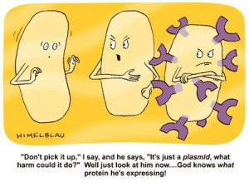
M1D3: Induce and purify TDP43 protein
Prelab discussion #1
Protein purification
Prelab discussion #2
“Don’t pick it up,” I say, and he says, “It’s just a plasmid, what harm could it do?” Well just look at him now…who knows what protein he’s expressing!

Slide 2
Get started on protein purification
Have a pellet of bacterial cells which express TDP43_RRM12
Resuspend pellet in lysis buffer (come and lyse cells for 15 minutes on nutator at front bench
During lysis, Tyler will show you how to prepare column
Divide material from cell lysis between 2 Eppendorf tubes and bring to front bench
Lysed cells will be centrifuged for 30 minutes to separate soluble protein
During centrifugation, prepare nickel resin, wash buffer, elution buffer
Remove 30ul of supernatant and place in fresh Eppendorf tube
Add remaining supernatant to nickel resin and incubate for 2 hours
Prelab and Assignment lectures during this time

Slide 3
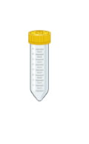
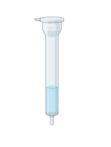
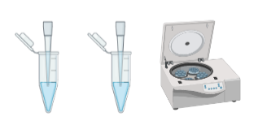
Lyse & watch Tyler assemble column
Split lysate evenly & spin 30 minutes
Assemble Column
Save 30 ul of lysate
Incubate lysate in resin for 2 hours nutating @ 4C
Prelab II, Lecture, BREAK

Slide 4
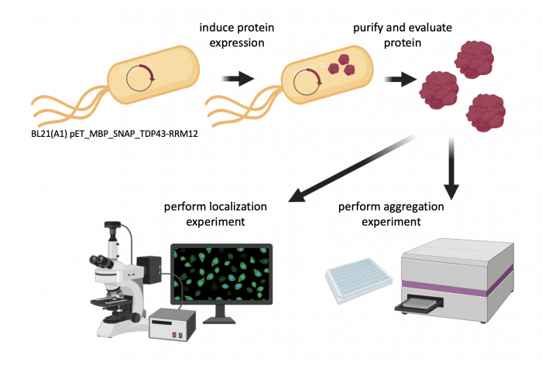
Overview of Mod1 experiments
Research goal: Use functional assays to characterize ligands identified as binders to TDP43 from SMM technology

Slide 5
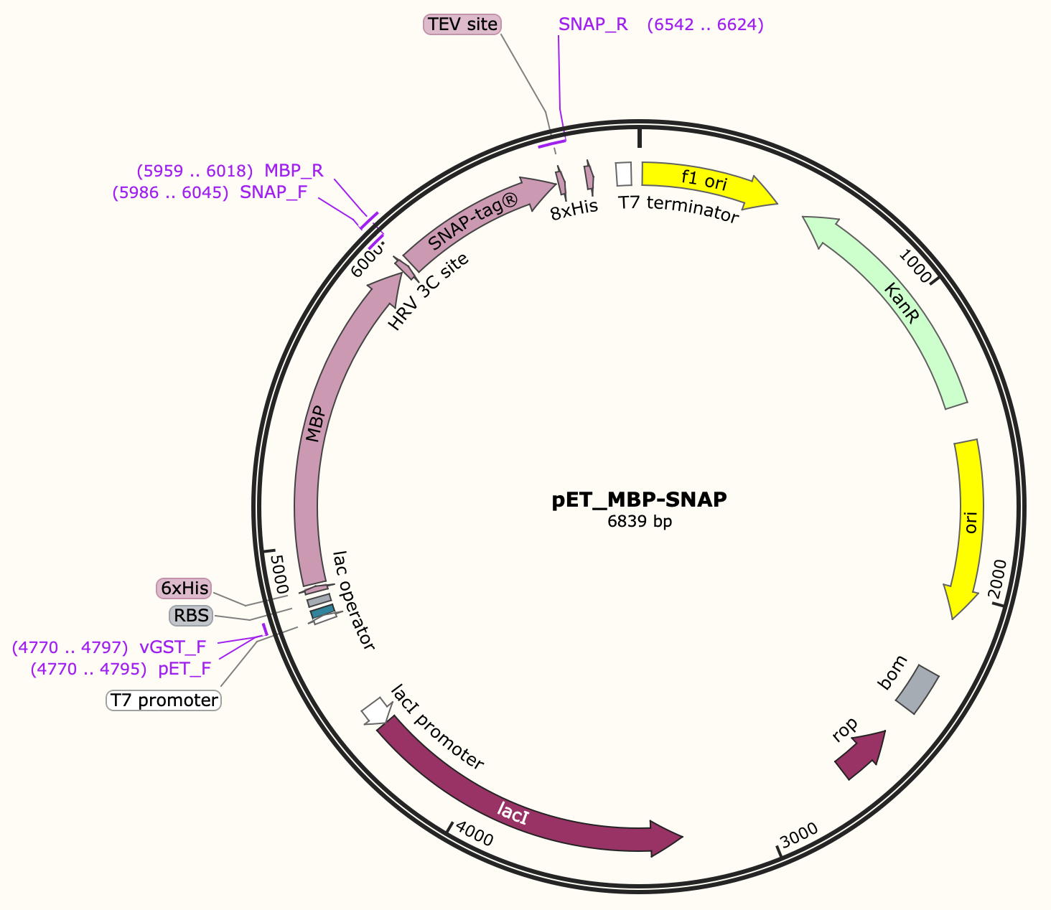
Use genetic features of the plasmid to control protein expression and purification
Induction
T7 promoter
Lac operator
Kanamycin
Purification
His-tag

Slide 6
Bacterial induction: How it begins…
Arabinose
AraC dimers
I₁
I₂
P_{BAD}
(Promoter
controlling T7 gene)
T7 gene
lacI
T7 promoter
lac operator
TDP43-RRM12
pET_MBP_SNAP_TDP43-RRM12

Slide 7
Bacterial induction: Arabinose controls T7 expression
T7 Pol
AraC dimers
Arabinose
RNA
Pol
I₁
I₂
P_{BAD}
(Promoter
controlling T7 gene)
T7 gene
lacI
T7 promoter
lac operator
TDP43-RRM12
pET_MBP_SNAP_TDP43-RRM12

Slide 8
Bacterial induction: Lac repressor
lac repressor
Arabinose
T7 Pol
I₁
I₂
T7 gene
lacI
T7 promoter
lac operator
TDP43-RRM12
pET_MBP_SNAP_TDP43-RRM12

Slide 9
Bacterial induction: IPTG removes lac repression
+ IPTG
lac repressor
Arabinose
T7 Pol
I₁
I₂
T7 gene
lacI
T7 promoter
lac operator
TDP43-RRM12
TDP43
protein
pET_MBP_SNAP_TDP43-RRM12

Slide 10
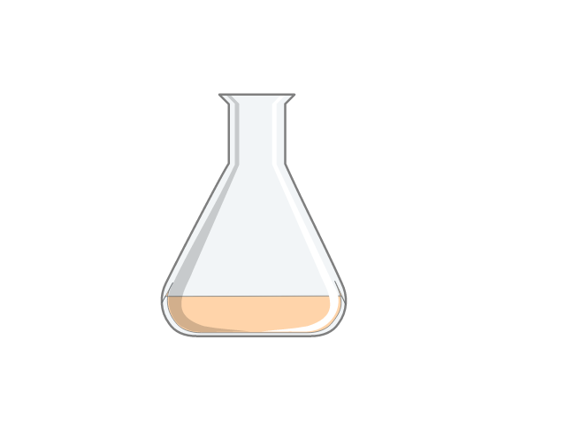
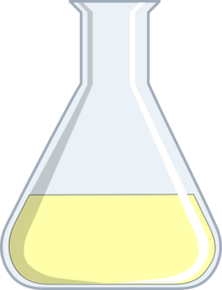
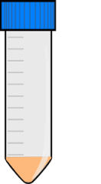
How do we induce protein expression?
add
1 mM IPTG
Arabinose
when
OD₆₀₀ = 0.6
subculture
in
TB + kan
pellet
after
~2.5 h
overnight
culture
stored at
- 80 °C
Why do we induce protein expression at OD₆₀₀ = 0.6?

Slide 11
2) Exponential
3) Stationary
# of bacteria
4) Death
OD 0.6
1) Lag Phase
Time

Slide 12
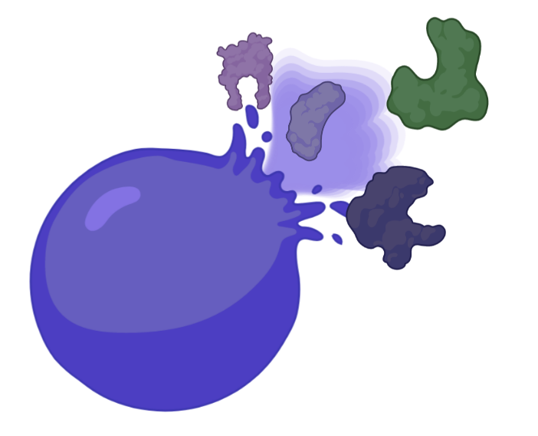
How will you purify TDP43_RRM12?
First, need to lyse cells to release proteins:
B-PER bacterial extraction reagent
Detergents, Buffers
Lysonase & Benzonase
Cell wall & DNAse/RNAse
Protease Inhibitor Cocktail Prevents degradation
6XHis
0.8kDa
Maltose binding protein
40.3kDa
3C site
0.9kDa
Snap-tag®
19.3kDa
TDP43 domains RRM1 and 2
19.2kDa
Affinity tag MBP solubliziaiton tag Cleavage Alexafluor 647 Protein Of Interest
Notes:
Detergent in sodium phosphate buffer; no enzyme components
Lysozyme is a naturally occurring enzyme found in bodily secretions such as tears, saliva, and milk. It functions as an antimicrobial agent by cleaving the peptidoglycan component of bacterial cell walls, which leads to cell death.

Slide 13
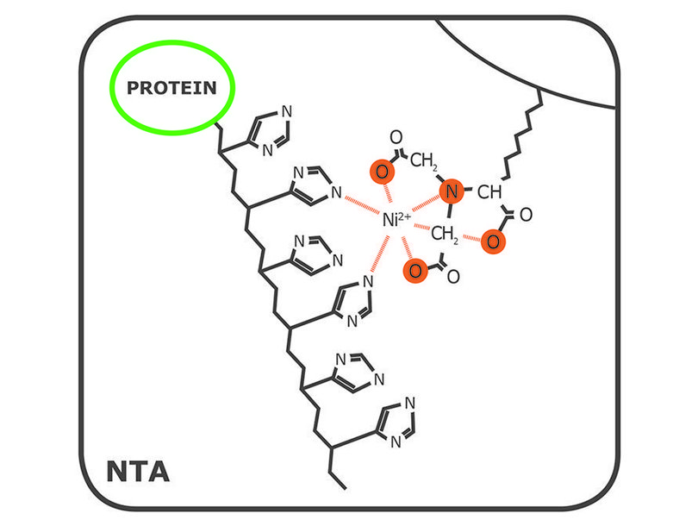
6xHis tag binds to Ni²⁺ resin / column to allow purification of protein of interest
equilibrate Ni²⁺
beads with buffer
add protein
mixture
Ni²⁺ chelated onto agarose resin via nitrilotriacetic acid (NTA) ligand
His tag chelates to Ni²⁺ causing protein to ‘stick’ to resin / column
Notes:
carboxymethyl group present in NTA makes it a stronger
his His-tag binds tightly to the immobilized metal ions because the side chain of Histidine, imidazole, has a specific binding affinity to metal ions (in this case, nickel II)

Slide 14
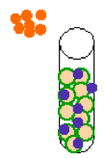
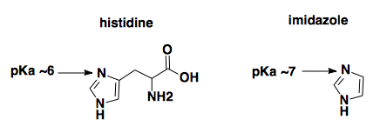
Non-specific binders washed from Ni²⁺ resin / column using a low concentration of imidazole
Low concentration of imidazole included in wash buffer
Imidazole competes for binding to Ni²⁺ resin
Low affinity binders / non-specific binders are outcompeted and released from the resin
wash away
non-His proteins
POIs remain after imidazole wash
Notes:
The more positive the value of pK_{a}, the smaller the extent of dissociation at any given pH

Slide 15
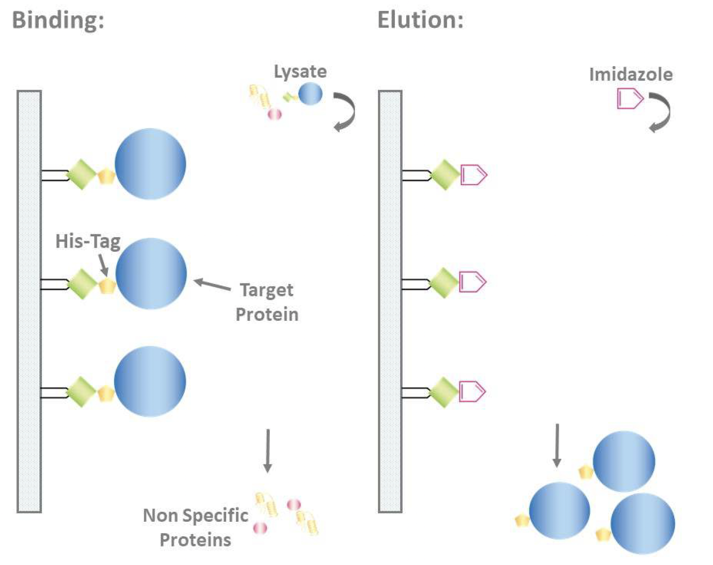
High concentration of imidazole is used to elute the protein from the Ni²⁺ resin / column
Similar concept to wash
Wash uses 10mM imidazole
Elution used 250mM imidazole
Instead of competing away non-specific binding, we can now out-compete the His Tag
GoldBio

Slide 16
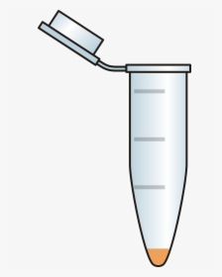
Purification process (and where you will save samples)
Pellet
Lysate
Flowthrough
Wash
Elution
Slurry
bacterial lysate

Slide 17
For today…
Discuss Background and Motivation with Noreen
Complete protein purification
Deliver all purification samples and final elution to instructors by end of lab!
For M1D4…
Work with your lab partner to write a methods section for the protein purification protocol
Checklist on the wiki provides useful guidance
Visit Comm lab before M1D5

Slide 18
Pro tips for writing a methods section
Include enough information to replicate the experiment
List manufacturer’s name (Company)
Be concise and clear in your description
Use subsections with descriptive titles
Put in logical order, rather than chronological order
Begin with topic sentence to introduce purpose / goal of each experimental procedure
Use clear and concise full sentences
NO tables or lists, all information should be provided in full sentences and paragraphs
Write in passive voice and use past tense
Use the most flexible units
Write concentrations (when known) rather than volumes
Eliminate 20.109 specific details
Example “labeled Row A, Row B…”
Do not include details about tubes and water!
Assume reader has some biology experience
Include parts of the protocol that the teaching faculty completed, but do not say “completed by teaching faculty.”

Slide 19
How can you improve this example?
“Cells were grown in 12 mL of RMPI supplemented with FBS. We spun
down the cells and counted them with a hemocytometer. Flasks
were incubated in 37 C incubator.”

