Slide 1
20.109 Foci Analysis using Deep Convolutional Neural Networks
Dushan N. Wadduwage, 20190926

Slide 2
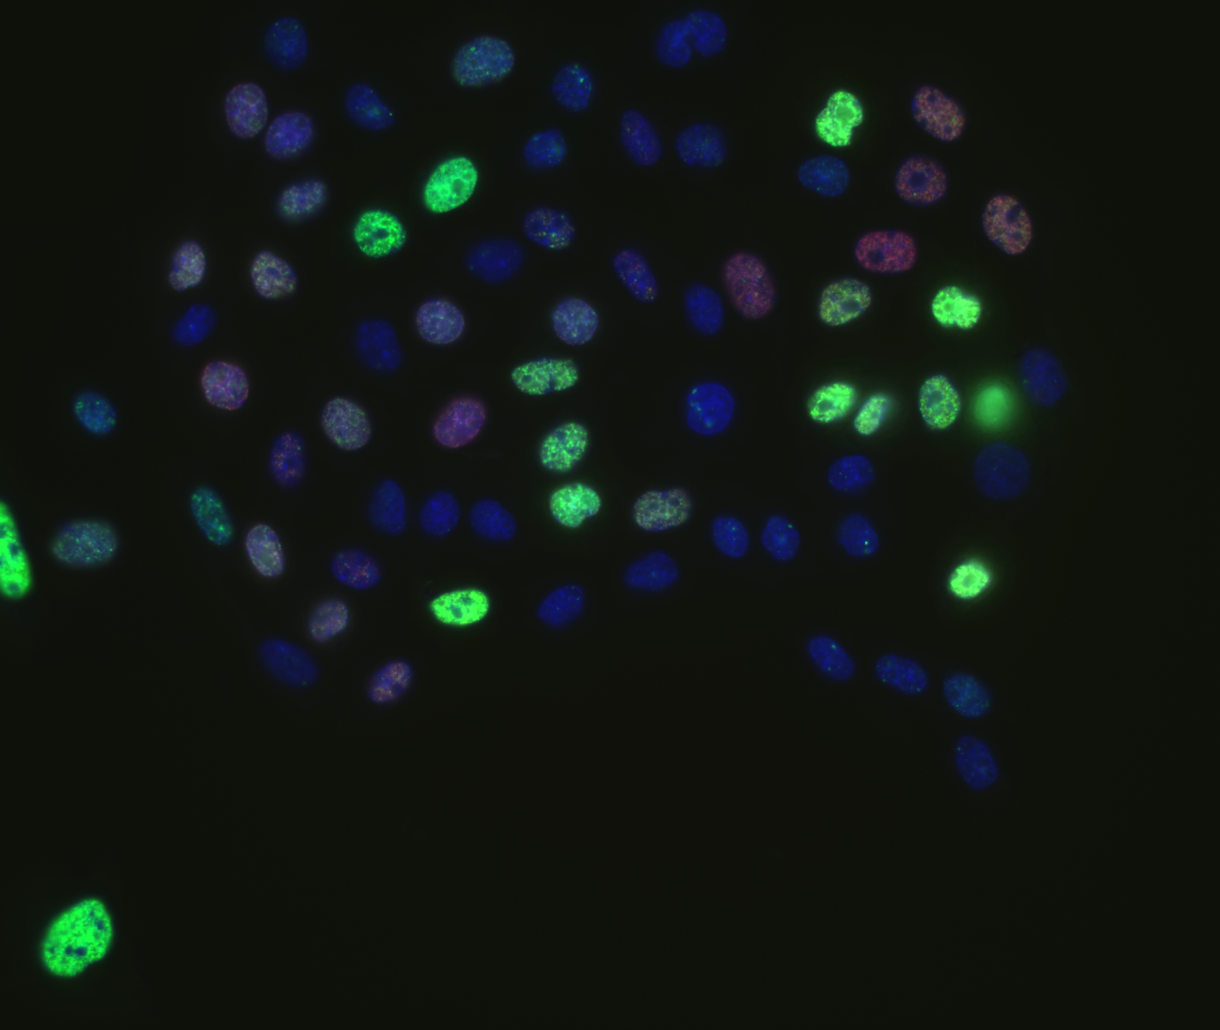
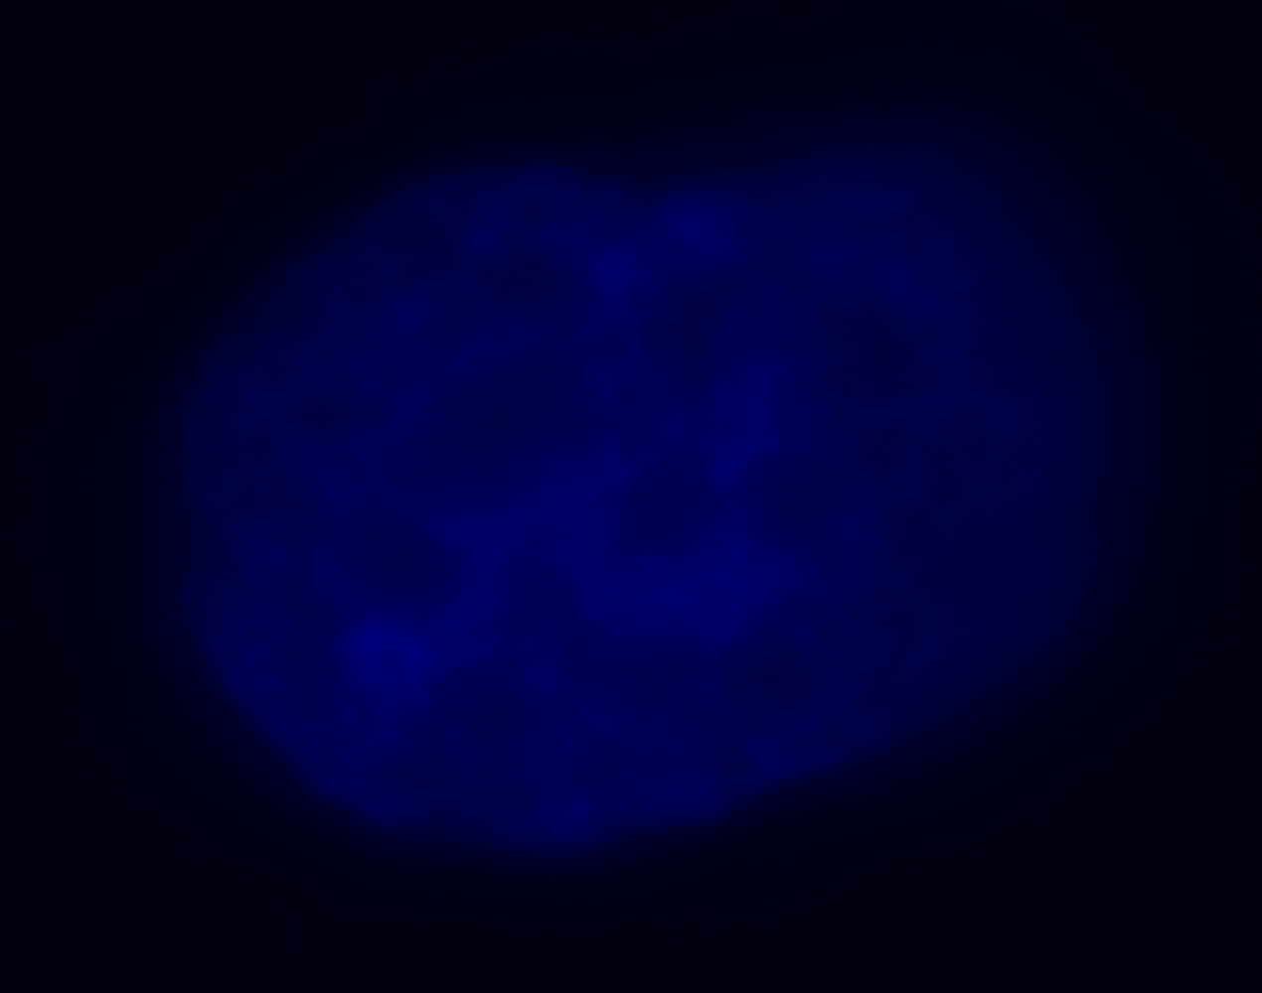
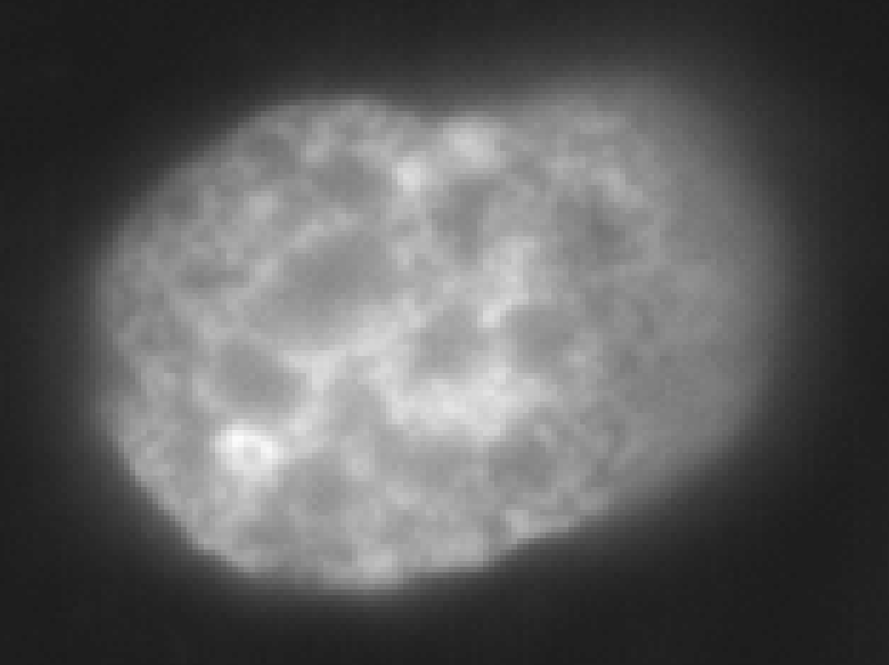
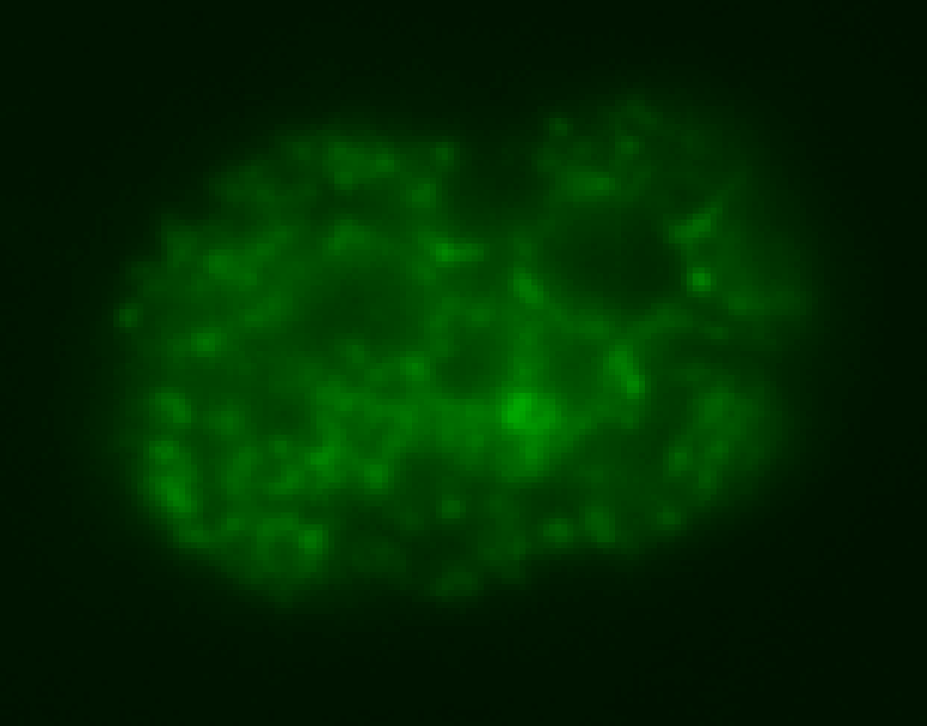
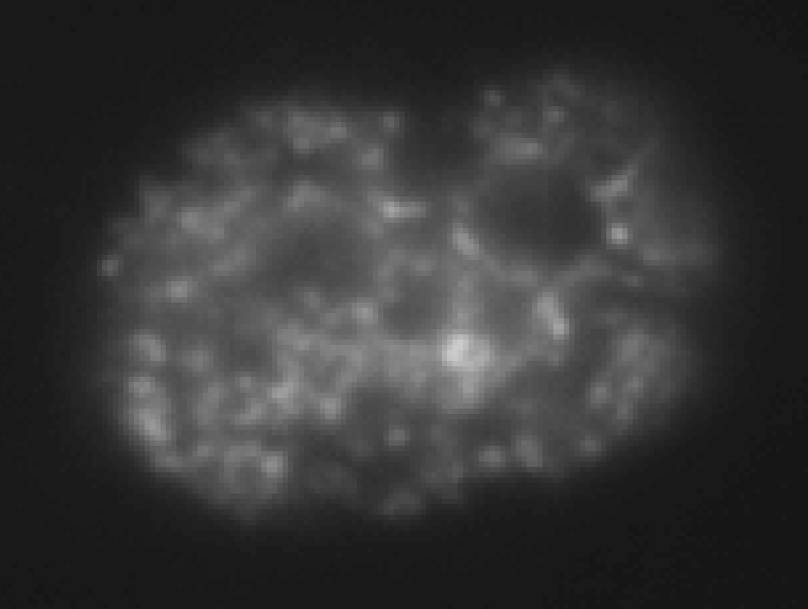
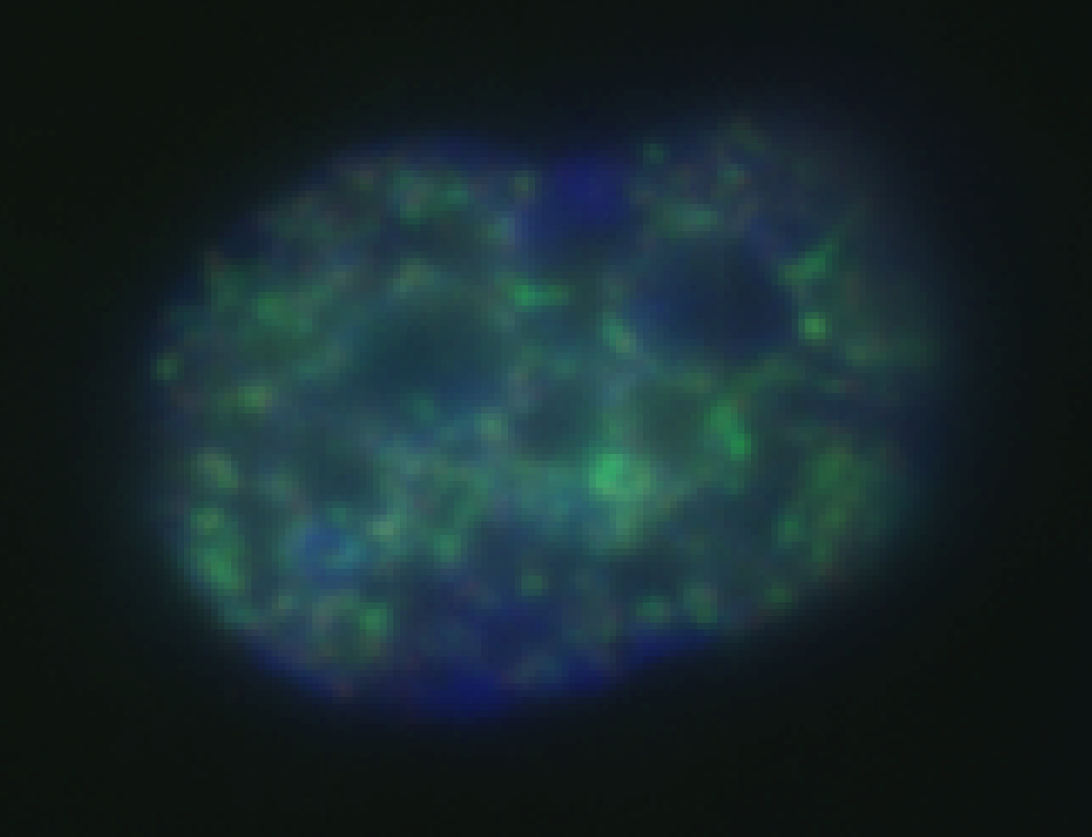
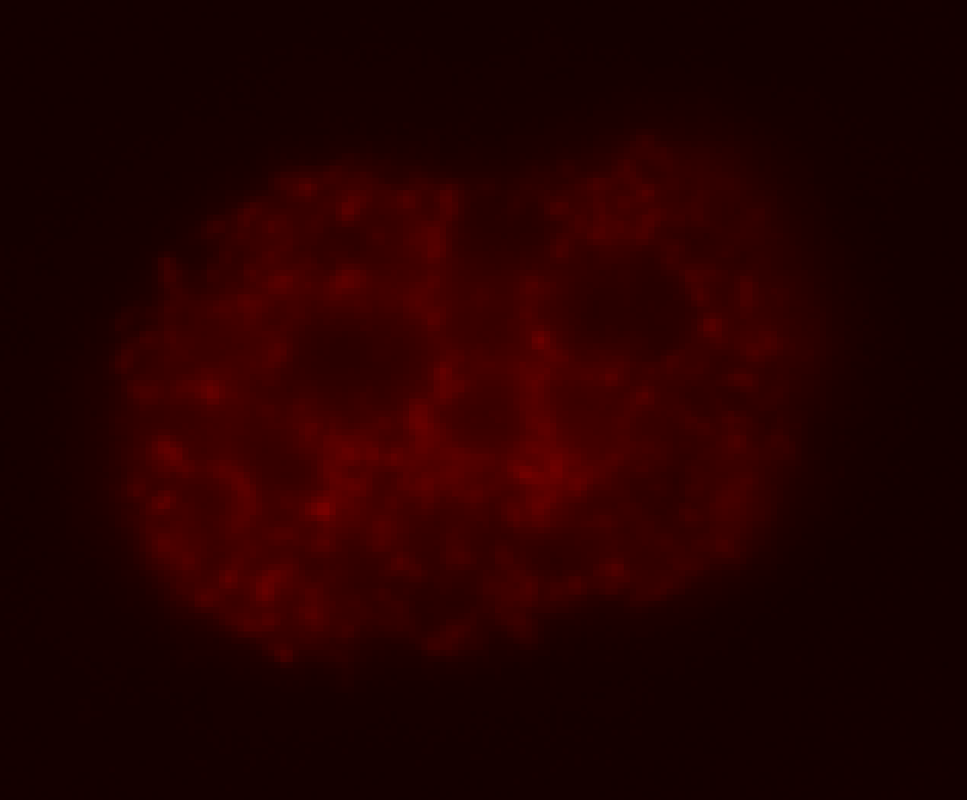
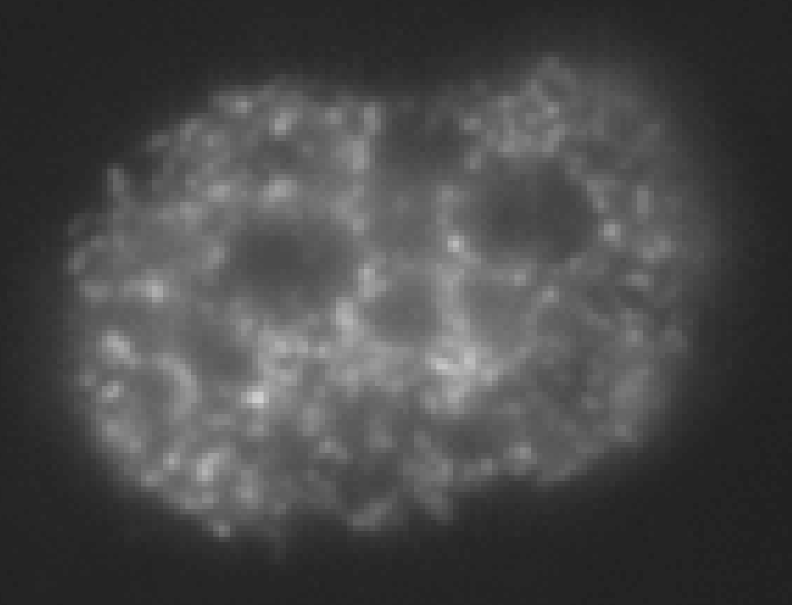
Data
DAPI
H2AX
EdU
DAPI
H2AX
EdU

Slide 3
Analysis Pipeline
DCNN₁
DAPI
H2AX
EdU
DCNN₂
Number of H2AX foci
for each Nucleus
Average intensity
for each Nucleus

Slide 4
Deep Convolutional Neural Networks

Slide 5
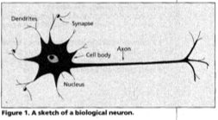
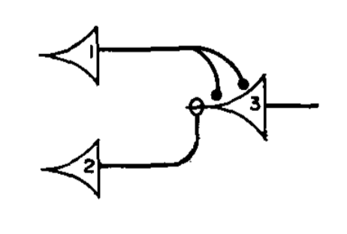
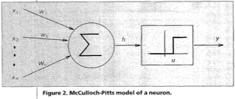
Perceptron
Jain et. al. 1996
$$y=\left\{\begin{aligned}0, if \sum{w_{i}x_{i}≤u} \\ &1, if\sum{w_{i}x_{i}>u}\end{aligned}\right.$$
McCulloch & Pitts 1943
Rosenblatt 1958

Slide 6
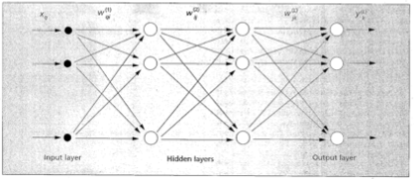
Artificial Neural Networks (ANNs)
$$y=\left\{\begin{aligned}0, if \sum{w_{i}x_{i}≤u} \\ &1, if\sum{w_{i}x_{i}>u}\end{aligned}\right.$$
$$y=\left\{\begin{aligned}0, if \sum{w_{i}x_{i}−u≤0} \\ &1, if\sum{w_{i}x_{i}−u>0}\end{aligned}\right.$$
$y=θ$($w_{i}x_{i}−w_{0}$)
$y=θ$($w_{i}x_{i}−u$)
$y_{1}=F_{1}$(${\{w}_{ij}\},\{x_{i}\}$)
$y_{2}=F_{2}$(${\{w}_{ij}\},\{x_{i}\}$)
${(y}_{1},y_{2}…{,y}_{N})=F$(${\{w}_{ij}\},(x_{1},x_{2},…)$)
$y=F$($w,x$)
$y_{N}=F_{N}$(${\{w}_{ij}\},\{x_{i}\}$)
Minsky and Papert 1969

Slide 7
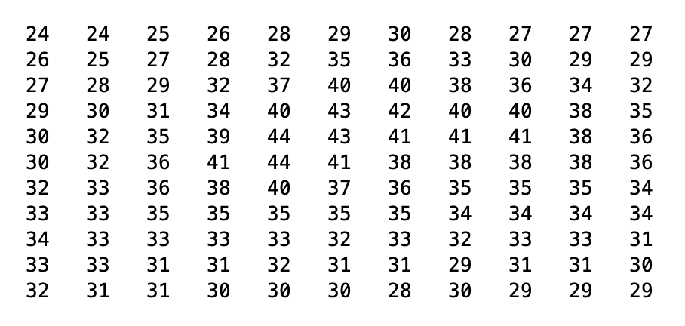
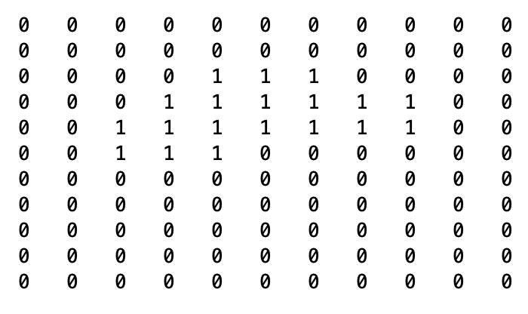
Image processing with ANNs
$$x$$
$$y_{1}$$
$$y$$
$$x_{1}$$
$$x_{2}$$
$$y_{2}$$
$y=F$($w,x$)
$$x_{N}$$
$$y_{N}$$
$y=F$($w,x$)
What about $w$ ?
$w$ is found by ”training” through backpropagation

Slide 8
Architecture of the network
Fully connected neural network
Megapixel image = ${10}^{6}$ pixels
Say 5 layers
Number of connections = ${5×10}^{12}$
Hubel and Wiesel, 1959

Slide 9
Convolutional Neural Networks
Neuron 1
Weights $=\{w_{0},w_{1},w_{2},…,w_{9}\}$
$$y=\sum{w_{i}x_{i} }$$

Slide 10
Convolutional Neural Networks
Neuron 1
Neuron 64
Input image
Convolutional Layer
Outputs of the convolution layer
Number of weights = 640

Slide 11
Convolutional Neural Networks
Input image
Outputs of the convolution layer

Slide 12
Convolutional Neural Networks
Activation function
Image input
Convolution layer
$$y=\sum{w_{i}x_{i} }$$

Slide 13
Convolutional Neural Networks
Image input
Output

Slide 14
Convolutional Neural Networks
$$CNN$$
Number of convolutional layers = 20
Maximum number of weights in layer = 36928
Number of weights ~ 750,000

Slide 15
Summary
Perceptron
Artificial Neural Networks, ANNs (multi layer Perceptrons)
Image processing with ANNs
Convolutional Neural Networks
http://introtodeeplearning.com

Slide 16
Analysis Pipeline
nuc_net
DAPI
H2AX
EdU
foci_net
Number of H2AX foci
for each Nucleus
Average intensity
for each Nucleus

Slide 17
Demo

