Slide 1
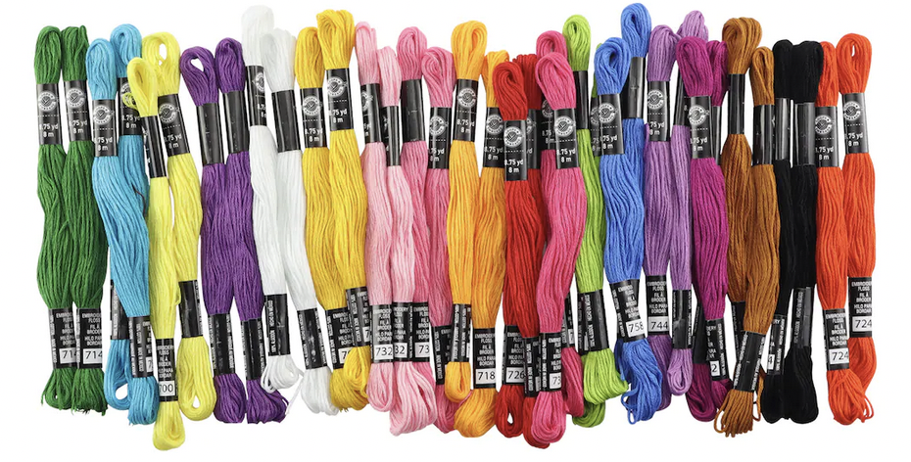
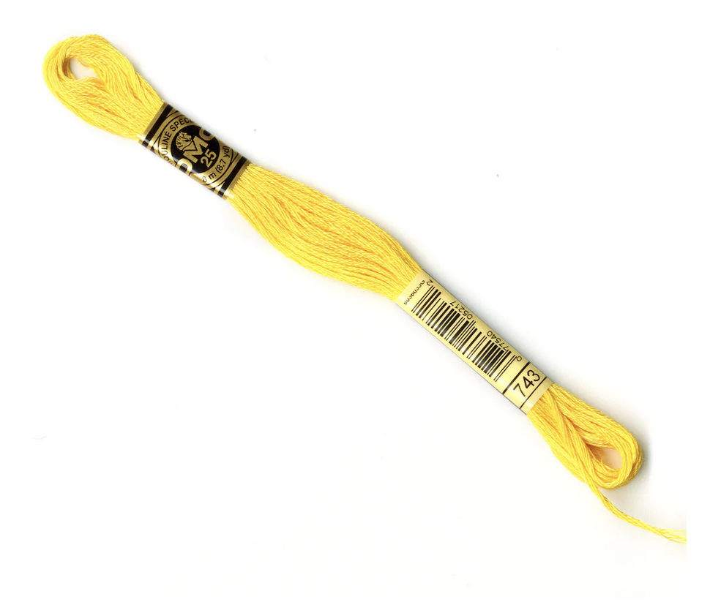
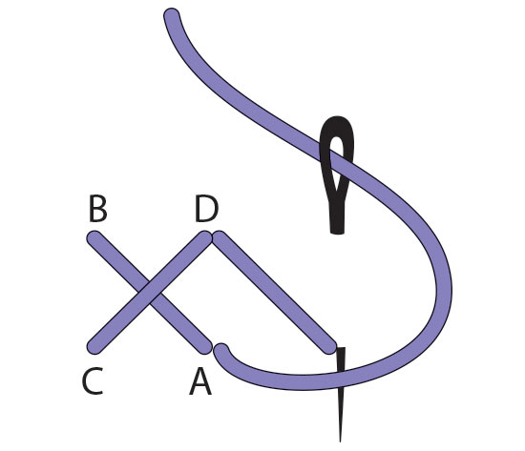
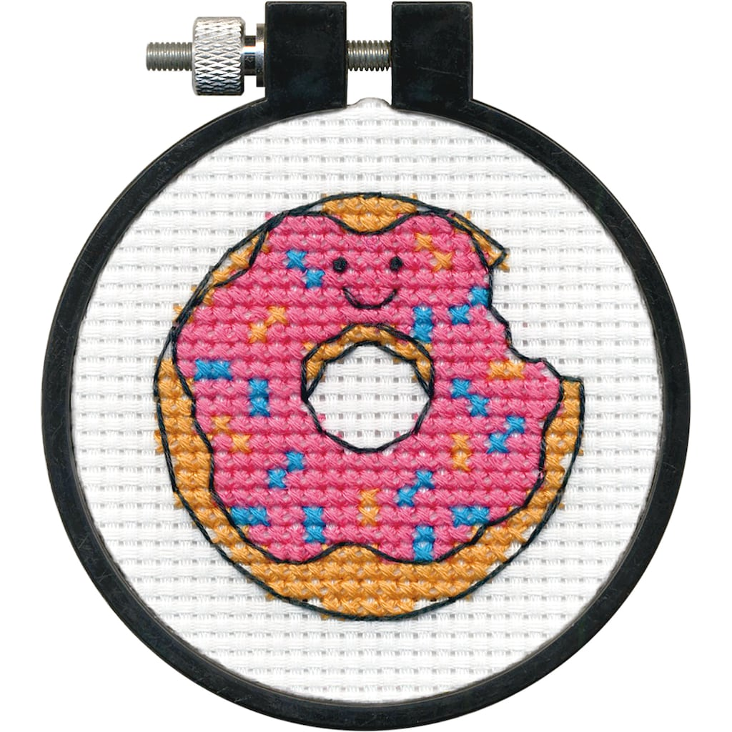
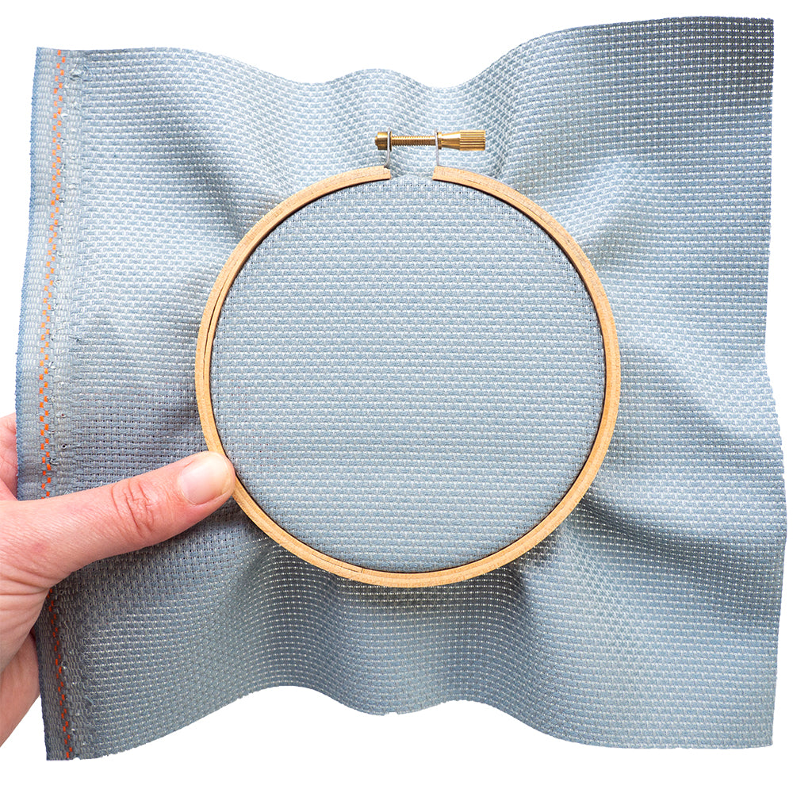
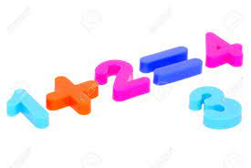
Notes on experimental schematics…
How to cross-stitch.
gather thread colors from my collection
buy needed thread colors from Michael’s
search Etsy for pattern
prepare aida fabric by finding the center
complete pattern and frame finished picture!
miscount, remove, and correct stitches
follow the pattern to create a picture using x-stitches
secure fabric in embroidery hoop
Notes:
An experimental schematic provides key steps used in a particular method / technique / procedure. The goal is to highlight the key steps at a high level. In this, the minor technical and methods details are eliminated…remember that this schematic is not meant to be used to replicate the method / technique / procedure as that is the purpose of the methods section.
With this, what steps / details can be eliminated from the example here?

Slide 2
Notes on experimental schematics…
How to cross-stitch.
3
2
gather thread colors from my collection
buy needed thread colors from Michael’s
search Etsy for pattern
prepare aida fabric by finding the center
1
1
5
4
complete pattern and frame finished picture!
miscount, remove, and correct stitches
follow the pattern to create a picture using x-stitches
secure fabric in embroidery hoop
Notes:
Things that can be omitted from this example:
That the pattern is found on Etsy or that the thread is purchased from Michaels’s is not important…including manufacturer / supplier details should not be included.
How certain supplies were acquired is not needed.
Steps used to prepare the materials needed for the method / technique / procedure are not needed. Instead focus on the steps that directly lead to the final product.
Technical details regarding how certain equipment was used / prepared is not needed.
Mistakes that were made / corrected do not need to be included.

Slide 3
What should be in the Title and Caption?
Title: State was is shown / represented in the schematic
Caption:
Explain the flow of information using concise / clear language
Expand on text shown in figure labels to eliminate excess wordiness / clutter from the figure
Define all abbreviations / jargon / labels / symbols

Slide 4
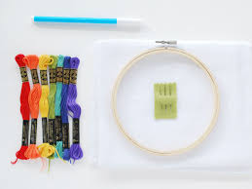
Notes on experimental schematics…
A
B
C
1
2
3
1
3
4
2
choose pattern and gather embroidery thread
follow the pattern to create a picture using x-stitches
complete pattern and frame finished picture
Figure 1: Noreen uses cross-stitching to embroider pictures. Cross-stitching is a method of embroidery that is used to create pictures from x-shaped stitches. (A) The supplies for cross-stitching include: 1. embroidery thread, 2. aida fabric, and 3. a hoop. (B) The x-shaped stitches are completed by using the strokes in the order indicated by the numbers. (C) …
Notes:
Be sure to define all labels included on the figure in the caption!

