Slide 1
1
Module 3 overview
lecture lab
1. Introduction to the module 1. Examine protein structure
2. Rational protein design 2. Identify mutants
3. Binding behavior 3. Analyze protein data
4. Fluorescence and sensors 4. Design new mutants
5. High throughput screening 5. Write mini-report

Slide 2
2
Lecture 3: Binding behavior
I. Bimolecular binding
A. First-order binding
B. Ligand-depleting model
II. Cooperative binding
A. Cooperativity and Hill coefficients
B. Cooperative vs. noncooperative binding

Slide 3
3
+
P
L
C
[P]₀ = [P] + [C]
[L]₀ = [L] + [C]
What do these equations mean about the amount of C present under a given set of conditions?

Slide 4
4
+
[P]₀ = [P] + [C]
[L]₀ = [L] + [C]
P
L
C
Common to describe binding as fractional saturation:
0 ≤ Y ≤ 1
Y = 0 at low [L]
Why is Y a relevant quantity in vitro and in vivo?
algebraic simplification of Y:
Y as a function of [L] describes a titration curve

Slide 5
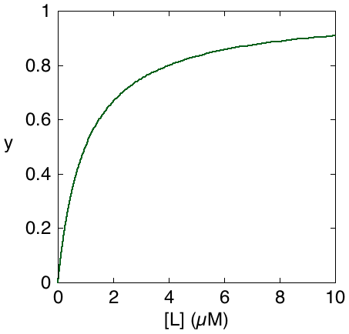
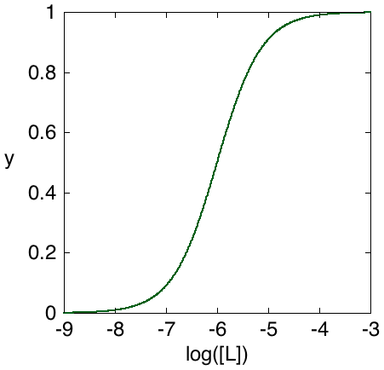
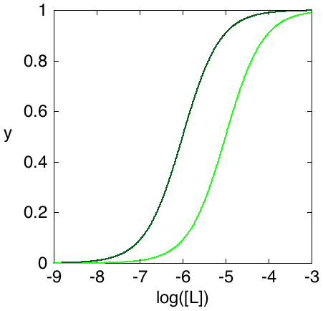
5
Y
Y = 0.5
when [L] = K_{d}
convenience of dissociation
vs. association constant
real binding isotherms
Shapiro, Westmeyer (2010) Nat. Biotechnol.

Slide 6
6
Y
Q: Why doesn’t this curve appear to depend on the amount of protein present?
A: Amount of protein affects depletion of ligand into [C].
So far, we have assumed that we can keep track of [L] (free ligand concentration), but this is usually only true when ligand is not depleted: [L] ~ [L]₀ >> [C]

Slide 7
7
What if [L]₀ is not >> [P]₀?
useful to express Y in terms of [P]₀ & [L]₀, where [L]₀ = [L] + [C]
Y = [C]/[P]₀
“depleting model”
harder to fit to actual data ...
depends on more variables ...
... but describes behavior of systems over a wide range of ligand concentrations

Slide 8
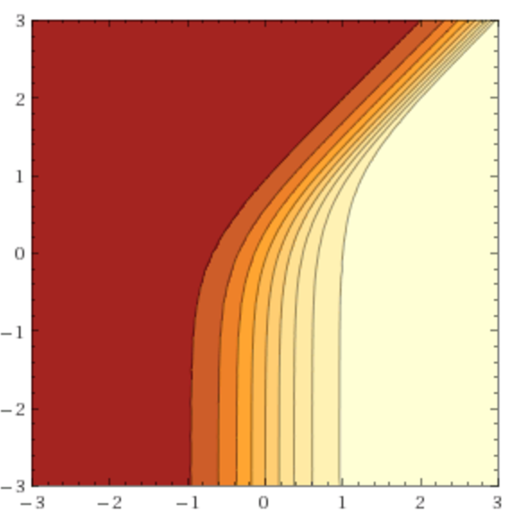
fractional saturation of P assuming K_{d} = 1
8
binding isotherm
depends on [P]₀
Log₁₀ [P]₀
}
about an order
of magnitude
pseudo-first order
region: binding
independent of [P]₀
Log₁₀ [L]₀
transition usually takes two orders of magnitude

Slide 9
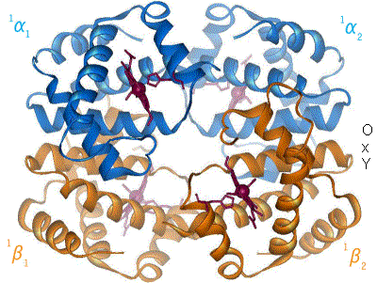
9
But our protein binds four ligands (Ca²⁺ ions), not one…
assuming that the four ions are bound approximately simultaneously:
Coupling between distinct binding sites is often achieved through allosteric interactions (“allo” = other).
This is an example of the phenomenon of cooperative binding:
• positive cooperativity means that binding to one site promotes binding to subsequent sites
• negative cooperativity means that binding to one site depresses binding to subsequent sites
classic example: hemoglobin (Hb) transitions between R and T states; binding of O₂ shifts Hb toward the R state, which binds O₂ more avidly.

Slide 10
10
The fractional saturation of pericam calcium binding sites is:
[P]_{tot} = [P_{u}] + [P_{b}]
K_{d} = ([P_{u}][Ca²⁺]⁴)/[P_{b}]
The exponent of 4 on the ligand concentration follows from the simultaneous binding of four calcium ions.
EC₅₀ = (K_{d})^{1/4} is the calcium concentration at which half-maximal binding and fluorescence change occurs.
• always has units of concentration (convenient)
• functions like an “effective K_{d}” for complex binding scenarios

Slide 11
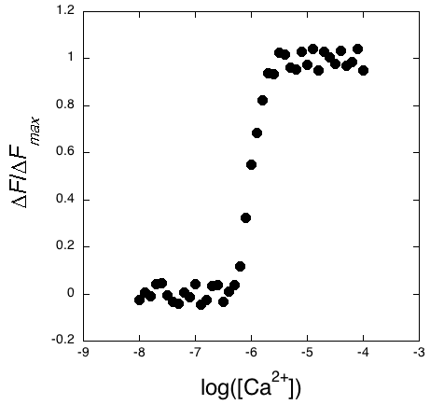
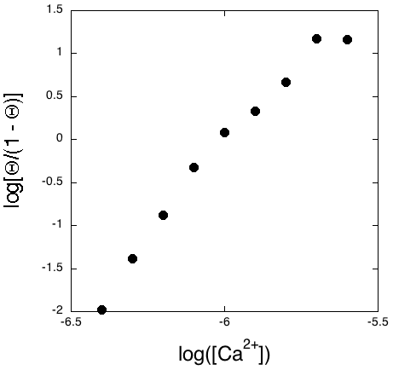
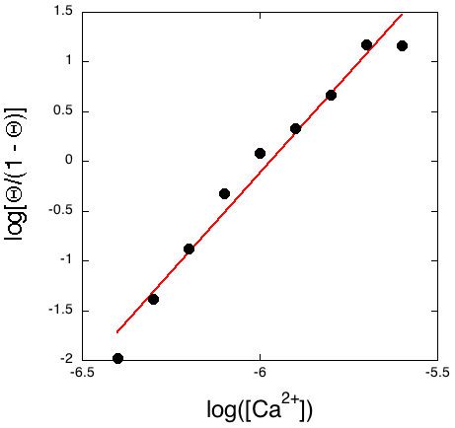
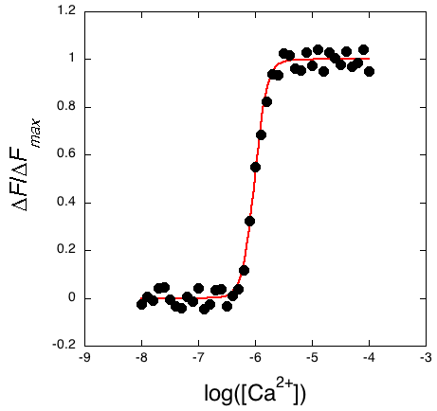
Cooperative behavior is commonly detected in two ways:
11
1. Hill analysis (linearization)
• compute Y values from data
• consider y = log[Y/(1 - Y)]
• plot y vs. x = log([Ca²⁺]) for
transition region
• slope tells number of simultaneous
binding sites, “Hill coefficient”
• x intercept is log(EC₅₀)
= log([Ca²⁺]⁴/K_{d})
log[Y/(1 – Y])
Y
Why not all data?
2. Curve fitting
• fit data to binding equation of the form
• use Matlab or related to determine
values of n and EC₅₀ that best
fit the data
• for GCaMP example, ideal n is 4

Slide 12
12
Hill coefficient n reflects number of sites simultaneously bound,
provides a measure of cooperativity.
n > 1 implies positive cooperativity
n < 1 implies negative cooperativity
For comparison with pericam, consider monovalent calcium binding to BAPTA, a commonly used calcium-specific chelator:
In this case, the equation that describes a titration curve (fraction of bound sites vs. calcium concentration) is:
What is the Hill coefficient here?

Slide 13
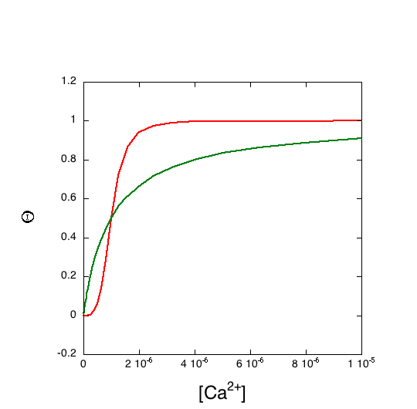
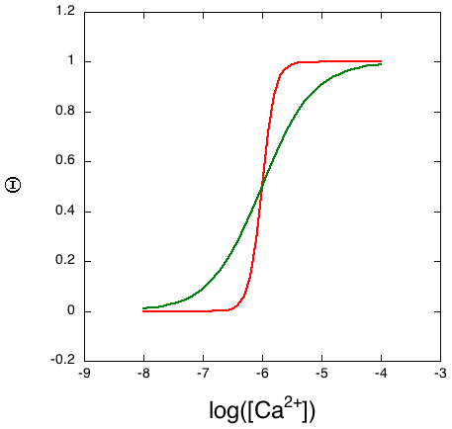
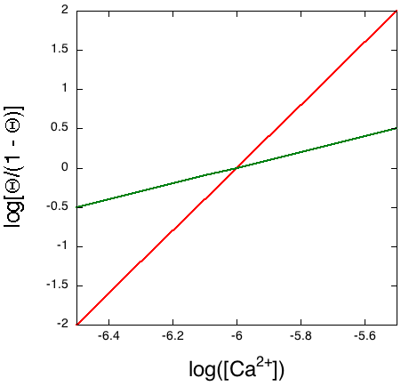
13
Simulated binding curves for BAPTA and pericam compare as follows:
saturation vs. log([Ca²⁺])
saturation vs. [Ca²⁺]
Hill plot
Y
Y
log[Y/(1 – Y])
pericam: sharper transition
BAPTA: broader transition
pericam: sigmoidal transition
BAPTA: smooth transition
pericam: greater slope
BAPTA: lesser slope

Slide 14
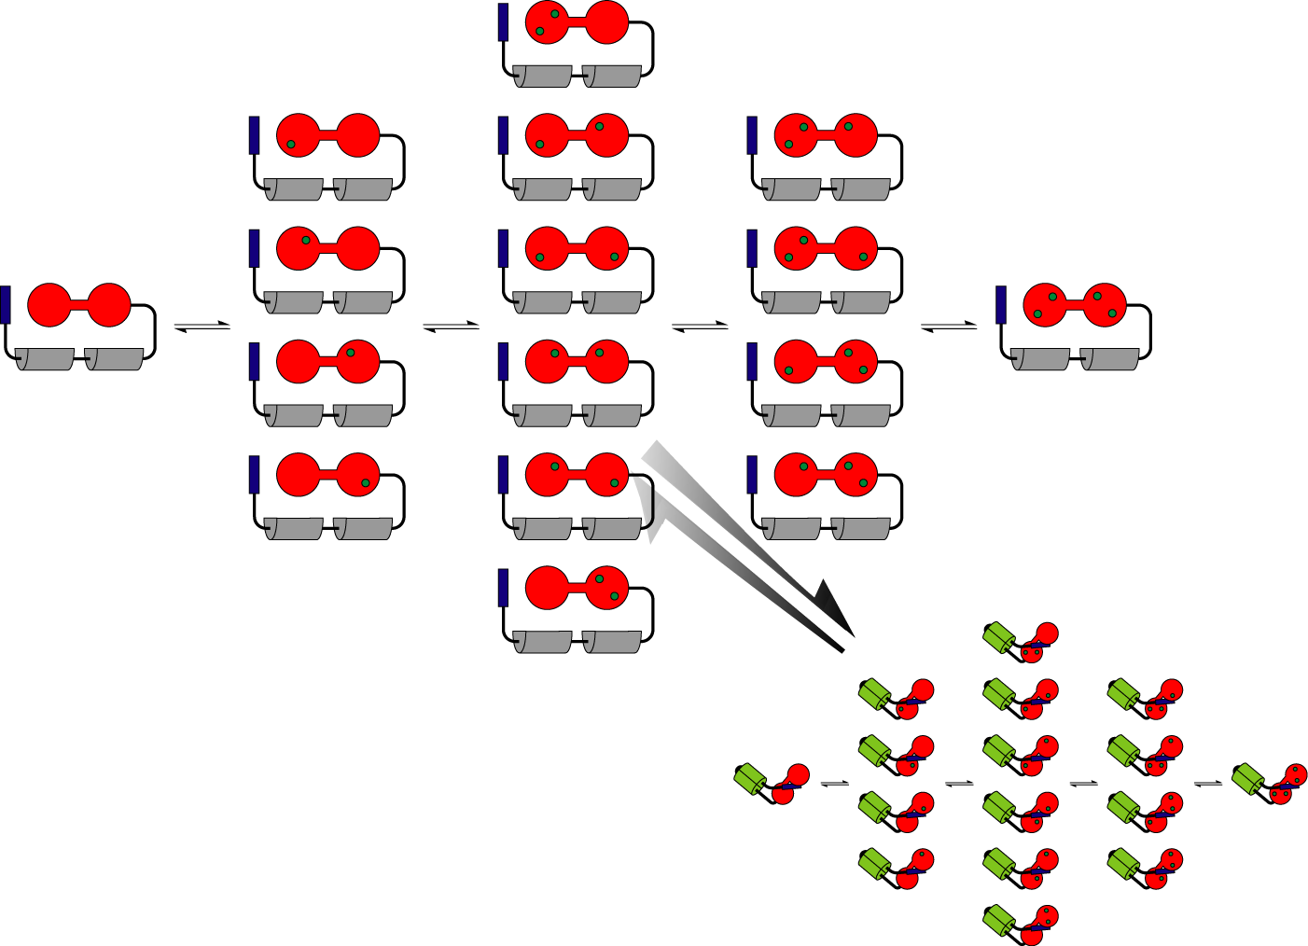
The behavior we’ve been discussing for pericam is idealized, because we have been assuming complete cooperativity among the calcium binding sites (all four Ca²⁺ ions bind at once). In fact, binding to individual sites can occur independently, but each site’s apparent affinity still depends on whether the other sites are occupied.
Here is a scheme that better represents pericam’s multiple binding states:
14
In practice, what n might
we expect for pericam?

