Slide 1
Want more info? Contact:
Shirley Li (shirleyl@mit.edu)
or
Julian Zulueta (jzulueta@mit.edu)
https://app.joinhandshake.com/career_fairs/26965#employers

Slide 2
M1D5: Draft data slide for major assignment
Comm Lab
Work on the draft of your data figure
Format
Refine/edit
Write a Results and Interpretation section in bullet points
Paper discussion with Noreen

Slide 3
Notes for adjusting H2AX images for figures (adapted from Bevin’s email)
Open a H2AX image
Go to FITC channel
On main ImageJ Menu -> Image -> Adjust -> Brightness/Contrast
Brightness all the way to the right
“Apply”
Zoom in on promising nuclei
Adjust brightness and contrast to pull up foci

Slide 4
Notes for adjusting H2AX images for figures continued…
Zoom back out to original (Reset zoom)
Take screenshot of image in screen (will keep all nuclei on the same scale)
Zoom back in to promising nuclei and take screenshot
Move both images into powerpoint
With cutout, crop image to highlight nuclei
Keep the crop the same size across all figures

Slide 5
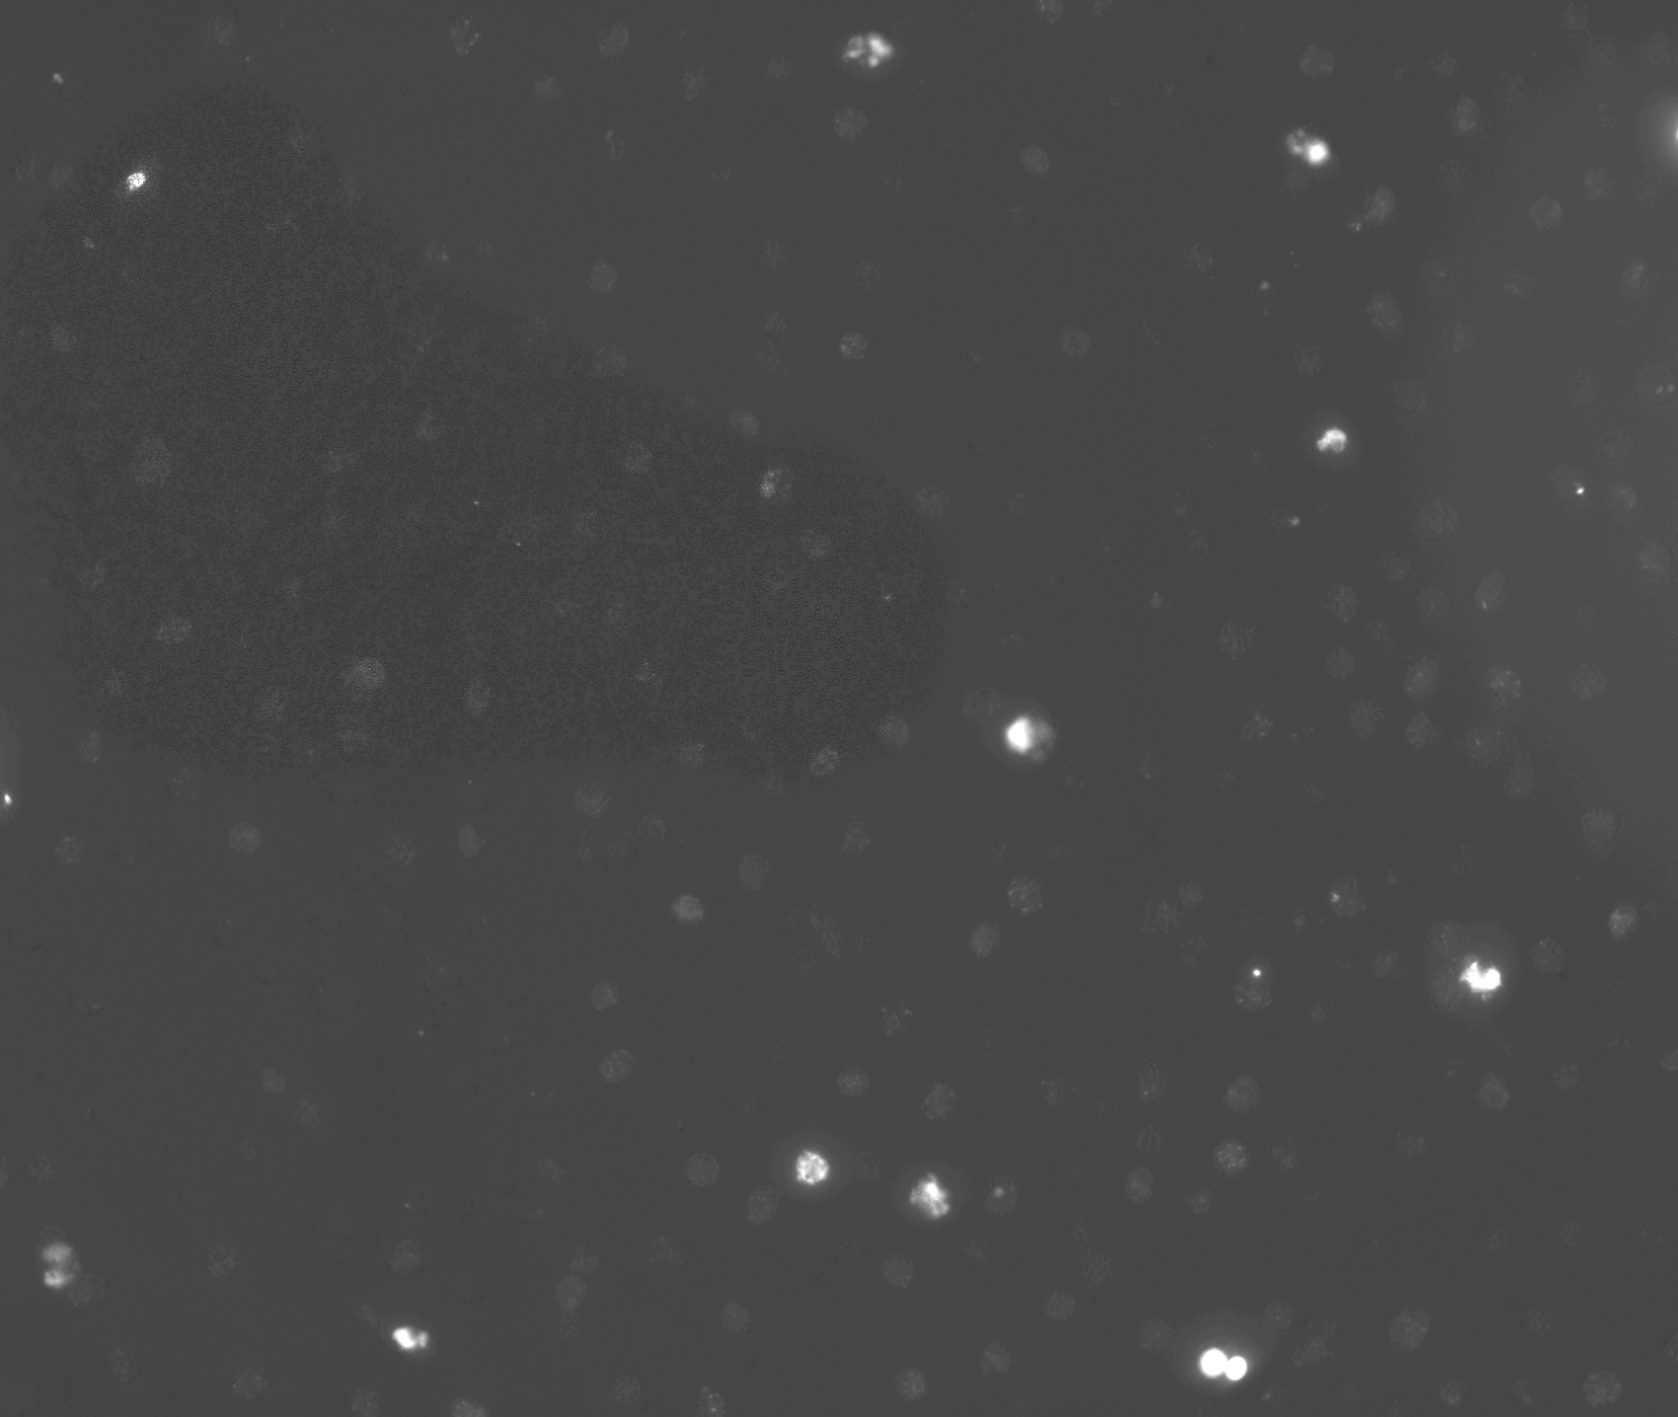
H₂O₂ + As

Slide 6
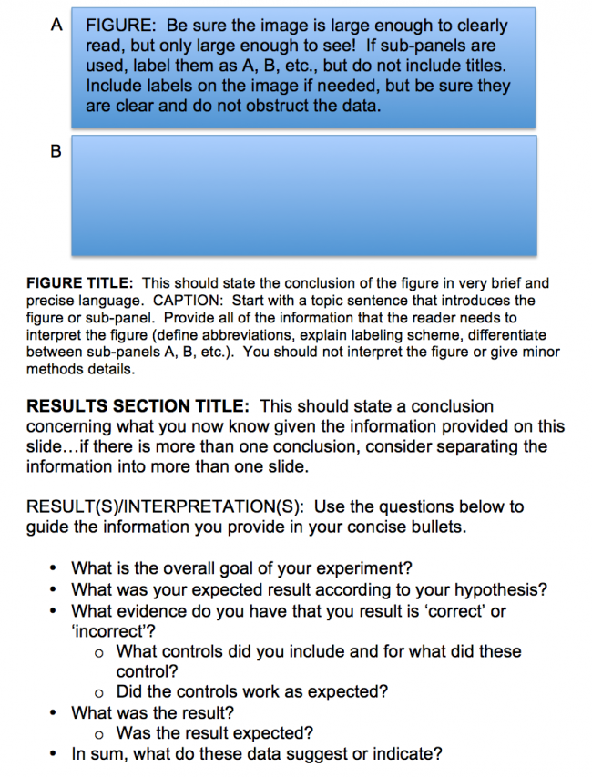
Use wiki guidance!
Format powerpoint slides to 8.5” x 11” in portrait-mode
Work on figure arrangement so that figure and text all fit on same slide

Slide 7
For Today
Gray, Purple, Pink, Blue Teams begin with paper discussion
For M1D6
Turn in Data Summary slide (revised figure and completed bullet points)

